Slide 1
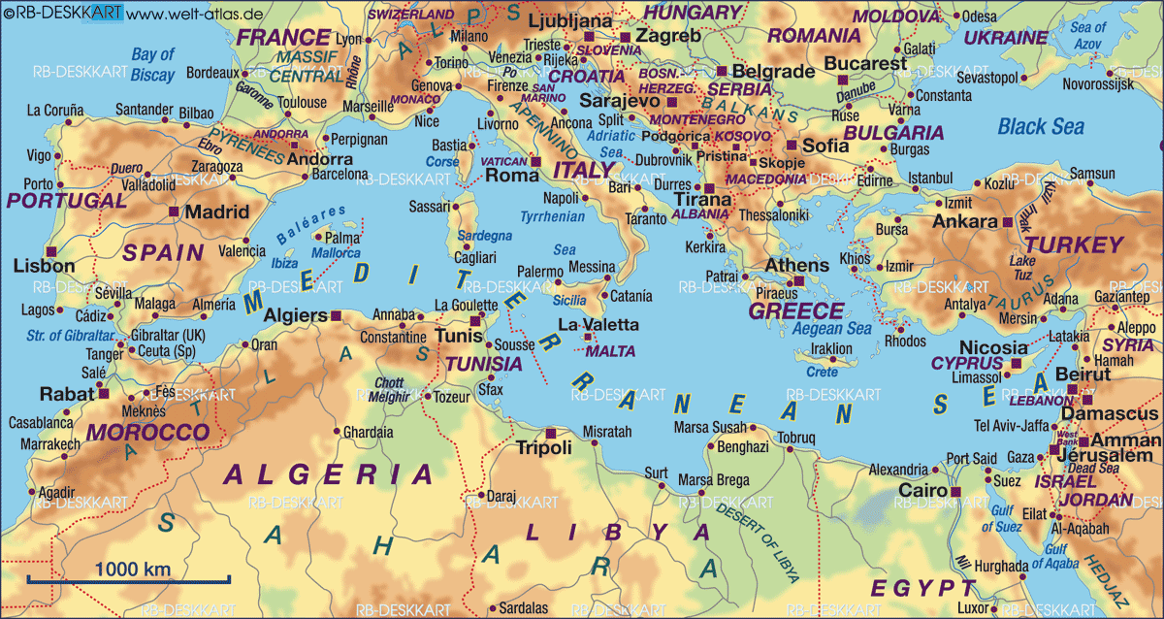
Moron AB 313 Air Expeditionary Wing
Aviano AB 510th/555th Fighter Squadrons
Allied Joint Command Force
Operation Active Endeavor
Sigonella Naval Air Station VP squadron, HC squadron, C-2, C-9, and C-130 Dets
Vicenza 173rd Airborne (-)
USN Base Rota
USMC FAST* Team
Turkish Fast Movers
NO USMC MEU
(Normally There Is)
Israeli Fast Movers
*Fleet Anti-Terrorism Support Team
NO Marine Security Guard Detachments
FLYING TIMES TO BENGHAZI -- FAST MOVERS WOULD REQUIRE AERIAL REFUELING
Sigonella AB: 1 hour; Naples AB 1.5 hours; Aviano AB: 2 hours; Moron AB 2 hours
Refueling Tankers Known to be at Aviano; AC-130 Gunship Locations Being Withheld

