Slide 1
Healing the Americas with an Open Source Agency -- and Integrity Robert David Steele
Dicho Sobre la Curacion de las Américas con una Agencia de Todo Abierto - y la Integridad Roberto David STEELE Vivas
Notes:
1 -- In the next fifteen minutes I am going to outline what I have learned in the past 30 years.
It is with absolute certainty that I present to you the idea of an Open Source Agency as the necessary service we must create and share in order to create a prosperous world at peace with the Americas, and healing the Americas, as our top priorities.

Slide 2
TINY URL
URL corto para esta entrada: http://tinyurl.com/IADB-Abierto
Short URL for this post: http://tinyurl.com/IADB-Open
/IADB-Open or /IADB-Abierto
Notes:
2 --I always provide a memorable Tiny URL. At this location you will find both this briefing with my words in Note format, and also links to my two Spanish language briefings in Chile and in Spain, both much more complex, and a few other useful references. The Chile briefing is available on YouTube in Spanish with embedded slides.

Slide 3
Notes:
3 -- I am sorry to say that most in the North have no idea this book exists, and even if they received it as a gift, they would not read it.
A major part of our mutual problem is the complete lack of public understanding in the USA about what is done in their name and at their expense.

Slide 4
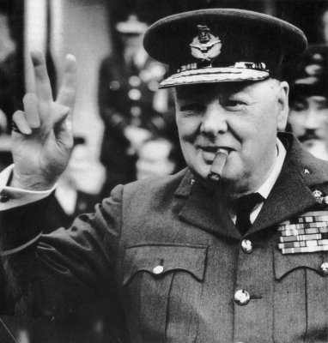
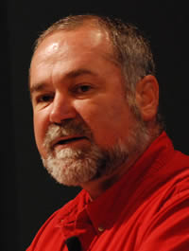
Los estadounidenses siempre hacen lo que deben hacer. Sin embargo, ellos intentan todo lo demás primero.
Lamentablemente, nunca podemos subestimar la habilidad de los estadounidenses de pensar en más cosas malas para probar.
Notes:
4 -- As Winston Churchill has said
“The Americans always do the right thing.
They just try everything else first.”
I have my own codicil to this.
It is not possible to under-estimate the ability of the Americans to think of more wrong things to do before they ever get to doing the right thing.

Slide 5
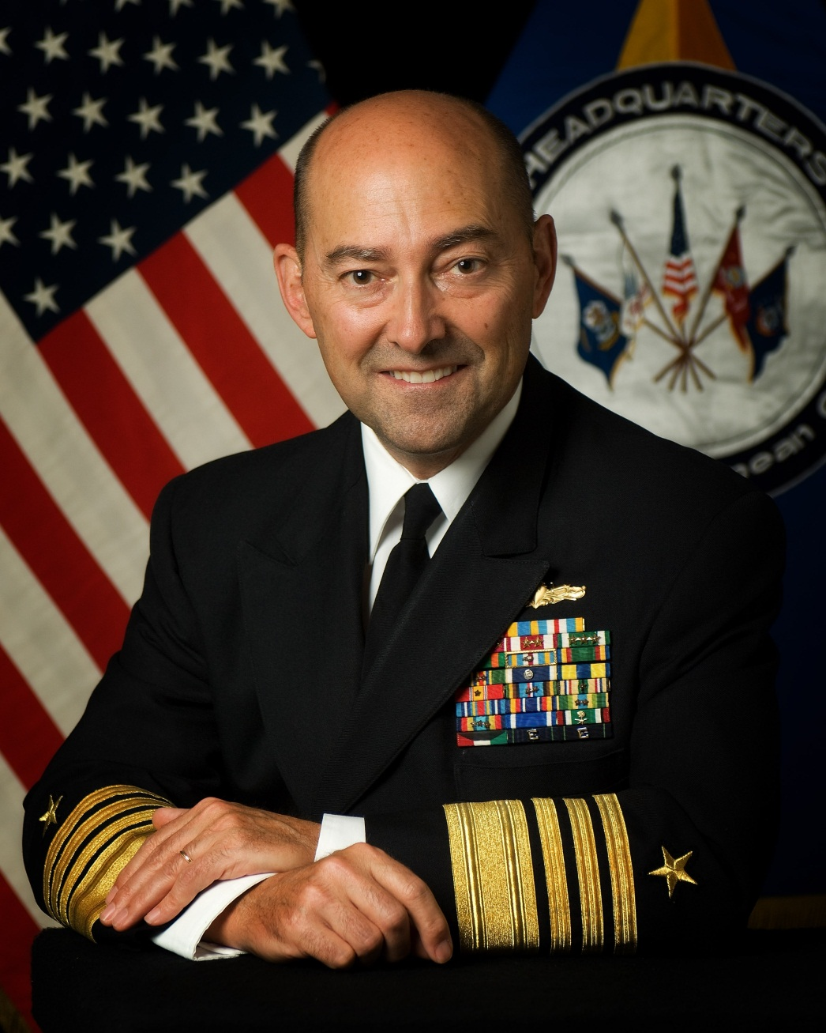
Open Source Security
Imagine global security driven by collaboration -- among agencies, government, the private sector and the public. That's not just the distant hope of open-source fans, it's the vision of James Stavridis, a highly accomplished Navy Admiral. Stavridis shares vivid moments from recent military history to explain why security of the future should be built with bridges rather than walls.
What will 21st-century security look like? Navy Admiral James Stavridis suggests that dialogue and openness will be the game-changers.
We must build bridges. Sharing information is how we connect everything.
Admiral James G. Stavridis, USN
NATO SACEUR
Notes:
5 -- My friend Alvin Toffler built a chapter around me in 1993, “The Future of the Spy” in his book War and Anti-War.
He believes, as Admiral Stavrides and I both believe, that information is a substitute for violence and a means of creating infinite wealth.
War is only profitable for bankers. It is not profitable for nations or peoples.

Slide 6
Open Source Agency (OSA)
An Open Source Agency (OSA) is an intelligence-gathering and decision-support capability, relying exclusively on sources and methods that are open….in all languages (183+).
Main Events:
Create a Smart Nation integrating education, intelligence, & research networks
Provide Open Source Intelligence (OSINT) Decision-Support to ALL
Host a Global Planning and Monitoring Centre (GPMC)
Host a Multinational Decision Support Centre (MDSC)
Open Source Everything (OSE) -- below is a partial listing.
Open Access
Open Architecture
OpenBTS
Open Cloud
Open Cost
Open Courseware
Open Data
Open Design
Open Ecologies
Open Education
Open Geospatial
Open Government
Open Hardware
Open Knowledge
Open Manufacturing
Open Materials
Open Money
Open Science
Open Security
Open Space
Open Society
Open Software
Open Spectrum
Open Standards
Notes:
6 -- Five of us have fought for 20 years to create an Open Source Agency.
The Office of Management and Budget has approved it twice, but each time we were blocked from reaching the Secretary of State or Defense.
This time we have reached both of the designees for State (the parent) and Defense (the funder). You can help – there are still secret forces in opposition.
If the OAS will form an alliance with Saudi Arabia and the JFK Center, I believe we can create this agency.

Slide 7
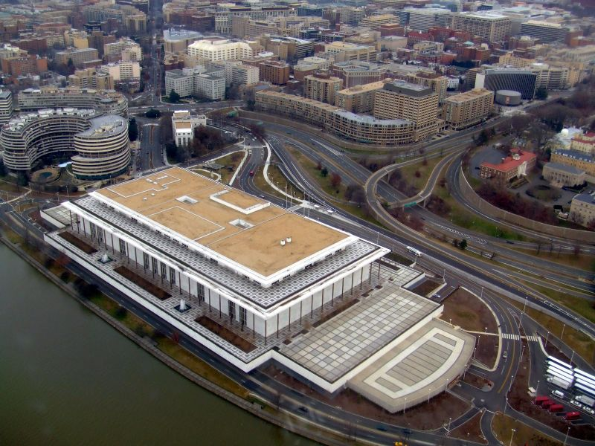
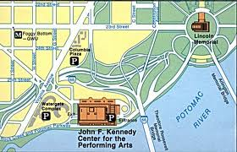
PLAN 2013-2016
SecState & SecDef ask for Open Source Agency on South Central Campus.
Saudis and JFK Center raise funds Potomac Plaza ($600M estimate)
OSA as hub for first ever multinational open source intelligence network.
2
1
1
2
Notes:
7 -- Here is a physical concept for the actual proposed location of the Open Source Agency, funded by Defense but under diplomatic auspices, at $125M in year one, and climbing to $3B in year six.
The Potomac Plaza is a plan that was approved by Congress in the 1970’s provided that it was privately funded. With the Saudi Embassy on one border, we believe that between the Saudis and the JFK Center, the funds can be raised for what could be the real estate deal of the century – giving the Saudis a new building with a water view, connecting the city to the water, and enabling new forms of global understanding.

Slide 8
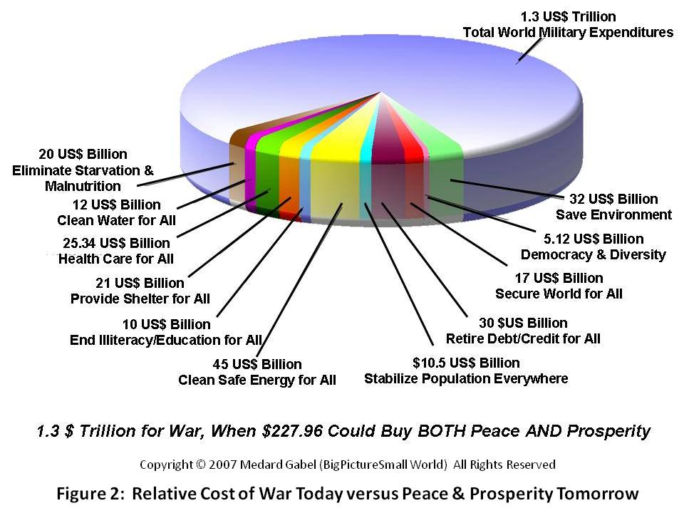
Spending on War versus Peace In the absence of intelligence with integrity
TOTAL SPENDING ON MILITARY (100% OF THE PIE)
FUTURE OF LIFE COST PER YEAR $227B PER YEAR
Notes:
8 -- What we spend on war instead of peace benefits the few bankers rather than the many citizens, and it happens because we are all—as a collective—abdicating our responsibilities for intelligence with integrity.
These numbers are from Medard Gabel, and consistent with those of E. O. Wilson and Lester Brown.
The time has come to displace the bankers and restore the people as the center of gravity for peace and prosperity.

Slide 9
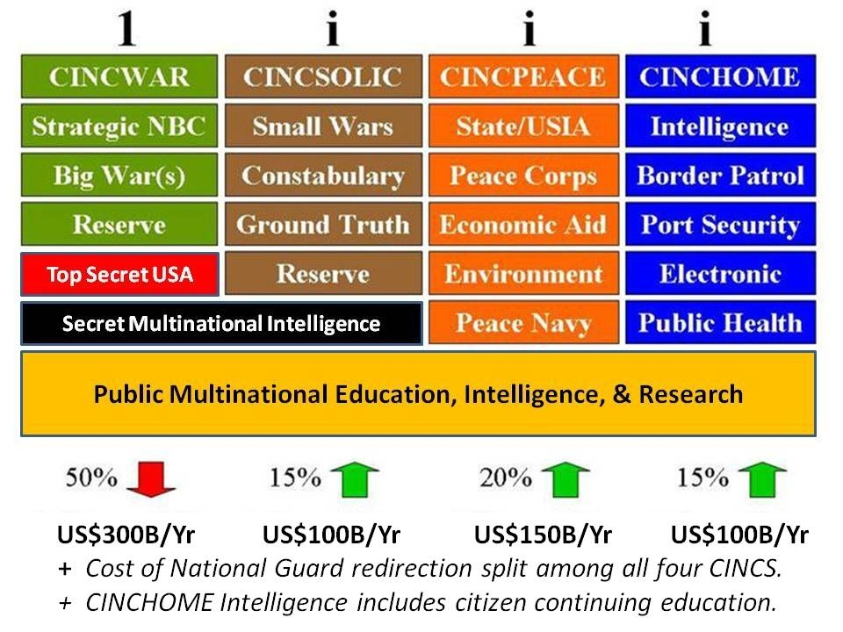
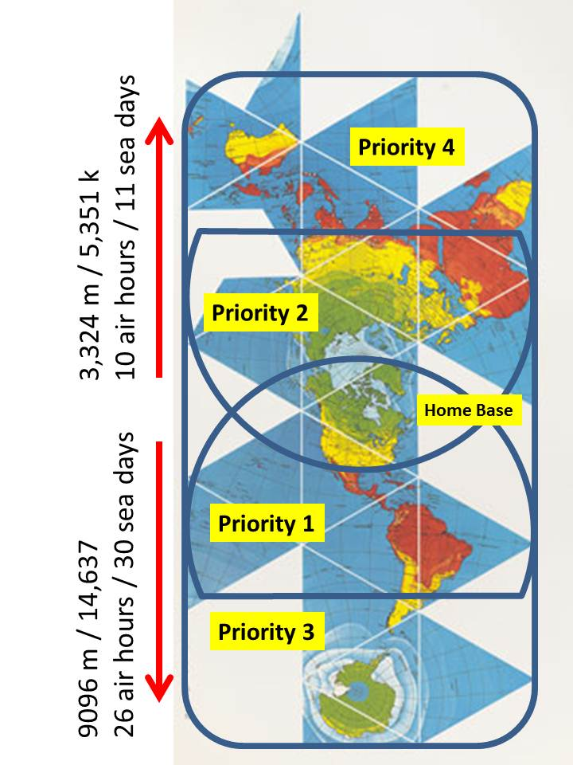
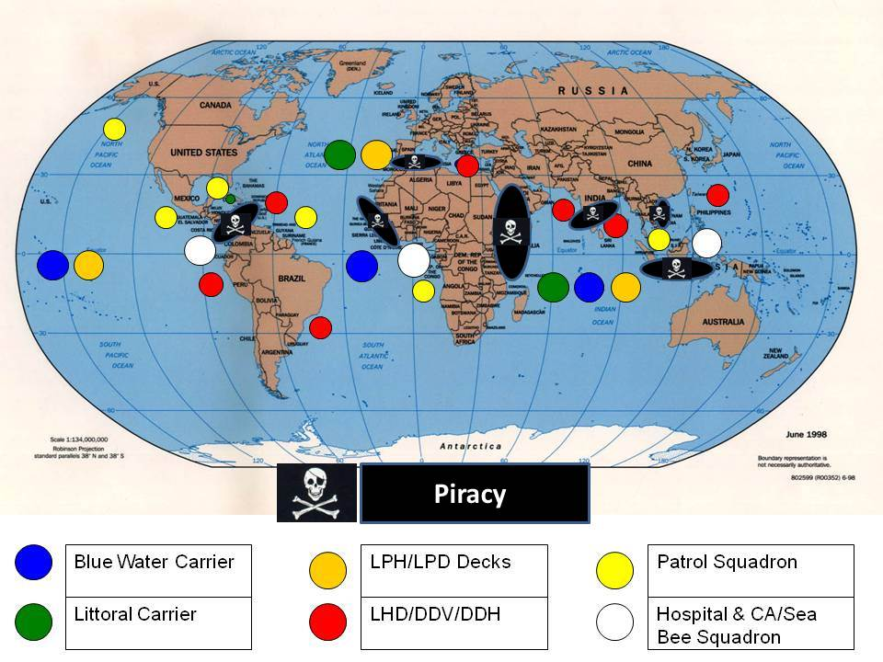
Notes:
9 -- Since the 1990’s I have been calling for four forces after next, for the elimination of most of our very expensive bases—each a target--overseas, and for the creation, instead, of a 450-ship Navy, a long-haul Air Force, and an air-liftable Army. I know how to do this while also reducing the Pentagon budget by 30% over 6 years. More recently I have devised the Hour-Glass Strategy in an attempt to refocus attention on the Western Hemisphere.
We need to shut down the American Empire and restore America the Beautiful, waging peace and respecting regional and cultural natural rights.

Slide 10
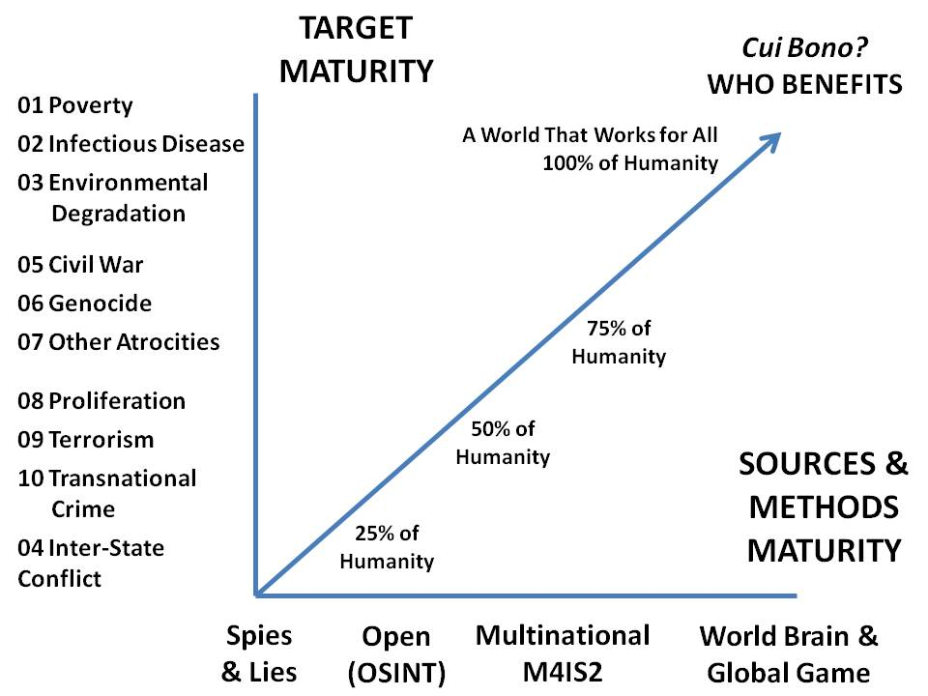
¿quién se beneficia?
Whole Systems
True Cost Focus
ALL Sources
ALL Tribes
Narrow Focus, Narrow Methods
Notes:
10 -- With all that by way of introduction, now I will quickly introduce some key ideas.
We must begin creating a more mature local to global intelligence or decision-support capability.
On the left are the ten high-level threats to humanity as identified by the UN panel in 2004.
There are not enough guns on the planet to save any dictatorship, monarchy, or plutocracy. Wise stewardship is the only path to sustainable power.

Slide 11
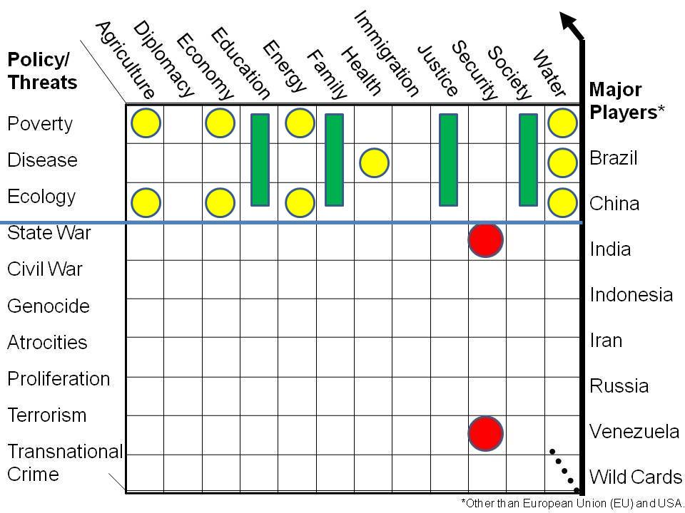
Policy
High-Level Threats
Poverty
Disease
Environment
State Conflict
Civil War
Genocide
Other Atrocities
Proliferation
Terrorism
Transnational Crime
Notes:
11 -- We have to move beyond the US focus on global militarism and the false war on terrorism, and instead focus on the top three threats to humanity.
This is very relevant to the future-proofing of the large cities in Latin America, and it will demand the harmonization of how we do each of the twelve core policies across the top….harmonization with shared information.
If we create a new model for public hybrid governance using shared knowledge that heal the Americas, this is rapidly scalable to other regions.

Slide 12
Government
Law Enforcement
Secret Internal
Secret Shared
Sensitive Shared
Military
Business
Open (Public)
Information Commons
Green
Media
Non-Profit
Yellow
Orange
Red
Academia
Civil Societies
Notes:
12 -- The government is the most ignorant and least flexible of eight information “tribes” or communities.
All tribes have secrets, where we have failed terribly is in ensuring that we can all share the majority of the information that is not secret.
Our entire approach to information-sharing and sense-making is retarded.

Slide 13
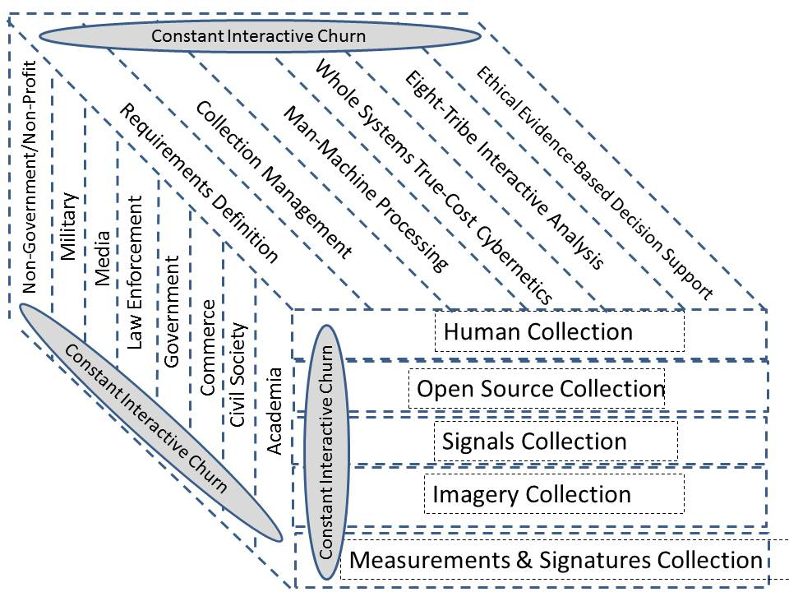
OLD
Human Collection
Step 1:
Planning & Direction
Signals Collection
Imagery Collection
Measurements & Signatures Collection
Open Source Collection
Stovepipes
Step 5:
Delivery
Step 2:
Collection
Government
Secret
Policy Focus
NEW
Step 4:
Analysis & Production
Step 3:
Processing
Next Higher Levels of Processing:
Multinational, Multiagency
Multi-Disciplinary, Multi-domain
True Cost Attributes at all times
Geospatial Attributes at all times
Historical Reach-Back
7th Generation Forecasting
Transparent & Truthful at all times
Notes:
13 -- Intelligence today is still mostly about governments doing secrets for policy, with collection being secret and stove-piped.
Here I present a more holistic approach to intelligence, one that is multinational.
This new concept leverages open source everything—especially sources and software easily shared– to enable continuous interactive churning.

Slide 14
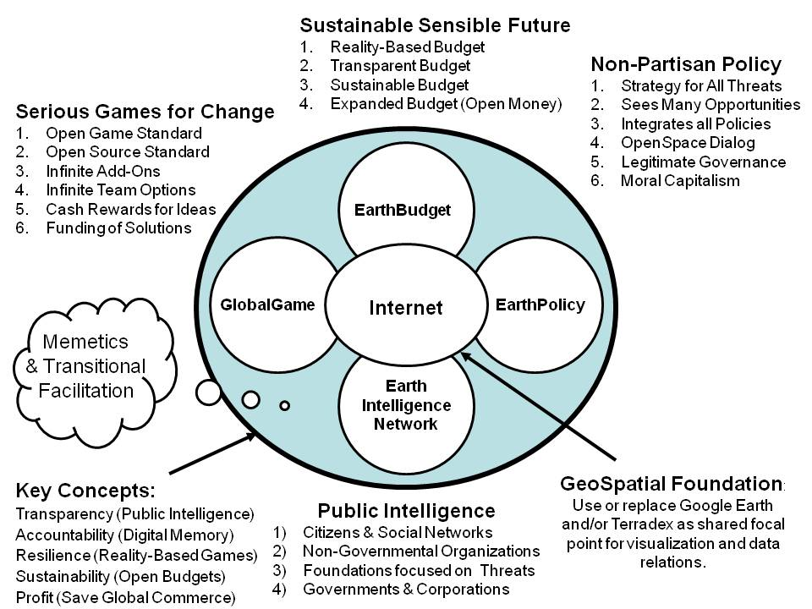
Notes:
14 -- I funded Earth Intelligence Network, a 501c3, and 24 of us came together to design the foundation for a World Brain and Global Game. No one else has done this.
Any country can do this, but it works even better if an entire region agrees to this approach.
There are some advanced being made in Qatar, particularly with respect to the use of diasporas, real-time translation and plotting of points on maps, and interactive International Crisis Maps, that can be applied to local needs and local planning.

Slide 15
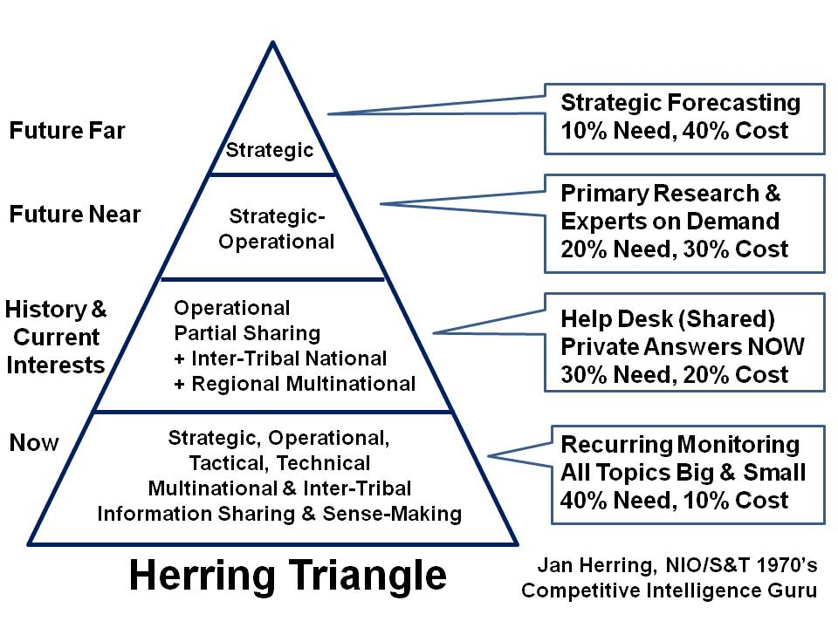
Notes:
15 -- Most of the eight tribes of information have no idea how to execute the proven process of intelligence, or how to balance resources among four major levels of effort.
This particular concept was developed by Jan Herring, the first National Intelligence Officer for Science & Technology, and it is still, in my view, an essential starting point for the Open Source Agency.
To prosper as a nation, we must meet the decision support needs of all elements of society, in a legal, ethical and affordable manner.

Slide 16
All those with a need, however miniscule
Cluster of Medical Needs
Cluster of Food Need Over Time
Harmonized Giving
Peer to peer giving
Time-Phased Harmonized Giving
All those with something to give
Organized Giving
Cluster of Clothing Need
Time & Space Relations
Wks, Mos, Yrs, Decades
Powered by Zero Waste Mind-Sets, Enabled by Ubiquitous Information Access
Benefit #1: On Demand Precision Giving Benefit #2: Elimination of Overhead
Benefit #3: Harnesses Giving of Billion Individuals Who Do Not Give Now
Making a Difference 21: Influence How OTHERS Spend
Figure 14: Global Range of Gifts Table Illustrated
Notes:
16 -- The United Nations, the Red Cross, and most international organizations and non-profits appear to spend less than 20% of all donations on actual assistance.
An Open Source Agency can enable the creation of a Global to Local Range of Needs Table in the cloud, one that everyone can access, where the fulfillment of needs can be tracked, and all donations accounted for in real time.
This approach respects the hoarded wealth of the few, and instead seeks to create infinite new wealth.

Slide 17
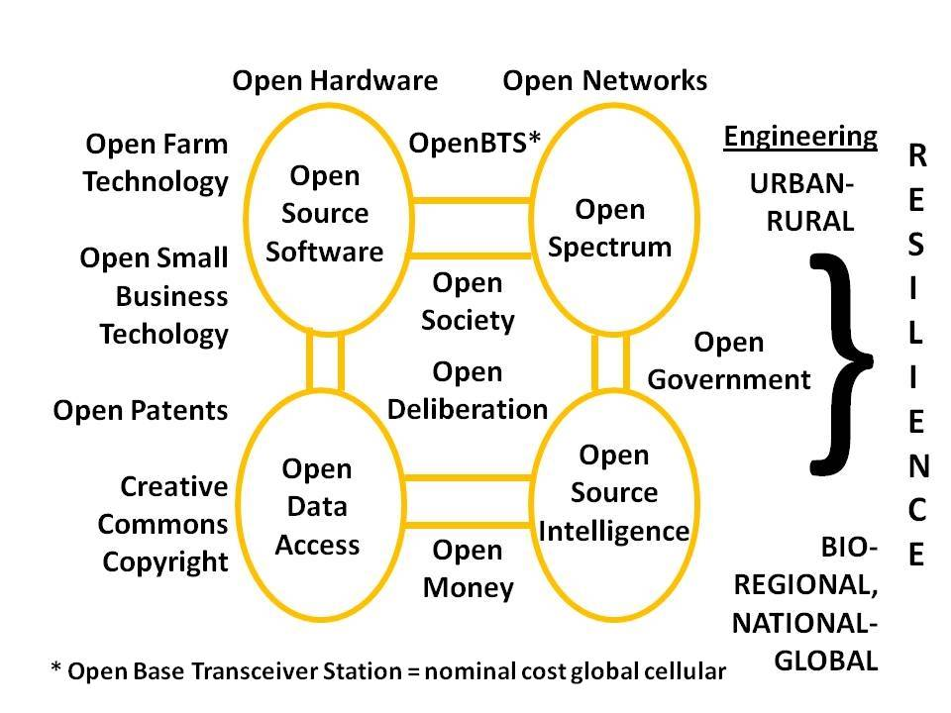
Notes:
17 -- From a technical point of view, this is our starting point. We must begin sharing open source information immediately.
We must move quickly toward open source software, open source hardware, and open cloud as well as open spectrum, all enabled by open standards.
This allows for rapid affordable scalability. This is how the South—with or without the USA—can heal and defend itself.

Slide 18
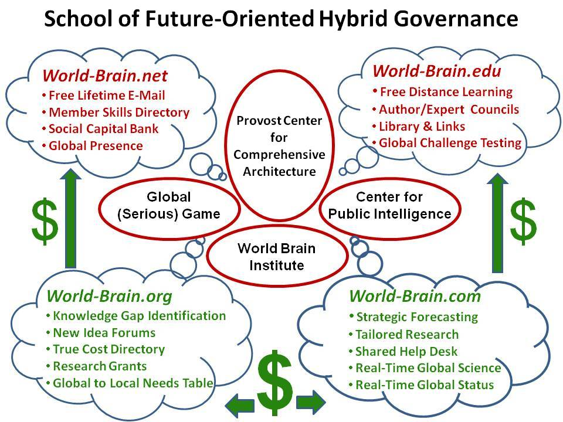
Notes:
18 -- Traditional governments are not adapting.
HYBRID governance is here to stay, beginning with water management and moving into all policy areas as quickly as possible.
The Open Source Agency would serve as the incubator for various implementations of this concept.

Slide 19
Smart Nation 21: Real Estate - Relevance - Ranking
School of Future-Oriented Hybrid Governance
Open Source Agency
(sister agency to BBG)
Special District
Dept. of State
World Brain Institute
& Global Game
Multinational Warning &
Decision-Support Centre
Horizons College & Multidisciplinary Research Consortium
Multinational Multiagency Conference Centre
Notes:
19 -- If created in the USA, the Open Source Agency must be a sister agency to the Broadcasting Board of Governors, and under diplomatic auspices. OMB agrees.
Here are my personal views on what we can and should build in Washington. If the US Government will not do this, I am available to build it anywhere in the Americas. Open Source Everything is the new oil, the new gold, the new water.
A copy of this briefing, and my private letters to Rice, Kerry, and Hagel, is being shared with the Saudi Embassy and the JFK Center tomorrow.

Slide 20
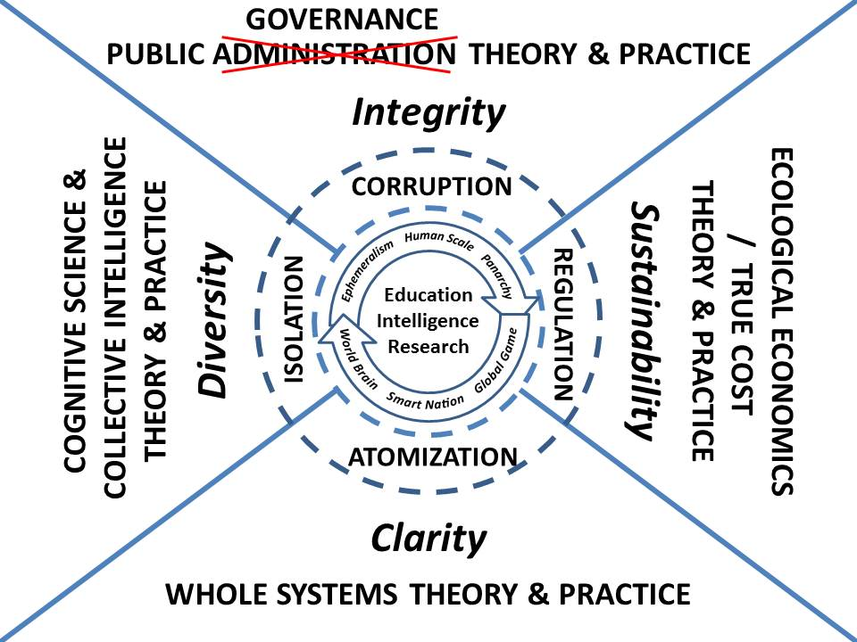
Notes:
20 -- This is my most complex slide, and I cannot spend time on it. My new book, INTELLIGENCE with Integrity: Enabling Hybrd Governance with Open-Source Decision-Support, will be a textbook on how to address all of this complexity.
Sub-regionalism and regionalism – and respect for the 5,000 secessionist movements world-wide that will accept legitimate governance in lieu of separation – demands that we rise to the challenge of enabling hybrid governance with open-source decision-support.

Slide 21
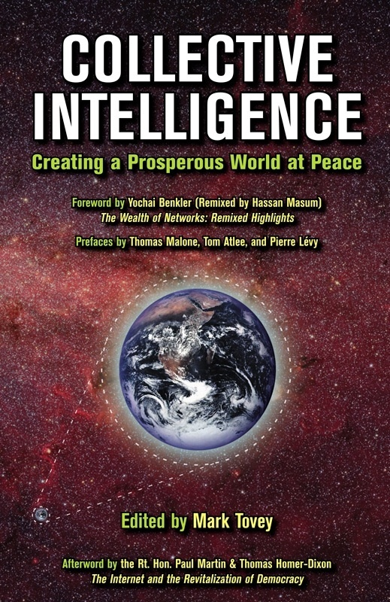
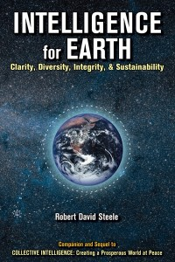
Notes:
21 -- These are the first two books our non-profit funded. The human brain can do petaflop calculations per second, weighs almost nothing, and consumes virtually no energy.
No computer, at any cost, can equal this cost-size and performance. There are five billion human brains lying fallow. Embracing their potential, connecting them to an autonomous internet that cannot be shut down by any actor, is our next challenge.
I would be glad to see these books translated.

Slide 22
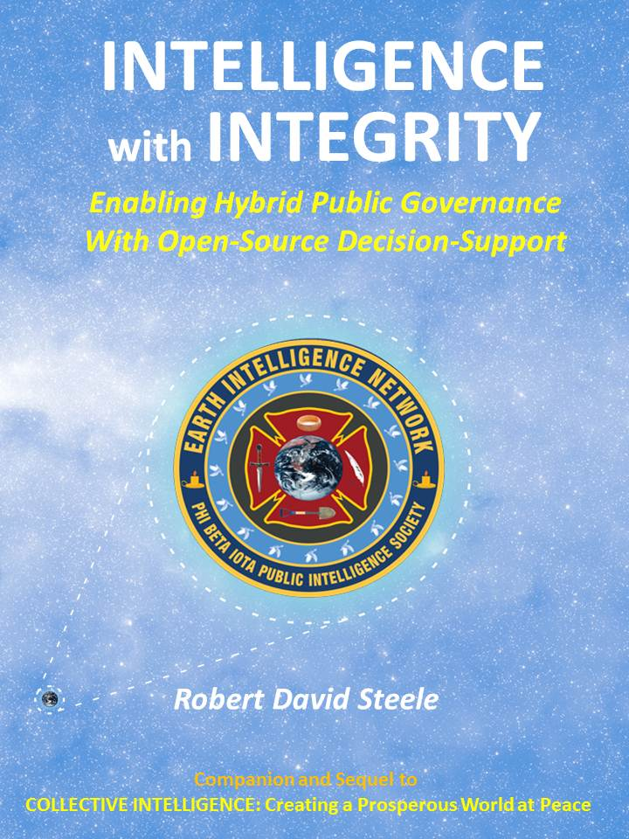
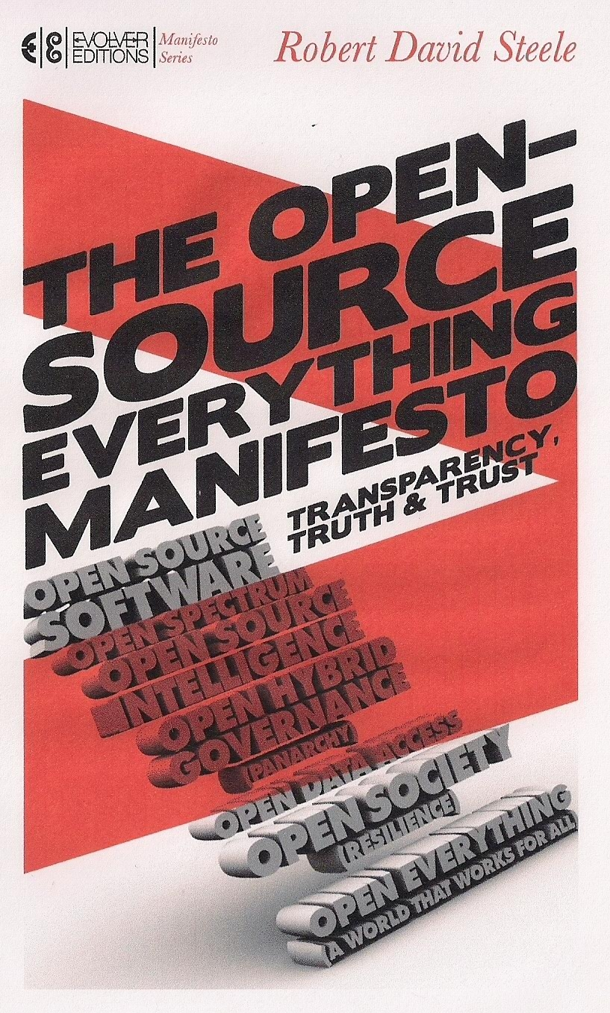
Notes:
22 -- Here to the left is my most recent book, also available for Kindle, and the draft cover of my next book.
HYBRID GOVERNACE
OPEN-SOURCE DECISION-SUPPORT
This is how we heal the Americas and come together on the basis of shared information and interactive sense-making. We can extend this quickly to Africa on the East and South Asia on the West, and in this way empower the Southern Hemisphere.

Slide 23
TINY URL
URL corto para esta entrada: http://tinyurl.com/IADB-Abierto
Short URL for this post: http://tinyurl.com/IADB-Open
/IADB-Open or /IADB-Abierto
robert.david.steele.vivas [at] gmail.com
Notes:
23 -- This briefing, including my planned words in the Notes format, is online now.
I ask for your help in asking—at the national level--that Chuck Hagel fund this and John Kerry sponsor it. If they will not, I am prepared to build it anywhere else.
Please consider sending this briefing to your Ambassadors and your Ministers of Defense and Foreign Affairs.
He dicho.

