Slide 1
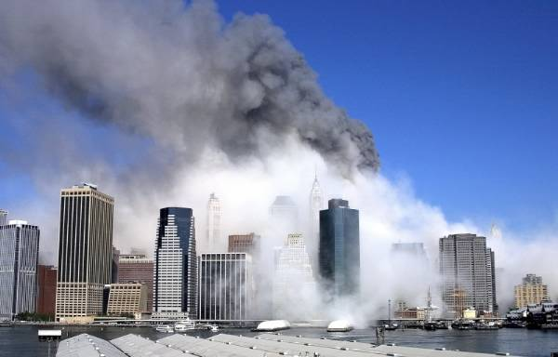
How Mini-nukes were used to Destroy the WTC and the untold story of 9/11
Compiled by
Donald Fox
June 16, 2012

Slide 2
Bio
I’m not a nuclear physicist
IT Professional from Minneapolis, MN
Bachelor of Science in Information Technology
I study Black Ops and “Deep Politics.”
Started down the rabbit hole after watching the movie JFK in 1992
I have been studying 9/11 since 2004
Researching Mini-Nukes since 2006
Followed Jim Fetzer since 2003
Regular listener of the Real Deal and Black Op Radio

Slide 3
Recommended Material
Recommended Videos: 9/11 Eyewitness, 9/11 In Plane Sight and several YouTube videos
Recommended web sites: 911U.org, ae911truth.org, drjudywood.com, Finnish Military Expert and Georgia State University HyperPhysics
Fetzer and Hightower: Has nanothermite been oversold to the 9/11 Truth community?
Jeff Prager’s PDF: http://www.datafilehost.com/download-b128ac41.html
Notes:
http://jamesfetzer.blogspot.com/2011/05/has-nanothermite-been-oversold-to-911.html
http://www.serendipity.li/wot/finn/military.htm
http://www.ae911truth.org/

Slide 4
Overview
Presentation will cover how WTC1 and WTC2 were destroyed by mini-nukes.
I’m not going to get into airplanes or video fakery – these things did not cause the buildings to come down.
Fissionless fusion represents a new energy paradigm.
In a deuterium and tritium fusion reactor 1 gallon of seawater could produce as much energy as 300 gallons of gasoline

Slide 5
Overview
Deuterium (heavy water) is virtually unlimited: 1 part in 5000 of the hydrogen in seawater is deuterium.
Tritium is rare. No sizable natural source since tritium is radioactive with a halflife of 12.3 years.
Tritium needs to be obtained by breeding tritium from lithium
Notes:
http://hyperphysics.phy-astr.gsu.edu/hbase/nucene/fusion.html#c2

Slide 6
Observed Phenomena of the
Destruction of WTC1 and 2
Two 500,000 ton 110 story skyscrapers pulverized in mid-air
Extremely rapid onset of “collapse”
Destruction proceeds through path of greatest resistance at near freefall speed
90% of the debris landed outside of the building’s footprints
No “stack of pancakes” as expected in a gravitational collapse
Buildings destroyed from the top down

Slide 7
Continued
Debris ejected upward and outward
One chunk of debris was ejected 603 feet from WTC1 into the Winter Garden
Pyroclastic flow and mushroom clouds
Huge explosions before each tower “collapses”
DOE report detected 55x background levels of tritium
USGS found uranium, barium, strontium and thorium among other fission products in dust samples.
Notes:
http://www.ae911truth.org/en/news-section/41-articles/505-ae911truth-faq-6-whats-your-assessment-of-the-directed-energy-weapon-dew-hypothesis.html

Slide 8
9/11 Was a Black Op
A black operation or black op is a covert operation by a government, a government agency, or a military organization. By extension the term may also be used for activities by private companies or groups. A black operation typically involves activities that are highly clandestine and often outside of standard military protocol or even against the law. Key features of a black operation are that it is clandestine, it has negative overtones, and it is not attributable to the organization carrying it out. A single such activity may be called a "black bag operation".
Notes:
http://en.wikipedia.org/wiki/Black_operation

Slide 9
NIST Cover Story
When a black operation is employed, a cover story is created before hand. The cover story is sent out to ”reliable” news agencies at the proper moment throughout the world. The cover story then becomes the history, a fait accompli.
The NIST Report was used to give legitimacy to the cover story that Muslim hijackers with box cutters flew commercial airplanes into the WTC causing them to collapse at free fall speed.
Notes:
http://meiswinkleforcongress.com/2010/09/332/

Slide 10
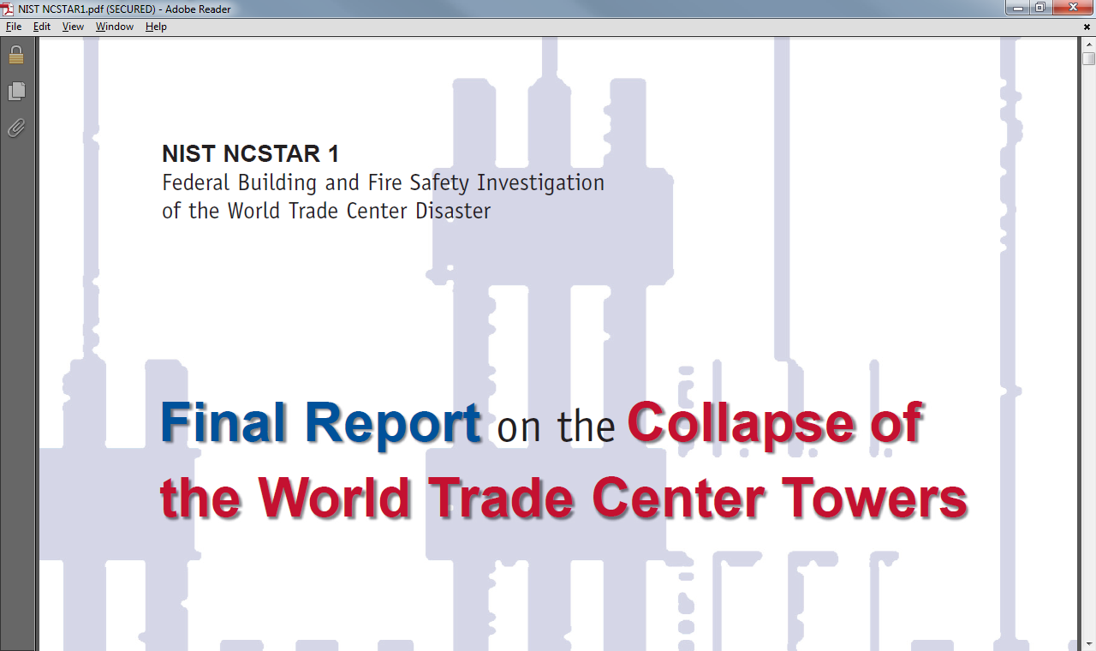
NIST NCSTAR 1A Report

Slide 11
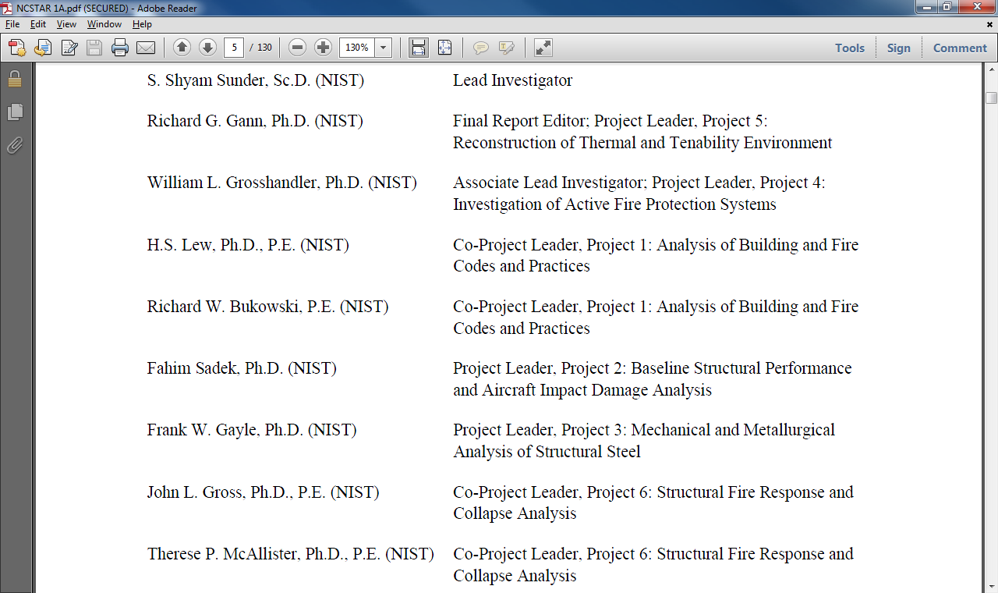
Notes:
A lot of PhD's on the staff yet they blame a kerosene fire for turning 2 500,000 ton buildings to dust in 10 seconds each.

Slide 12
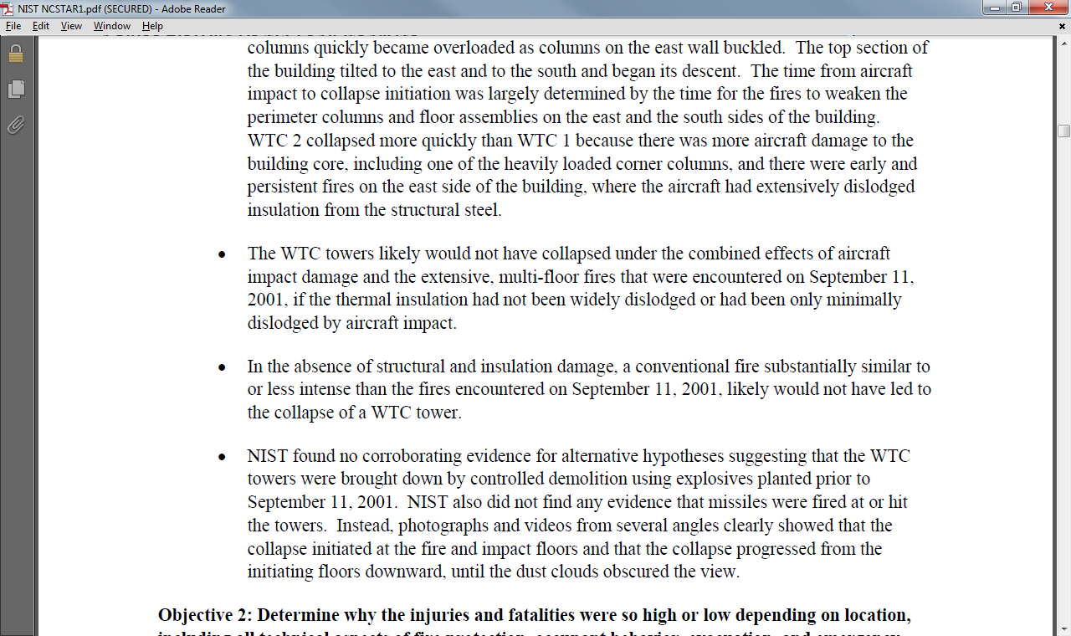
NIST: No Evidence of Explosives
Notes:
NIST found no corroborating evidence for alternative hypotheses suggesting that WTC towers were brought down by controlled demolition using explosives planted prior to 9/11

Slide 13
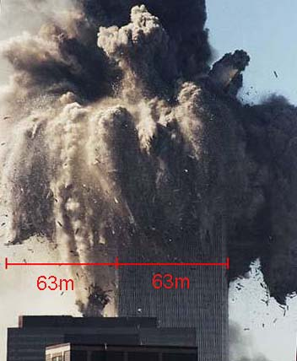
Sure Looks Like an Explosion to Me!!

Slide 14
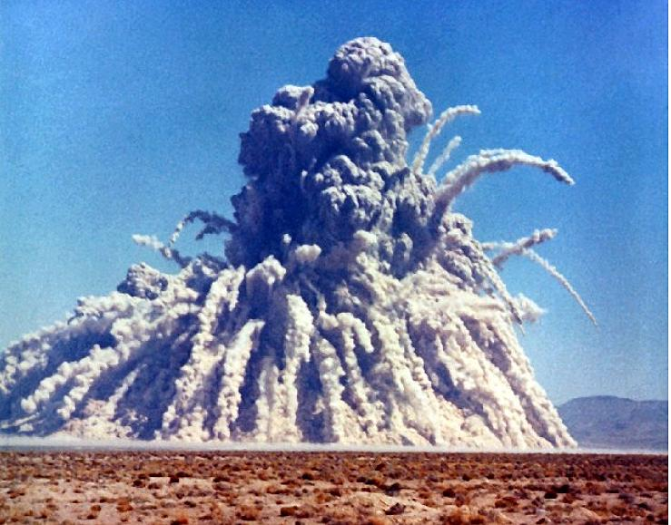
Storax Sedan 104 Kt shallow underground
Notes:
http://www.serendipity.li/wot/finn/5/soldier5.htm

Slide 15
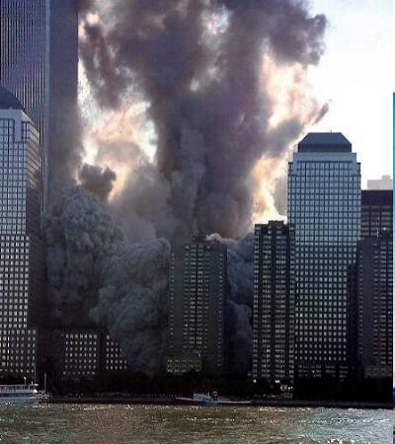
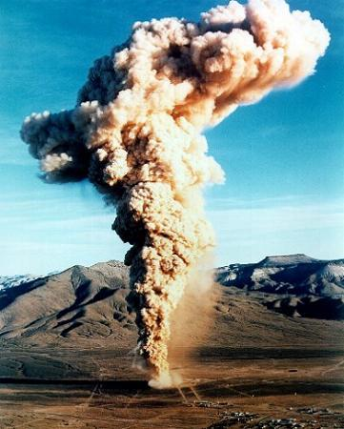
WTC2 compared to Banberry 10 Kt underground
Notes:
http://www.serendipity.li/wot/finn/5/soldier5.htm

Slide 16
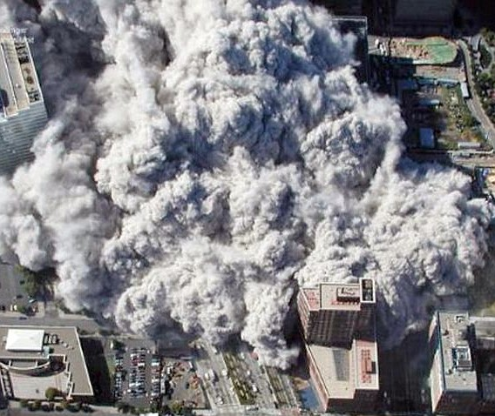
Pyroclastic Flow

Slide 17
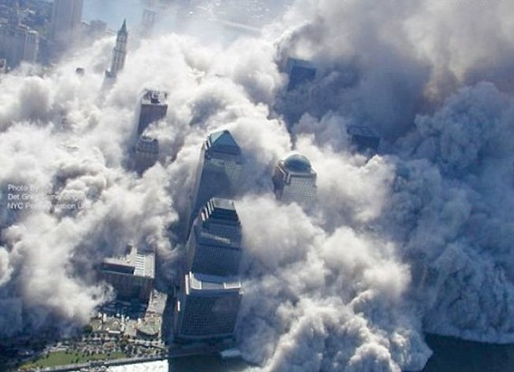

Slide 18
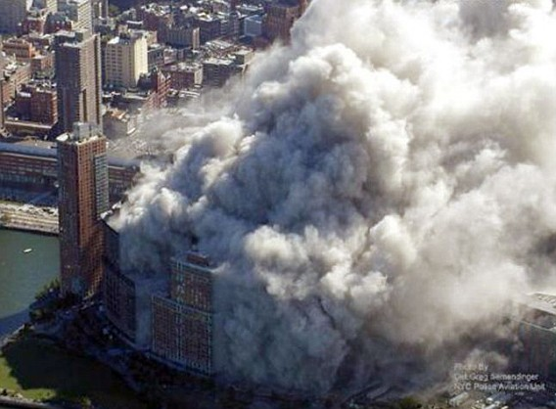

Slide 19
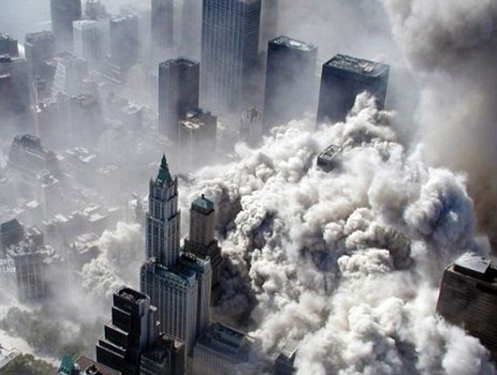

Slide 20
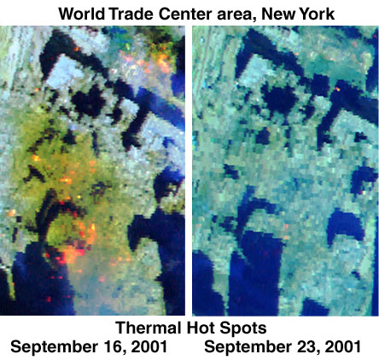

Slide 21
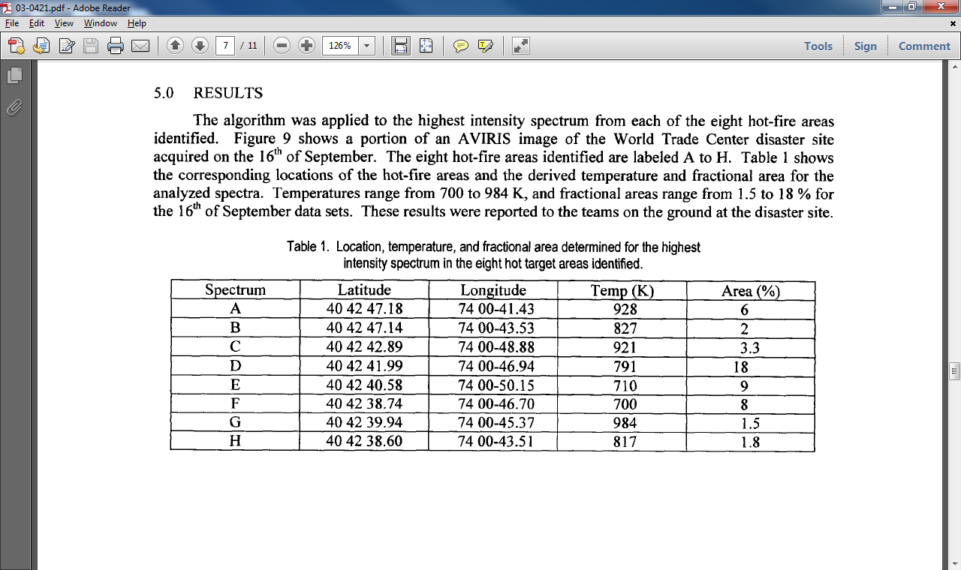
Notes:
984 K = 1,311.8 °F
http://trs-new.jpl.nasa.gov/dspace/bitstream/2014/6599/1/03-0421.pdf

Slide 22
Could Nanothermite Turn a 500,000 Ton Building Into Dust?
Detonation velocity only 895 meters per second
Thermite is an incendiary
Thermite gets very hot, it produces molten iron, it can melt steel, and it can catch things on fire, but it is absolutely not an explosive.
895 m/s is obviously too low of a value to account for the explosive effects observed in the catastrophic destruction of the WTC Twin Towers, including turning concrete and other materials into dust or separating and propelling steel members and other materials outward.
Notes:
http://jamesfetzer.blogspot.com/2011/05/has-nanothermite-been-oversold-to-911.html
http://www.veteranstoday.com/2011/07/17/is-911-truth-based-upon-a-false-theory/

Slide 23
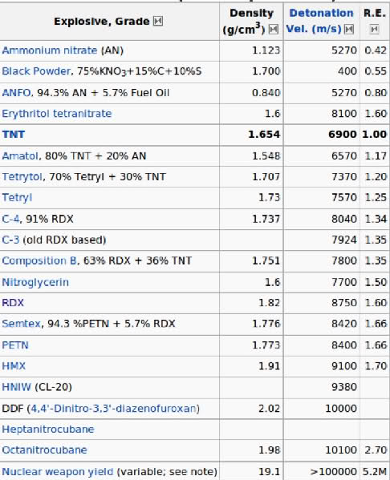
Notes:
http://www.veteranstoday.com/2011/07/17/is-911-truth-based-upon-a-false-theory/

Slide 24
Steven E Jones
Promotes theory that high-temperature cutter-charges such as thermite, HMX or RDX destroyed WTC.
Denies Mini-Nukes were used to destroy the WTC
Jones earned his bachelor's degree in physics, magna cum laude, from Brigham Young University in 1973, and his Ph.D. in physics from Vanderbilt University in 1978. Jones conducted his Ph.D. research at the Stanford Linear Accelerator Center (from 1974 to 1977), and post-doctoral research at Cornell University and the Los Alamos Meson Physics Facility.
Notes:
http://journalof911studies.com/volume/200609/WhyIndeedDidtheWorldTradeCenterBuildingsCompletelyCollapse.pdf
http://journalof911studies.com/letters/a/Hard-Evidence-Rebudiates-the-Hypothesis-that-Mini-Nukes-were-used-on-the-wtc-towers-by-steven-jones.pdf
http://en.wikipedia.org/wiki/Steven_E._Jones

Slide 25
Jones has Extensive Nuclear Physics Background
Jones conducted research at the Idaho National Laboratory, in Arco, Idaho where, from 1979 to 1985, he was a senior engineering specialist.
He was principal investigator for experimental muon-catalyzed fusion from 1982 to 1991 for the U.S. Department of Energy, Division of Advanced Energy Projects.
From 1990 to 1993, Jones studied fusion in condensed matter physics and deuterium under U.S. Department of Energy and Electric Power Research Institute sponsorship.
Jones also collaborated in experiments at other physics labs, including TRIUMF (Vancouver, British Columbia), KEK (Tsukuba, Japan), and the Rutherford Appleton Laboratory at Oxford University
Notes:
http://en.wikipedia.org/wiki/Steven_E._Jones

Slide 26
Is Steve’s Real Mission to Deny Nukes?
Promotes a theory (thermite) that cannot possibly explain what was observed on 9/11.
Has extensive background in nuclear physics and denies that nuclear weapons were used on 9/11
“But to date, all known hydrogen bomb-explosions have been started (“ignited”) by fission bombs. Our technology is not yet sufficient to have a “pure” fusion device of any significant size – we struggle to ignite small d-t pellets in a laser-bombardment environment.”
Notes:
http://journalof911studies.com/letters/a/Hard-Evidence-Rebudiates-the-Hypothesis-that-Mini-Nukes-were-used-on-the-wtc-towers-by-steven-jones.pdf

Slide 27
Dr. Judy Wood
Her book Where Did the Towers Go? Has caused quite a stir in the 9/11 Truth Community.
B.S. (Civil Engineering, 1981) (Structural Engineering),
M.S. (Engineering Mechanics (Applied Physics), 1983)
Ph.D. (Materials Engineering Science, 1992) from the Department of Engineering Science and Mechanics at Virginia Polytechnic Institute and State University in Blacksburg, Virginia.
Judy Wood has no theory for the destruction of the WTC: "What hypothesis, precisely, are you willing to commit yourself to at this stage of research? The hypothesis that the WTC buildings were all destroyed in a way that has never been seen before is consistent with the use of Directed Energy Weapons."
Notes:
http://wheredidthetowersgo.com/
http://www.drjudywood.com/articles/a/bio/Wood_Bio.html
http://www.drjudywood.com/faq/#22

Slide 28
Morgan Reynolds
Morgan O. Reynolds, Ph.D., currently is Professor emeritus, economics, Texas A&M University, College Station, Texas. He is a former Chief Economist at the U.S. Department of Labor 2001-2002, and he also served as the Director of the Criminal Justice Center and Senior Fellow at the National Center for Policy Analysis, headquartered in Dallas, Texas.
Protégée of Dr. Judy Wood
In a debate with Chuck Boldwyn, Morgan raised the following points:
No Audio of Big Explosions
No heat
No thermite
No nukes
Bombs don’t explode vertically
Believes that Judy Wood sees things we do not
Notes:
Morgan debated Chuck Boldwyn on Jim Fetzer’s show the Real Deal 2/6/12. These are points that Morgan made during that debate.
http://radiofetzer.blogspot.com/2012/02/chuck-boldwyn-morgan-reynolds.html#comment-form
http://nomoregames.net/bio/

Slide 29
What is a Directed Energy Weapon?
Beam Weapons, Energy Weapons, and Directed Energy Weapons (DEW):
I have used the terms "beam weapons" and "directed energy weapons" to refer to unconventional weapons (exotic weapons) that are energy weapons. I broadly define DEW as Energy that is Directed and is used as a Weapon. The full range of these weapons is classified information, so I make no limits or distinction of categories within the realm of energy weapons, as doing so would imply specific knowledge of all that is available. In the following paragraph, I have listed some of the possibilities we are aware of.
My critics have accused us of insisting that beam weapons did their damage from outer space, yet I make no claim about whether the directed energy weapon operated from a space-, air-, or ground-based platform. Nor do I make any claim about what wavelength(s) was used, what the source(s) of energy was, whether it involved interference of multiple beams, whether it involved sound waves, whether it involved sonoluminescence, whether it involved antimatter weapons, whether it involved scalar weapons, whether it involved HAARP (more here and here), whether it involved a nuclear process (e.g. NDEW, more info), whether it involved conventional directed energy weapons (cDEW), whether it involved improvised directed energy weapons (iDEW), nor what kind of accelerator was used, nor do I claim to know what the serial numbers of the parts that were in the weapon(s).
What I do claim is that the evidence is consistent with the use of energy weapons that go well beyond the capabilities of conventional explosives and can be directed.
Notes:
http://www.drjudywood.com/faq/#3

Slide 30
Drjudywood.com FAQ 39
The first step in a forensic investigation is to determine what happened. What happened on 9/11 is not merely a case of belief. This is a crime that should be solved by a forensic study of the evidence. Before it can be determined who did it, it must first be determined what was done and how it was done. Until he has done that, nothing else has any scientific value. I have determined what happened; most of the buildings were turned to dust. Therefore the dust would be expected to contain traces of all materials that were in the building. Finding traces of chocolate, sugar, and nano-wheat (flour) in the dust would not prove that chocolate-chip cookies turned the buildings to dust. It would not prove there were chocolate chip cookies in the building nor that such cookies were capable of turning buildings to dust. The same is true for thermite.
Notes:
http://www.drjudywood.com/faq/#39

Slide 31
What was Found in the Dust?
Uranium, Thorium, Strontium, Barium and many other fission products (telltale signs of nukes) that Jeff Prager has documented
Tritium was found by the DOE in the WTC storm sewer 3 days later and in the basement of WTC6 11 days later. Another telltale sign of nuclear fusion bombs
Undoubtedly Judy Wood is aware of the USGS and DOE findings yet she denies nukes

Slide 32
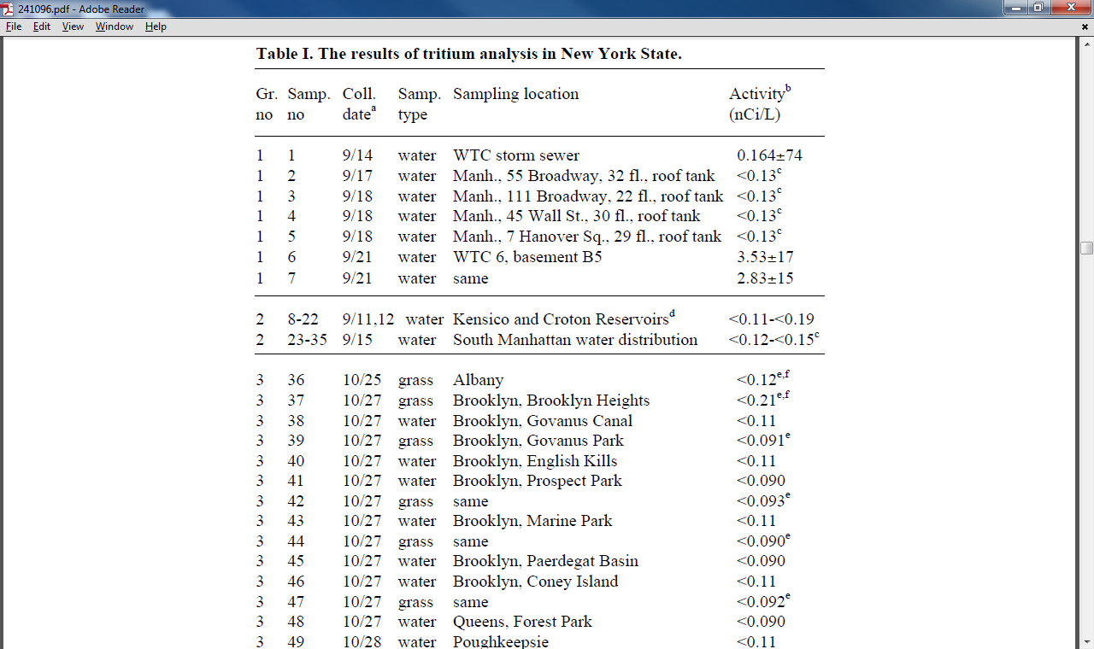
Notes:
Study of Traces of Tritium at the World Trade Center
https://e-reports-ext.llnl.gov/pdf/241096.pdf

Slide 33
Limited Hangout?
A limited hangout, or partial hangout, is a public relations or propaganda technique that involves the release of previously hidden information in order to prevent a greater exposure of more important details. It takes the form of deception, misdirection, or cover-up often associated with intelligence agencies involving a release or "mea culpa" type of confession of only part of a set of previously hidden sensitive information, that establishes credibility for the one releasing the information who by the very act of confession appears to be "coming clean" and acting with integrity; but in actuality, by withholding key facts, is protecting a deeper operation and those who could be exposed if the whole truth came out. In effect, if an array of offenses or misdeeds is suspected, this confession admits to a lesser offense while covering up the greater ones.
Notes:
http://en.wikipedia.org/wiki/Limited_hangout

Slide 34
NIST Cover Story not Holding Up
The NIST cover story is laughable. No way a puny office fire that is going out can cause a 500,000 ton building to collapse at free fall speed and eject tons of debris hundreds of yards.
Jones, Wood and Reynolds appear to be a limited hangout to protect the actual cause of the WTC’s destruction – mini-nukes.
All 3 expose SOME details of the actual 9/11 operation but none of their “theories” actually account for all of the observed phenomena.

Slide 35
Dr Ed Ward
The Current Irrefutable Conclusion = Treason, Murder and Crimes Against Humanity for 9-11, the Iraq War, and Revocation of Constitutional Rights of US Citizens – All US ‘representatives’ appropriate US citizens, and non citizens, need to be on trial in Constitutional Courts.
The Current ‘Basic’ Proven 9-11 Nuke Evidence – (About 95 to 98% of the TOTAL evidence covered) – All proven basic physics/chemistry ANY high school graduate should understand after the basic courses.:
1. Three Massive WTC Craters – See us government LIDAR proof: – Nothing else known to man can leave ALL the WTC debris and this particular evidence in the length of time needed , except a third generation Micro Nuke – Mini Nuke – Nuke. It’s 100% classic textbook nuclear event residue – ZERO ANOMALIES.
Notes:
http://edwardmd.wordpress.com/2010/09/06/proven-9-11-nukes-us-government-involvement/

Slide 36
3rd Generation Mini Nuke
2. Five Acres (1.2 Billion Pounds = Weight of Residue of 3 WTC Buildings (WTC 1, 2, and 6)) of WTC Land Brought to Seering Temperatures in a Few Hours by an
‘Anaerobic, Chlorine Fueled “Fire” – Impossible by Basic Laws of Physics. See us
gov Thermal Images proof – Nothing else known to man can leave ALL the WTC debris and this particular evidence in the length of time needed , except a third generation Micro Nuke – Mini Nuke – Nuke. It’s 100% classic textbook nuclear event residue – ZERO ANOMALIES.
http://letsrollforums.com/update-us-government-s-t22024.html?t=22024 – NOT an endorsement of the site.
3. Tritium Levels 55 Times (normal) Background Levels assessed a numerical value
of ‘traces’ and ‘of no human concern’. See us government (DOE report) proof: – Nothing but a NUCLEAR EVENT can cause ‘tritium’ formation – basic physics fact – Nothing else known to man can leave ALL the WTC debris and this particular evidence in the length of time needed , except a third generation Micro Nuke – Mini Nuke – Nuke. It’s 100% classic textbook nuclear event residue – ZERO ANOMALIES.
http://groups.yahoo.com/group/EdWard-MD/message/141
4. An Impossible “Fire” (Combustion Process). See Laws of Physics for
Fire/Combustion Process and Dr. Cahill’s data on ‘anaerobic incineration’. – Nothing else known to man can leave ALL the WTC debris and this particular evidence in the length of time needed , except a third generation Micro Nuke – Mini Nuke – Nuke. It’s 100% classic textbook nuclear event residue – ZERO ANOMALIES.
rense.com/general77/newlaws.htm
5. 3 Billion pounds of building instantly turned into 2 Billion pounds of
micronized dust. – Nothing else known to man can leave ALL the WTC debris and this particular evidence in the length of time needed , except a third generation Micro Nuke – Mini Nuke – Nuke. It’s 100% classic textbook nuclear event residue – ZERO ANOMALIES.
http://www.serendipity.li/wot/ed_ward/use_of_abombs.htm

Slide 37
What Is a Mini-Nuke?
1st generation nuclear bombs were atom bombs (A-bombs). These were fission devices. Used against Japan in 1945. High radioactivity.
2nd generation bombs were hydrogen bombs (H-bombs). These were fusion devices. Low radioactivity. Needed an A-bomb to detonate.
A mini-nuke or Tactical Nuclear Weapon is a low-yield thermonuclear device
Fissionless fusion (3rd generation) allows the size of these devices to be very small – hand grenade size
Notes:
http://911u.org/Physics/WTCenergySurplus.html
http://www.serendipity.li/wot/ed_ward/use_of_abombs.htm
http://edwardmd.wordpress.com/2010/09/06/proven-9-11-nukes-us-government-involvement/
http://www.fas.org/sgp/othergov/doe/rdd-7.html

Slide 38
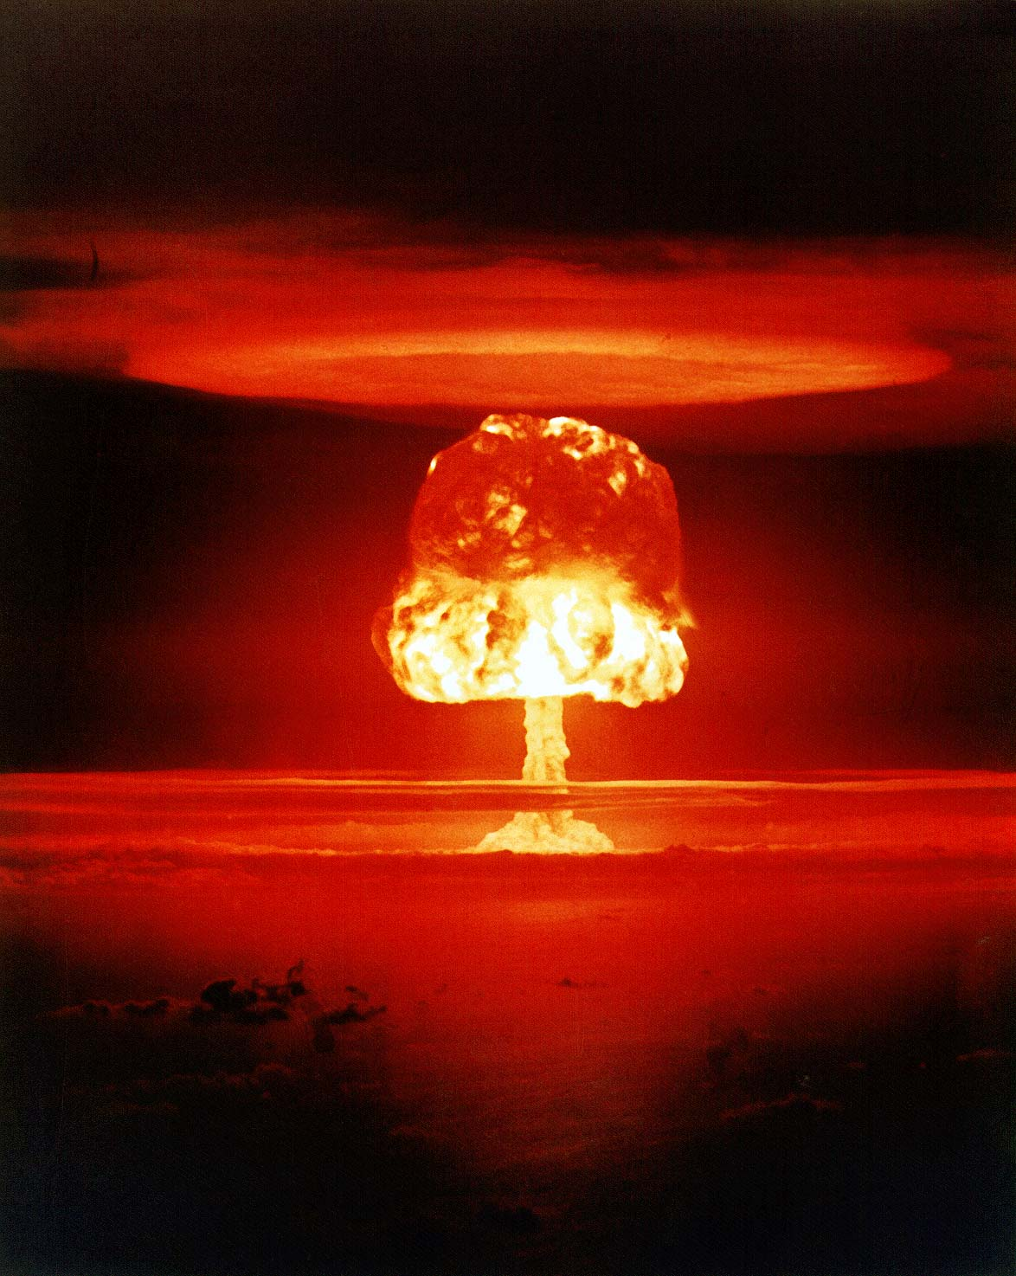
Notes:
Most people think of something like this when they think of a nuclear bomb.
Image 169 ROMEO, a 11 megaton shot of part of Operation Castle. It was fired from a barge near Bikini Atoll on March 26, 1954
http://www.angelfire.com/tx/yuccaflat/atomic-photos.html

Slide 39
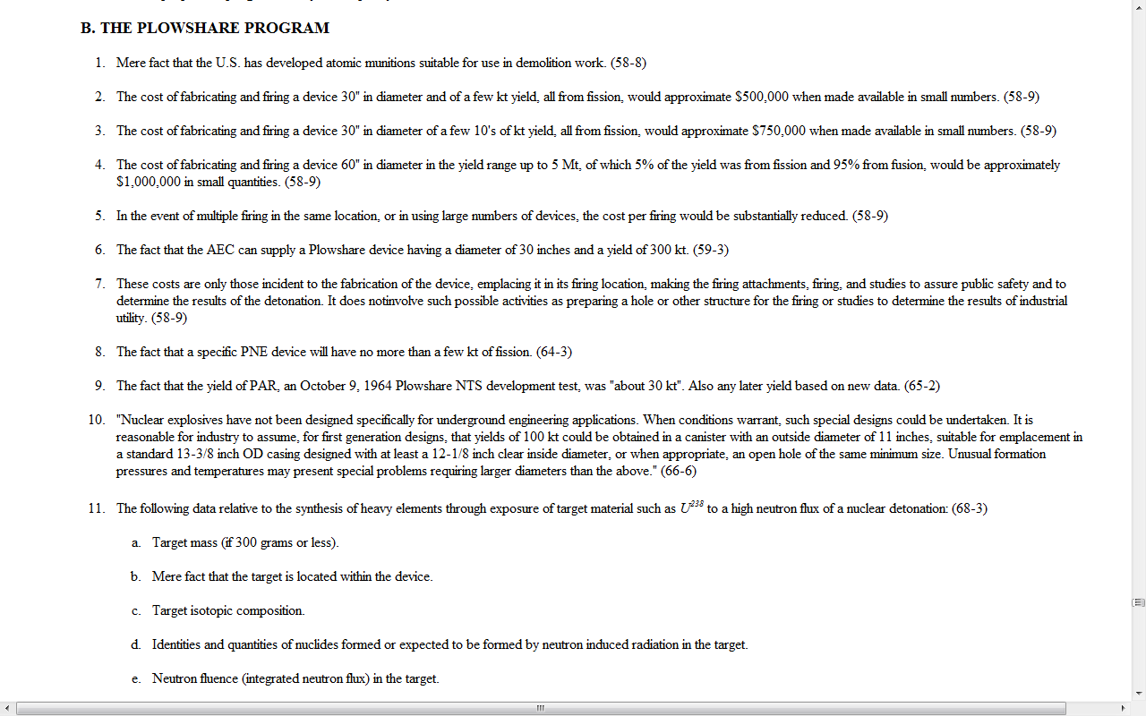
Do Mini-Nukes Actually Exist?
Notes:
U.S. Department of Energy Office of Declassification 2/1/01 admits that the US has “developed atomic munitions suitable for use in demolition work.”
http://www.fas.org/sgp/othergov/doe/rdd-7.html

Slide 40
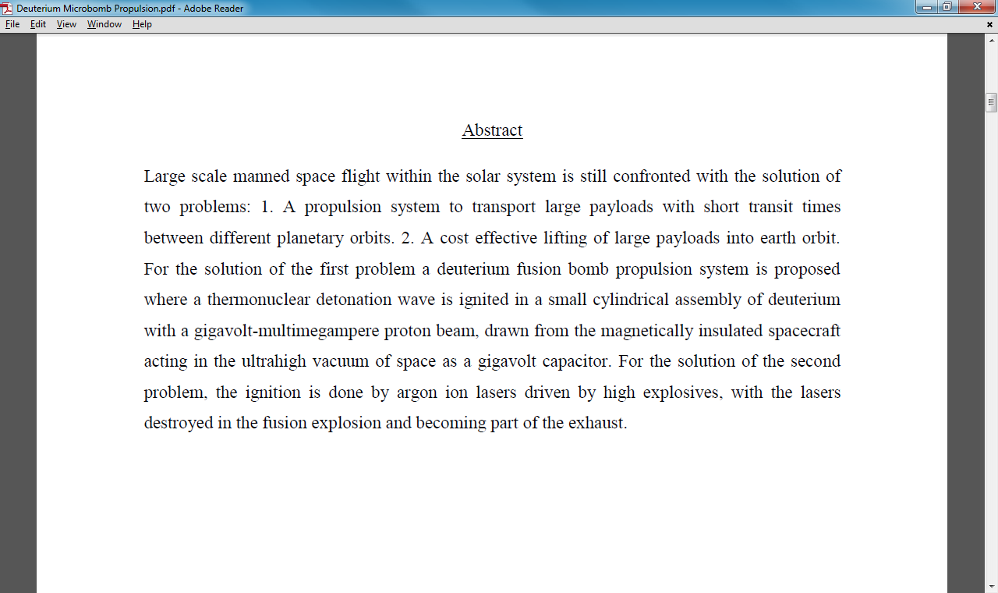
Notes:
Deuterium microbomb rocket propulsion
http://arxiv.org/pdf/0812.0397.pdf

Slide 41

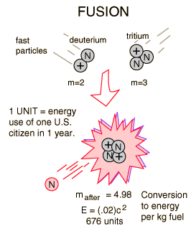
Deuterium-Tritium Fusion
The most promising of the hydrogen fusion reactions which make up the deuterium cycle is the fusion of deuterium and tritium. The reaction yields 17.6 MeV of energy but requires a temperature of approximately 40 million Kelvins to overcome the coulomb barrier and ignite it. The deuterium fuel is abundant, but tritium must be either bred from lithium or gotten in the operation of the deuterium cycle.
Notes:
http://hyperphysics.phy-astr.gsu.edu/hbase/nucene/fusion.html#c2

Slide 42
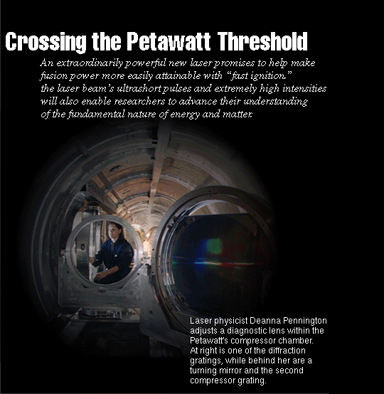
Lasers Enable Fissionless Fusion
Notes:
FOR more than three decades, Lawrence Livermore's Laser Programs have earned a worldwide reputation for pushing the limits of laser technology. But few accomplishments have rivaled the one celebrated in the early morning hours of May 23, 1996, by an exhausted but exuberant crew that just used a revolutionary laser that produced more than a quadrillion watts of energy, a world record.
The extraordinarily powerful laser is called the Petawatt because the prefix "peta" refers to a quadrillion, or 1015. The laser reached a peak of 1.25 petawatts of peak power, about 25% more powerful than expected and more than ten times the peak power of Lawrence Livermore's Nova laser, the world's largest. The historic shots shattered the existing record for laser power (125 trillion watts) by more than a factor of 10, set by Livermore researchers using a Petawatt prototype during the summer of 1995.
Although the shots exceeded by more than 1,200 times the entire electrical generating capacity of the U.S., they lasted less than half a picosecond (a trillionth, or 10⁻¹², of a second). In that exceedingly fleeting moment, nearly 10,000 times shorter than the typical Nova laser shot, only enough energy (about 600 joules) was generated to keep a 100-watt light bulb burning for about 6 seconds.
By crossing the petawatt threshold, the laser heralds a new age in laser research. Lasers that provide a petawatt of power or more in a picosecond may make it possible to achieve fusion using significantly less energy than presently envisioned, through a novel Livermore concept called fast ignition.
https://www.llnl.gov/str/Petawatt.html

Slide 43
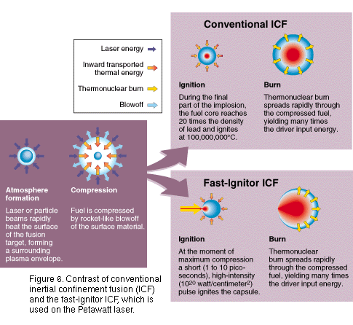
Inertial Confinement Fusion
Notes:
https://www.llnl.gov/str/gifs/Petawatt6.gif

Slide 44
How Were the Twin Towers Destroyed?
Likely Scenario: 35 fissionless fusion mini-nukes placed in each tower.
Larger nukes (fission/fusion devices) in the basements. These went off first.
Devices were timed to explode from top to bottom to simulate a free fall collapse.
The Fast-Ignitor laser triggered mini-nukes blast is NOT spherical; it IS directional
Bombs were configured to explode upward so as not to destroy the device(s) a few floors beneath.
Notes:
http://911u.org/Physics/WTCenergySurplus.html

Slide 45
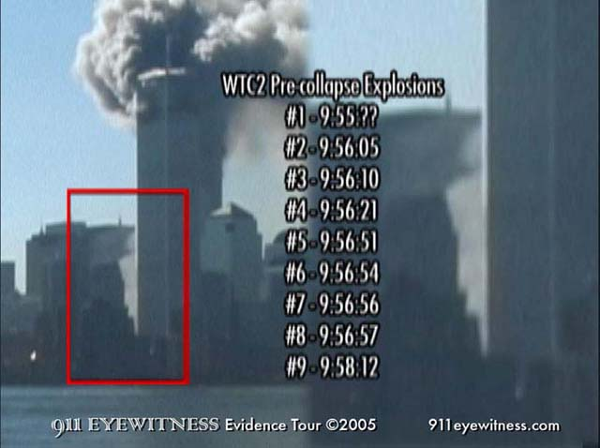
Destruction of WTC2
Notes:
Numerous explosions and corresponding dust clouds were recorded before the South tower fell supporting eyewitness testimony that was "Classified for National Security" and ignored by the 9/11 Commission.
http://www.911eyewitness.com/samples/precollapsenew.php

Slide 46
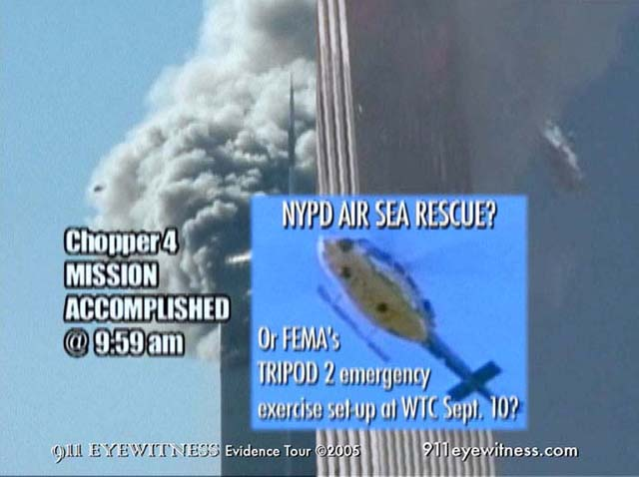
Chopper Spotted Over WTC2 Seconds Before “Collapse”
Notes:
Moments after Rick saw the rescue chopper #4 dropping a line down, the south tower fell into a pile of dust. Did someone set a detonation sequence timer before being picked up from the roof by chopper #4? If the fires were put out, there would be no reason for a symmetrical collapse at freefall speed.
http://www.911eyewitness.com/samples/chopper4split.php

Slide 47
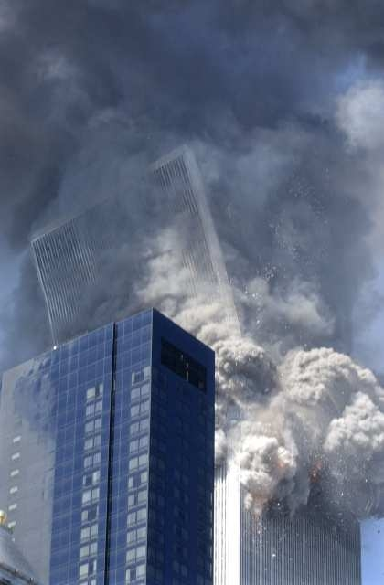
Top 25 Floors Tilt as “Collapse” Begins
Notes:
http://www.bollyn.com/how-thermite-and-explosives-brought-down-wtc-2/

Slide 48
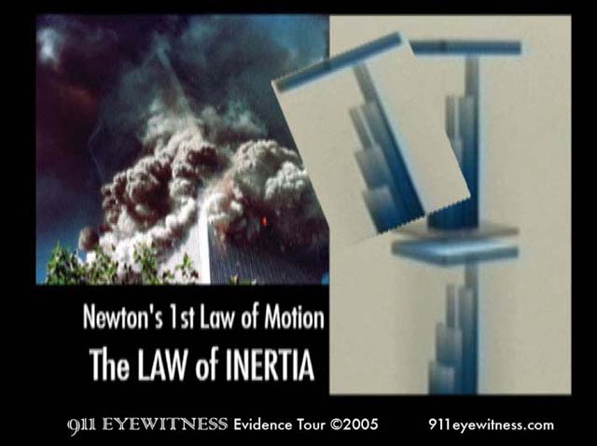
Notes:
According to Newton's 1st law of motion, the Law of Inertia, an object in motion tends to stay in motion with the same speed and same direction unless acted upon by an unbalanced force. Since the intact top section did not fall into the street, the unbalanced force of explosions pulverizing it from the bottom up must be responsible for it's change of motion from tipping sideways to falling straight downward.
http://www.911eyewitness.com/samples/newton1.php

Slide 49
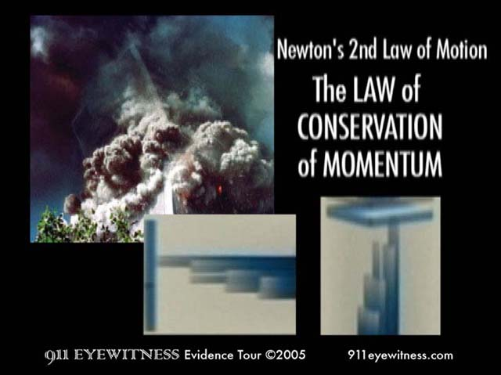
Notes:
A pancake collapse theory violates the laws of science because momentum would not be conserved according to Newton's 2nd law of motion. The tremendous mass of the 25 floor top section tilting at a sharp angle has established a sideways momentum that suddenly disappeared into clouds of pulverized concrete found only in the floors. A large supply of explosive energy would be required to instantaneously pulverize all the concrete.
http://www.911eyewitness.com/samples/newton2.php

Slide 50
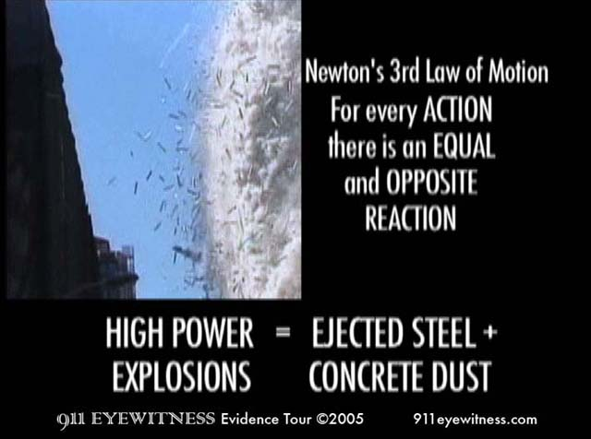
Notes:
Newton's 3rd law of motion states that: For every action, there is and equal and opposite reaction. Therefore the action of high-powered explosions produces the equal and opposite reaction of ejected steel beams and pulverized concrete dust. The cover story of floors pancaking cannot explain the tremendous energy required to shatter the 47 center columns, eject heavy steel debris horizontally and pulverize concrete flooring.
http://www.911eyewitness.com/samples/newton3.php

Slide 51
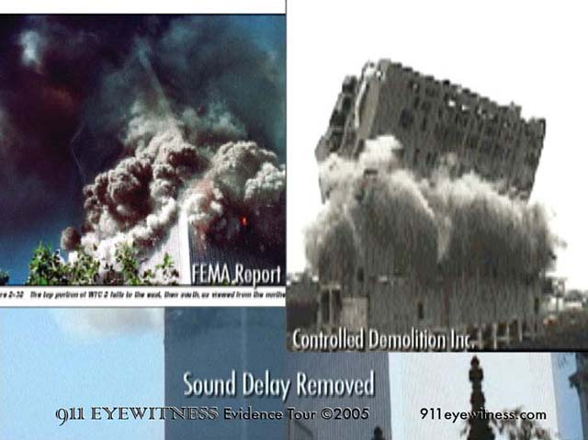
WTC2 Looks Like 1999 Controlled Demolition
Notes:
The top section of the south tower began to lean at a sharp angle early in its implosion. In the seconds that followed, this intact top section turned to dust instead of falling into the street in one large piece. Critics charge implosions always start at the bottom, but this style of mid-level detonation sequence is not uncommon, as seen in Philadelphia in 1999, courtesy of Controlled Demolition Inc.
http://www.911eyewitness.com/samples/south20floors.php

Slide 52
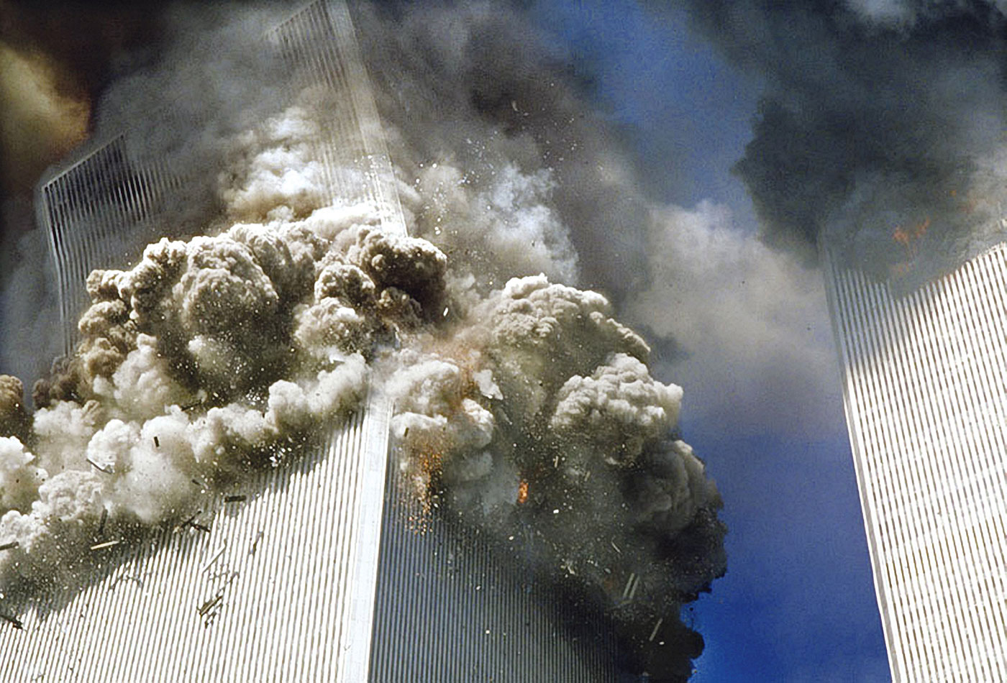
High Powered Explosives Take WTC2 Down
Notes:
http://www.bollyn.com/how-thermite-and-explosives-brought-down-wtc-2/

Slide 53
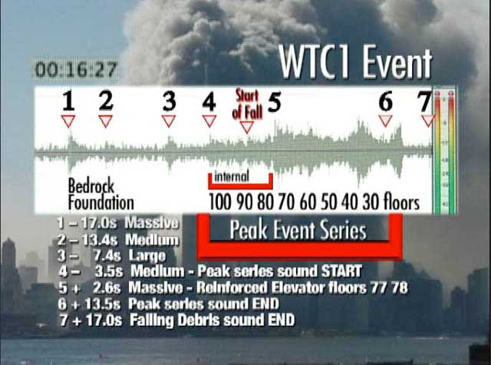
Destruction of WTC1
Notes:
Digital audio analysis clearly shows the sound wave signatures of explosions used in the controlled demolition of the North Tower ­ hard evidence that reveals the official story is a fraud.
http://www.911eyewitness.com/samples/wtc1summary.php

Slide 54
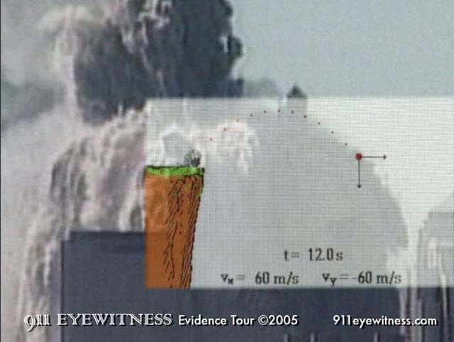
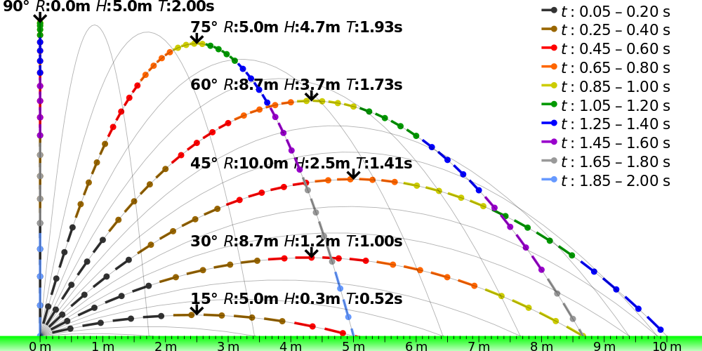
Debris Ejected From WTC1 at 45 Degree angle

Slide 55
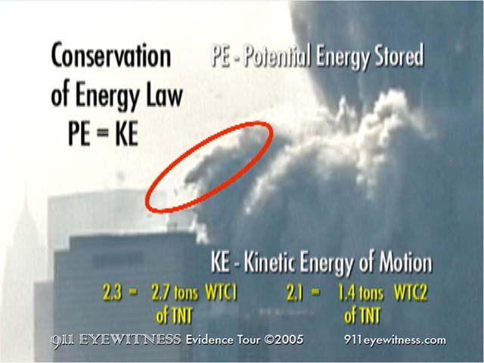
Notes:
Visual evidence of heavy steel framework ejected in an upward parabolic arc from all sides of the north tower, confirms that indeed massive explosions were required to fracture the 47 massive steel columns that made up the center core of both towers. The comet tail of pulverized concrete dust trailing behind the heavy steel is a signature of controlled demolition.
http://www.911eyewitness.com/samples/energy.php

Slide 56
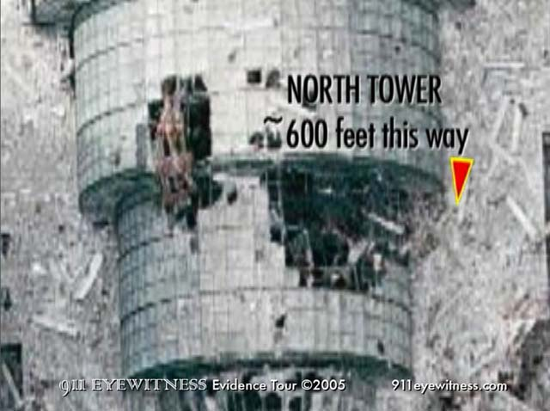
Debris Ejected 600+ Feet Into the Winter Garden

Slide 57
Mini-Nukes are the Dark Secret of 9/11
None of the leaders of the 9/11 Truth Movement advocate the mini-nuke theory.
Most mainstream and alternative media scoff at the mini-nuke theory.
Indeed Steve Jones and Judy Wood flatly deny that mini-nukes were used.
The intel community doesn’t seem too upset about thermite or DEW info getting out.
The public would be outraged if it were widely disseminated that NYC was nuked on 9/11.

Slide 58
Is there a silver lining to 9/11?
Fusion: The New Energy Paradigm

Slide 59
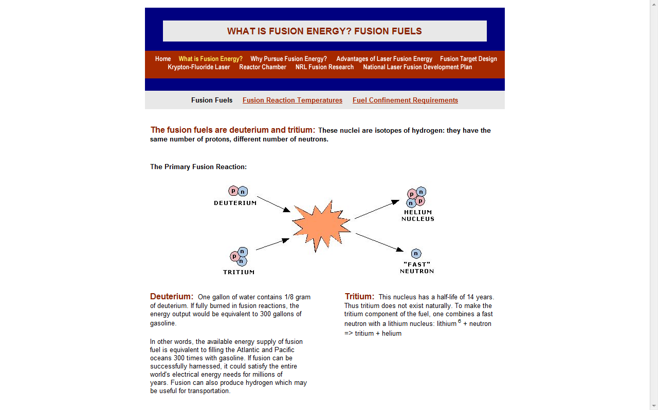
WHAT IS FUSION ENERGY?
Notes:
http://other.nrl.navy.mil/LaserFusionEnergy/fusionfuels.html

Slide 60
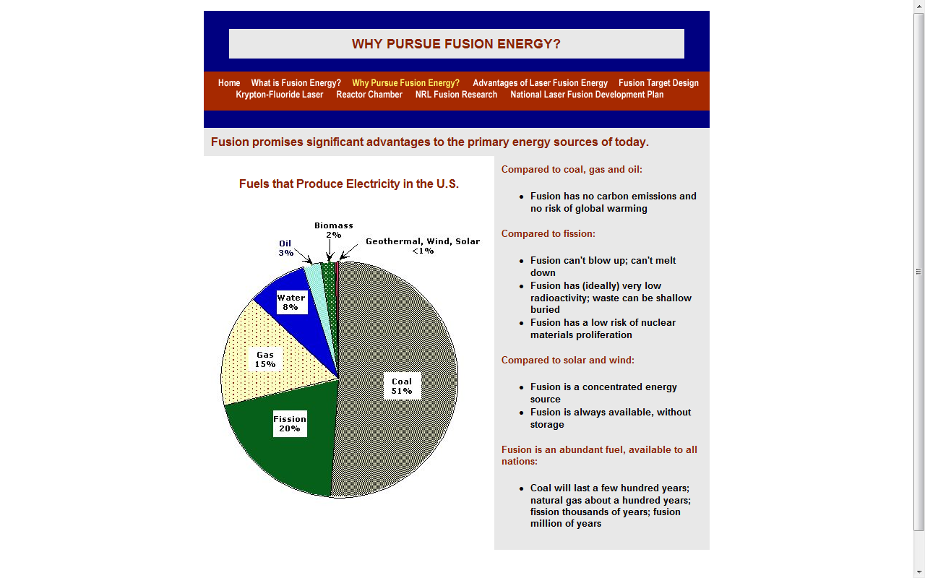
WHY PURSUE FUSION ENERGY?
Notes:
http://other.nrl.navy.mil/LaserFusionEnergy/otherfuels.htm

Slide 61
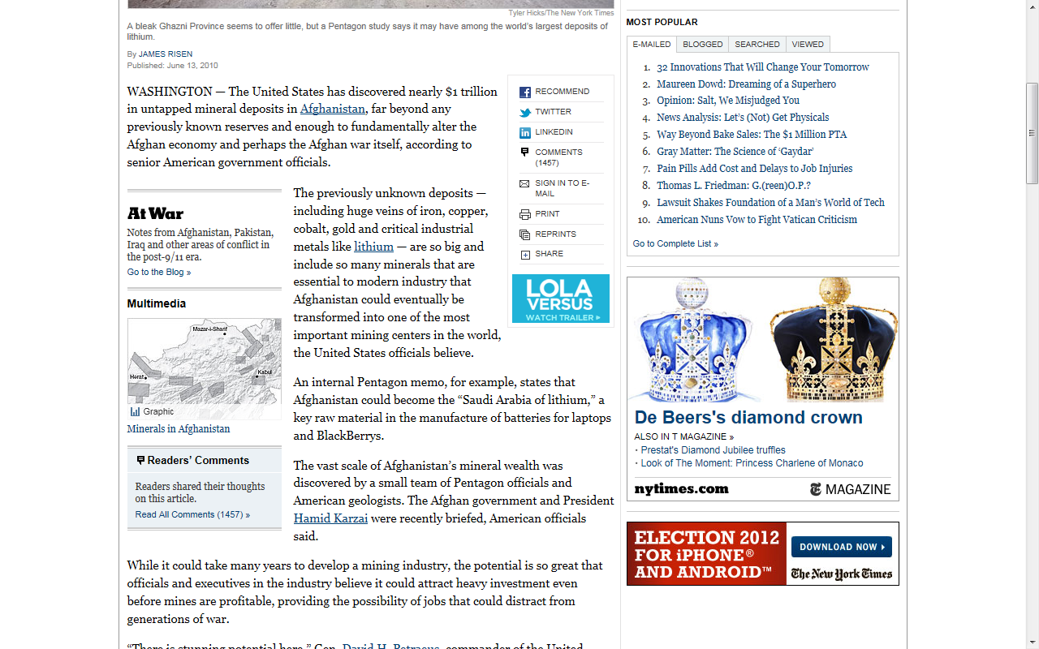
Lithium: Real Reason for Afghan Invasion?
Notes:
http://www.nytimes.com/2010/06/14/world/asia/14minerals.html?_r=1&pagewanted=all

