Slide 1
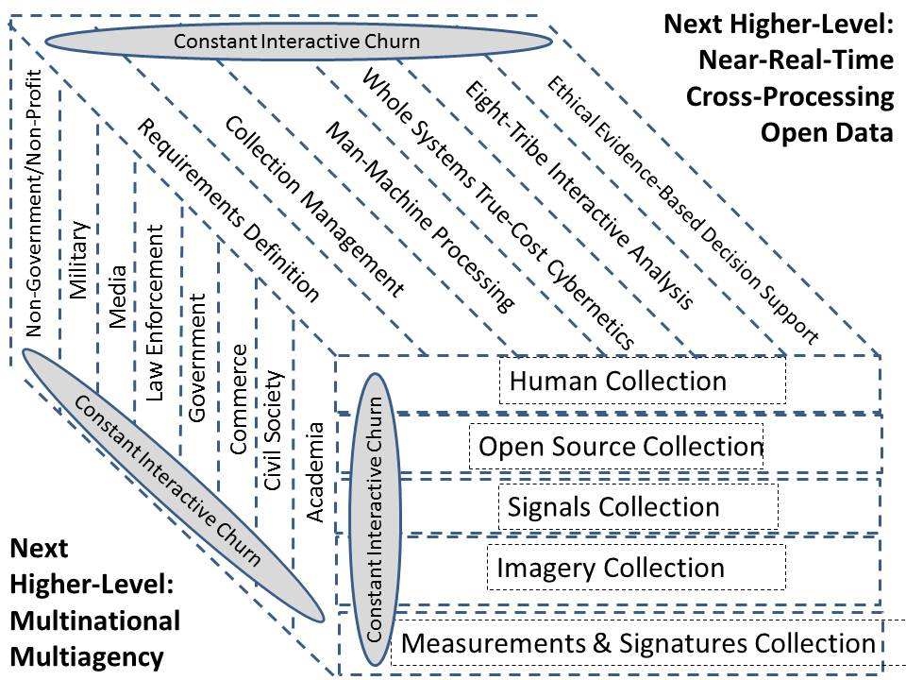
Strategic Intelligence
Far Future
Operational Intelligence
(Whole of Government)
Acquisition Intelligence
(Whole of Government)
Tactical Intelligence
Here & Now

