Slide 1
ON INTELLIGENCE
Overview 2.6
http://tinyurl.com/2013-Steele
Notes:
Note: Words are pro forma. Delivered extemporaneously.
In the next 40 minutes, I will provide an overview of what I have been calling the Third Era of intelligence, the era of Smart Nations, a World Brain, and a Global Game. You can download this briefing, with words in Notes format, at Tiny URL forward slash 2013-Steele, where I have also placed the Workshop briefing and a few other links.

Slide 2
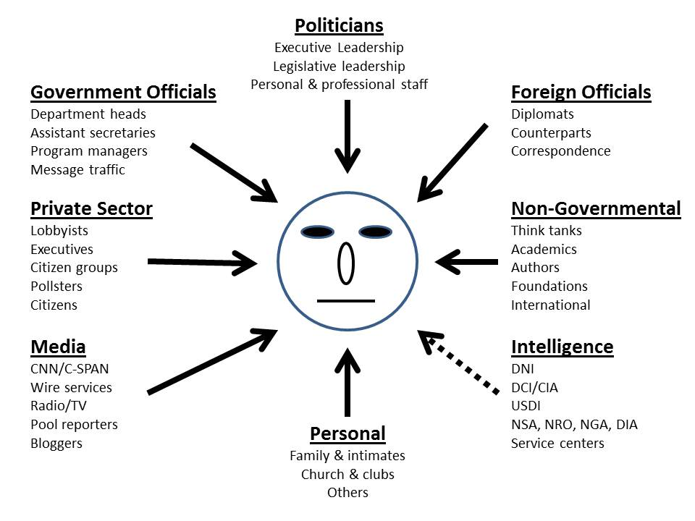
Why Is Intelligence So Feeble? Money, Sex, & Spotlight Trump Secrets
Greg Treverton (1986)
Notes:
The politics of intelligence are a challenge.
Intelligence is the least influential, in part because by virtue of the secrecy it has chosen to maintain, it can be so easily ignored.
Until US intelligence learns how to do public intelligence in the public interest, it will continue to be a sideshow – an expensive sideshow.

Slide 3
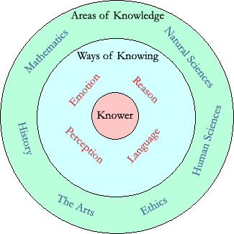
What Is Intelligence? And What Is Intelligence Not?
Intelligence Is:
Actionable Answers
Decision-Support
Evidence-Based
Holistic Process
Intelligence Is Not:
Applied Knowledge
Beliefs in Isolation
Consciousness
Covert Action
Espionage
Secret Information
Wisdom
Intelligence
Knower
Notes:
Intelligence is decision-support. If we are not supporting a specific decision by a specific decision-maker or decision-making group, it is not intelligence, it is information, however classified.
Intelligence as a term can apply to the proven process of creating intelligence, but must be distinguished from these other distracting functions and terms.

Slide 4
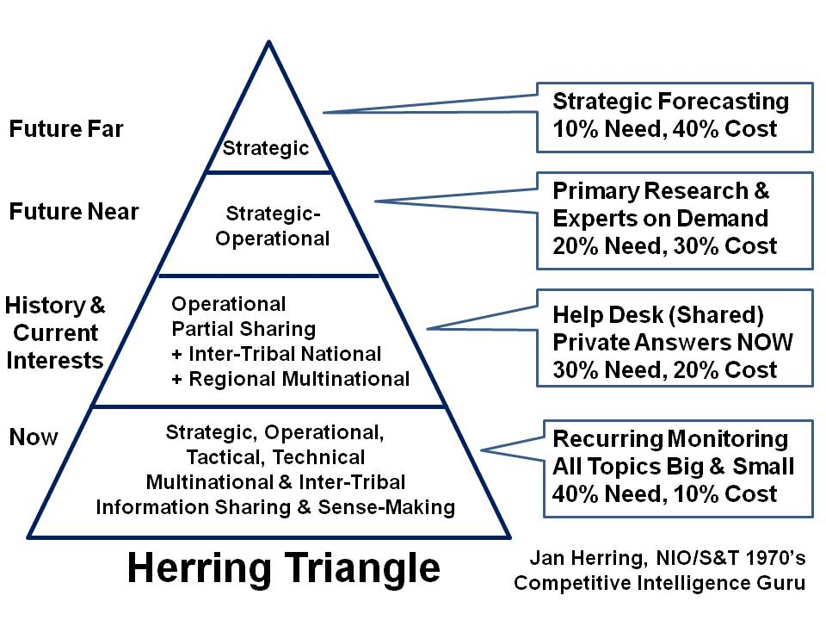
What Form Might Intelligence Be?
Notes:
Most do not execute the proven process of intelligence, or balance resources among four major levels of effort.
This particular concept was developed by Jan Herring, the first National Intelligence Officer for Science & Technology, and it is still, in my view, an essential starting point for both public sector and private sector decision-support.

Slide 5
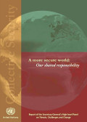
What Threats Should We Consider?
01 Poverty
02 Infectious Disease
03 Environmental Degradation
04 Inter-State Conflict
05 Civil War
06 Genocide
07 Other Atrocities
08 Proliferation
09 Terrorism
10 Transnational Crime
High-Level Panel on Threats, Challenges, & Change (including LtGen Dr. Brent Scowcroft),
A More Secure World: Our Shared Responsibility (United Nations, December 2004)
Notes:
I continue to be troubled by the moral and intellectual shallowness that permits an obsession with inter-state conflict and terrorism, to the exclusion of all else.
This list, in priority order, should be the foundation for intelligence with integrity at every level by every form of organization.

Slide 6
What Strategies & Policies Apply?
01 Agriculture
02 Diplomacy
03 Economy
04 Education
05 Energy
06 Family
07 Health
08 Immigration
09 Justice
10 Security
11 Society
12 Water
Mandate for Change
Various Presidential Transition Teams
Notes:
At the same time, the US Government fails to demand – or create -- ethical evidence-based decision-support for Whole of Government. Key policies are developed in isolation from one another, and within any given department – for example agriculture – many programs can be in direct opposition to one another.
Absent a holistic model that treats true cost economics as a foundation for evaluating returns on investment, we should not expect effective governance.

Slide 7
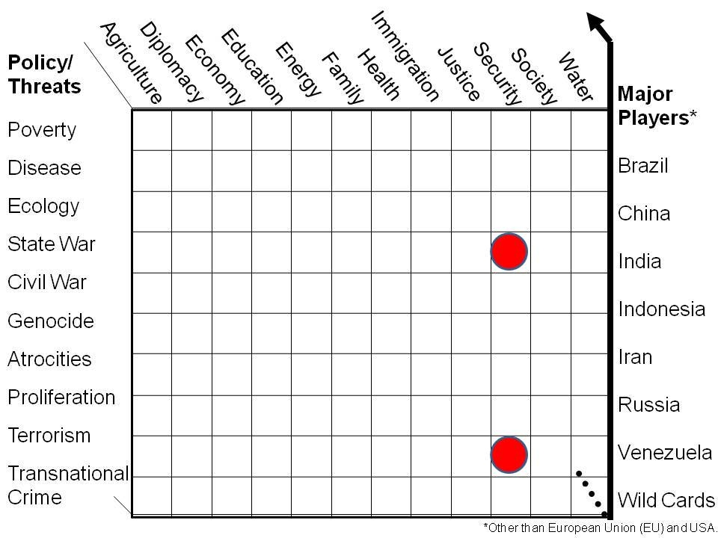
Preliminary Holistic Analytic Model
Core Gaps in Holistic Analysis
Essential to Future-Proofing
What US IC Focuses On..
Nigeria
Notes:
Now we see the threats and the policies together. I not only believe that the US IC must play a forcing function with respect to Whole of Government collection, processing, and analysis, but that the greatest threat to our future lies in the top three non-military threat areas.
These top three threats, across all the policy areas, are how we future-proof cities and states.

Slide 8
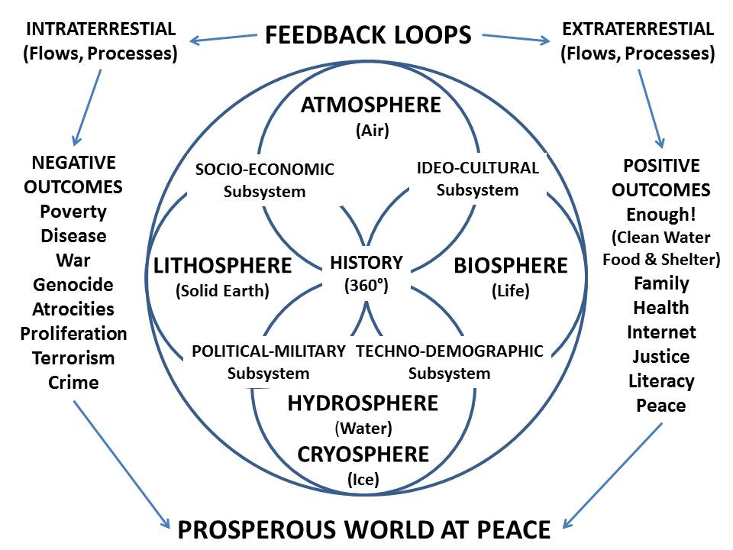
Whole Systems Analytics
Notes:
I completely understand that the US IC refuses to collect on all that it should because it assumes that the consumers of intelligence are responsible for that.
This is an assumption long over-due for termination. It is in my view essential that we recast intelligence as something that is done by both the traditional producers of intelligence and the consumers –and that this all be done in a holistic manner.

Slide 9
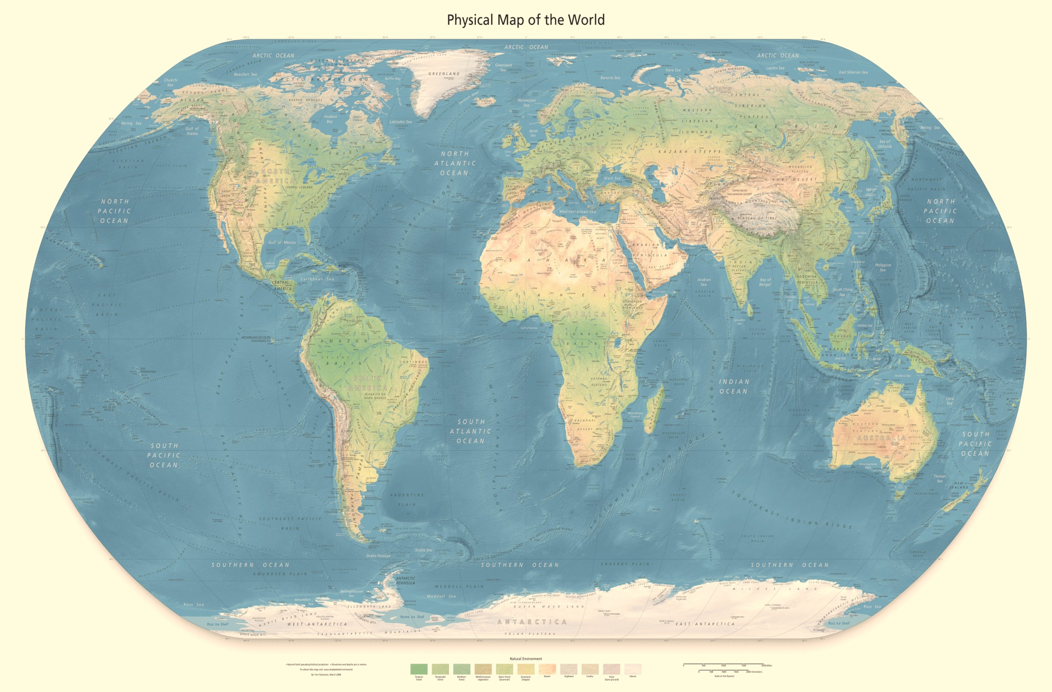
Who Owns the Future? Demography Rules [Minister-Mentor Lee Kuan Yew]
Projected for 2050
India 1.7B
China 1.3B
USA 0.4B
Nigeria 0.4B
Indonesia 0.3B
Pakistan 0.3B
Brazil 0.22B
Bangladesh 0.19B
Philippines 0.15B
Congo DR 0.15B
Ethiopia 0.15B
Mexico 0.14B
Tanzania 0.14B
Russia 0.13B
Egypt 0.12B
Japan 0.11B
Viet-Nam 0.10B
Kenya 0.96B
Uganda 0.94B
Turkey 0.91B
Notes:
The Western Hemisphere has failed to make the most of the time since the end of WWII and the more recent end of the Cold War, a fictional conflict created by the bankers and the arms merchants. Nothing matters more than how we all address the education and health of the global population. Everything is connected, and reality is last at bat.

Slide 10
Utility of Open Sources
Economic and social threats, including 95%
Poverty 99%
Infectious Disease 95%
Environmental Degradation 90%
Interstate conflict 75%
Internal conflict, including 90%
Civil War 85%
Genocide 95%
Other Large-Scale Atrocities 95%
Nuclear, radiological, chemical, and biological WMD 75%
Terrorism 80%
Transnational organized crime 80%
2008 Open Source Intelligence [in Loch Johnson (ed) Strategic Intelligence Vol 2. Chapter 6]
Notes:
In 2004, I used the UN high-level threat panel’s finding, the first-ever consensus list, to speculate on the relative utility of open sources. I continue to marvel that the US refuses to be serious about open sources.*
* No, the OSC is not serious. 100 T-1 lines, and HUMINT took overt human sources away from them. The measure of US IC OSINT is in Global Trends 2030 – junk.

Slide 11
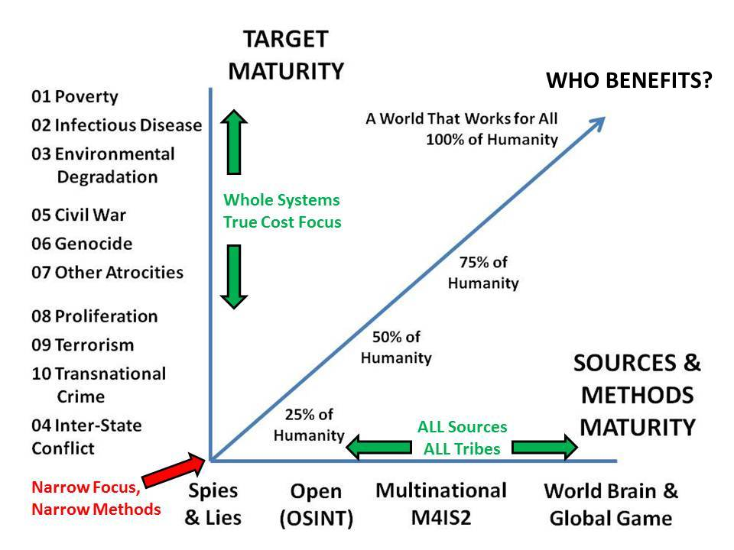
Evolutionary Path for Intelligence
Notes:
This is my most important graphic in the past decade, or so I believe.
You can see where most governments are still positioned, treating intelligence as secrets for the president and generally only in relation to national security writ violent.
It would be so easy – so inexpensive, to run the table out, I am saddened by the inability of our aging intelligence bureaucracies to adapt to new needs.

Slide 12
Understood from 1988 Less Cyber, Cyber Added 1992.
BOTH US IC Leaders and DoD Leaders (Cheney) Refused to Acknowledge
Notes:
In 1992 I developed these four threat classes with the intent of justifying four different intelligence approaches including new capabilities; and also to eventually justify four security forces after next, not just the one size fits all force that we still have today. It takes decades to create and train capabilities suited to each of these threats. In my view, US intelligence has not been effective at influencing strategy, policy, or acquisition, or in supporting operations—it has been sidelined.

Slide 13
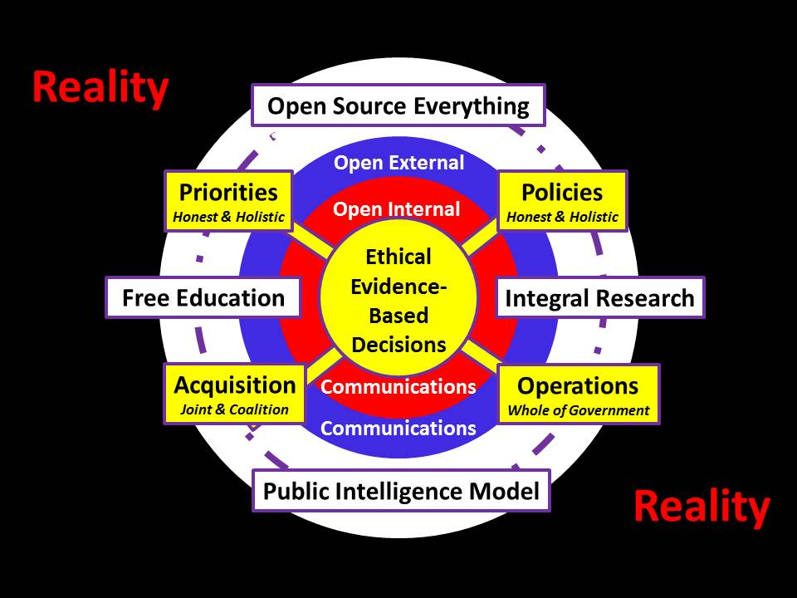
REALITY
Illuminate True Costs
Educate All Publics
REALITY
REALITY
Eradicate Corruption
Harmonize Field Effects
REALITY
Notes:
Intelligence is ethical evidence-based decision-support. Nothing more, and nothing less.
It must be used to support strategic priorities, all manner of policies, all manner of acquisition, and all operations by all parties – field harmonization.
We still need spies and secrecy, but only if rooted in a broad foundation of public intelligence with open communications.

Slide 14
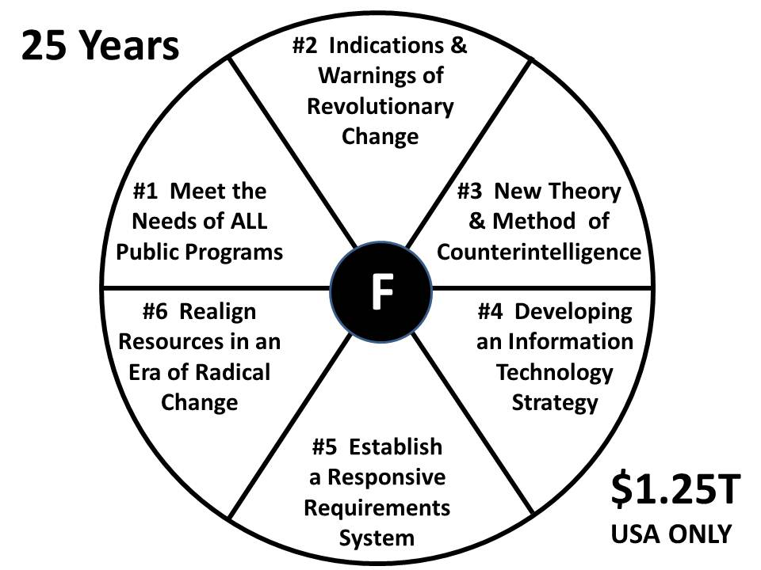
Fundamentals of Intelligence
25 Years – US$1.2 Trillion
Still Do Not Have This!
Whole of Government Decision-Support
Holistic Analytics with True Cost Economics
Counterintelligence on Domestic Enemies
Integrated Scalable IT
Open Requirements Showing Satisfaction & Connecting Clients
Spend with Integrity
Notes:
In 1990, still a government employee, I identified six fundamental challenges that we needed to address if we were to evolve into the 21st Century. We still do not have solutions for all six of these challenges today.
Speaking only of the US secret world, I see $1.25 trillion dollars wasted, on top of which we have another $10-15 trillion in elective wars and other high crimes – assassination by drone stands out.

Slide 15
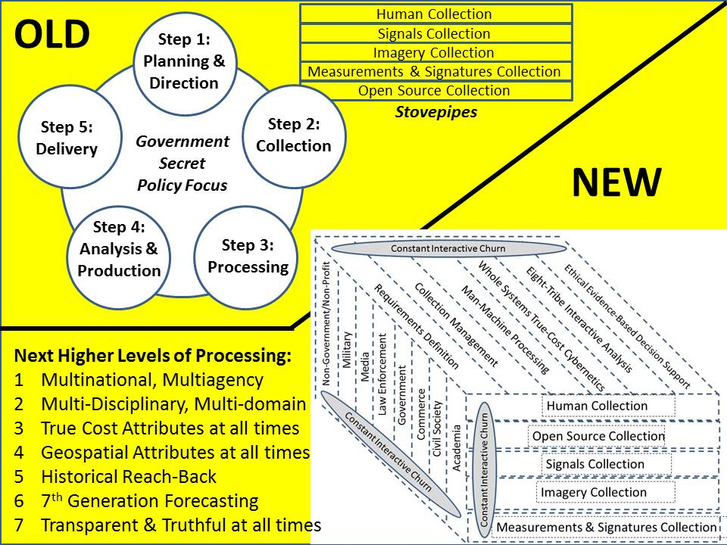
Notes:
In the US system, Cabinet officials and Congress represent the recipients of taxpayer revenue, not the citizens themselves. The Office of Management and Budget does not manage anything at all, and such policies as we have are generally isolated, incomplete, bespoke, often in conflict with one another, and expensive in their ignorance.
Here I show my proposed new form of Whole of Government intelligence.

Slide 16
Long Term (100 Years)
STRATEGIC
Poverty
Infectious Disease
Environmental Degradation
Inter-State Conflict
Civil War
Genocide
Other Atrocities
Proliferation
Terrorism
Transnational Crime
Agriculture
Diplomacy
Economy
Education
Energy
Family
Health
Immigration
Justice
Security
Society
Water
50 Years Out
TECHNICAL
25 Years Out
President
Vice President
State
Treasury
Defense
Justice
Interior
Agriculture
Commerce
Labor
Health & Human Services
Housing & Urban Development
Transportation
Energy
Education
Veterans Affairs
Homeland Security
Environmental Protection Agency**
Office of Management & Budget**
US Trade Representative**
US Ambassador to the UN**
Council of Economic Advisors**
Small Business Administration**
12 Years Out
Whole of Government Institutions*
Cross-Cutting Threats & Policies
1 Year Out
90 Days Out
OPERATIONAL
72 Hours Out
* In Order of Secession to Presidency
** Cabinet Rank Not In Succession
TACTICAL
Imminent
Notes:
This is another way of looking at the holistic nature of intelligence in the 21st Century, but here I add the dimension of time.
Any intelligence community that cannot help shape decisions in the moment and also 100 years out, is not worthy of the scarce resources being assigned to its function.

Slide 17
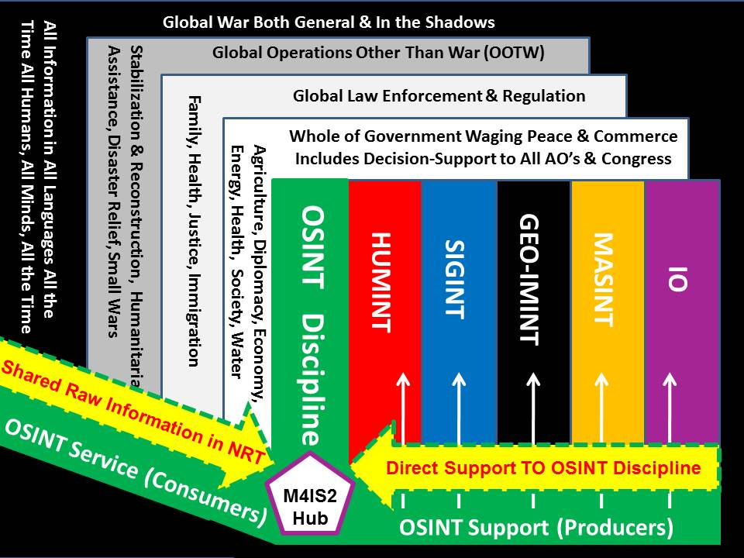
Full-Spectrum Intelligence
Notes:
In the ideal, all of our intelligence disciplines should be working together and providing decision support to all of our whole of government mission areas.
Among them, open source intelligence, a twin to human intelligence, offers the most promise, while the technical disciplines fight tooth and nail to remain retarded.
It is in this context that I have high hopes for M4IS2 – Multinational intelligence.

Slide 18
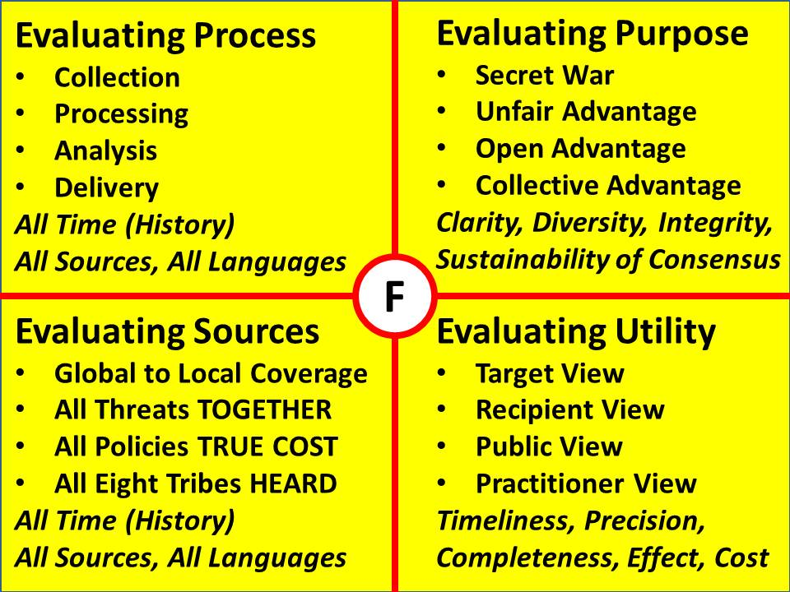
Notes:
In my view, this graphic captures what we should be doing but do not do. If we are to be successful intelligence professionals in the 21st Century, this is our starting point….the truth at any cost lowers all other costs.
I simply do not see any of this happening within the US Intelligence Community. They are slaves to money and not even remotely close to the truth or being free.

Slide 19
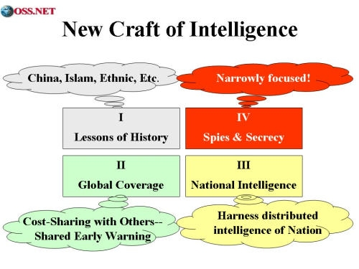
Context & Process for Intelligence
Notes:
Energized by NATO, and by my continuing relationship with the Strategic Studies Institute of the US Army, I developed a monograph and then a book on the new craft of intelligence in 2002.
These are such simple sensible concepts, one must conclude that anyone rejecting them is doing so not on their merits, but rather on the basis of another agenda far removed from the public interest.

Slide 20
Notes:
I created this graphic a decade ago, and I fear it is not yet appreciated. It is the first graphic in my chapter, “The Evolving Craft of Intelligence,” in the Routledge Companion book coming out in August.
In this context, secret intelligence for the top-down unilateral approach is vastly less important than public intelligence that can inspire bottom-up multi-lateral consensus harmonizing the spending and behavior of larger coalitions, both preventive and reactive.

Slide 21
Government
Law Enforcement
Secret Internal
Secret Shared
Sensitive Shared
Military
Business
Open (Public)
Information
Commons
Green
Media
Non-Profit
Yellow
Orange
Red
Academia
Civil Societies
Notes:
There are eight tribes of intelligence; it is not possible to be fully effective without harnessing the distributed intelligence of all eight of these tribes. The government is the most ignorant and least flexible of the eight tribes.
All tribes have secrets. Where we have failed terribly is in ensuring that we can all share the majority of the information that is not secret.

Slide 22
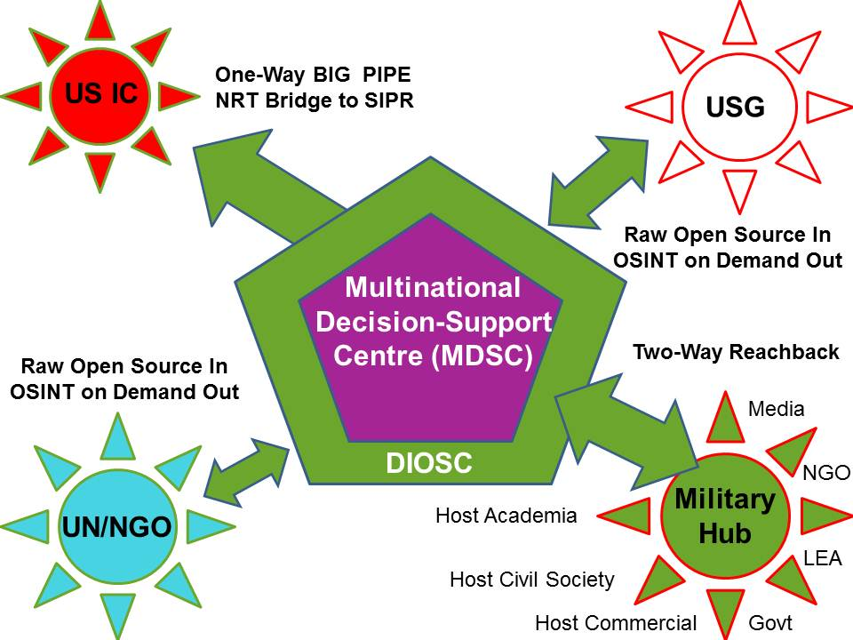
Multinational - Strategic
Notes:
This is the vision I briefed to the Coalition Coordination Center (CCC) in Tampa in 2006. What they did for logistics we need to do for intelligence. There are four special relationships depicted here.
Perhaps most important is the use of national militaries as the C4I hubs for interlocking reach-back into the eight tribes of each respective nation.
Reciprocity will be vital across this scheme.

Slide 23
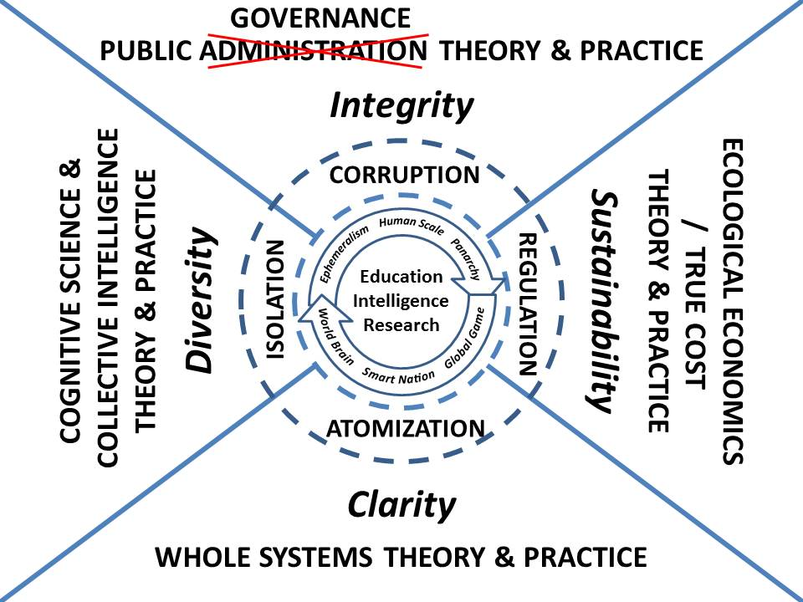
Notes:
In 2010 I supported a UNESCO project on governing water, and also did my book INTELLIGENCE for EARTH: Clarity, Diversity, Integrity, & Sustainability. This graphic shows the larger context for intelligence. Decision-support is needed for hybrid governance, for establishing consensus across all boundaries while fully developing whole systems analytic models and embracing true cost economics as a foundation for ground truth. Down the road I wish to fully integrate education, intelligence, and research. That is a strategic vision.

Slide 24
Notes:
China has already taken steps to convert those that wish to the yuan as a reserve currency, and to also offer an alternative to the SWIFT banking system that has been turned against Iran, very unwisely in my view. I believe the time has come for the eight greater demographics to test a new multinational information-sharing and sense-making toward their mutual benefit. In each region of the world, ethical evidence-based decision support is the best tool for creating peace & prosperity.

Slide 25
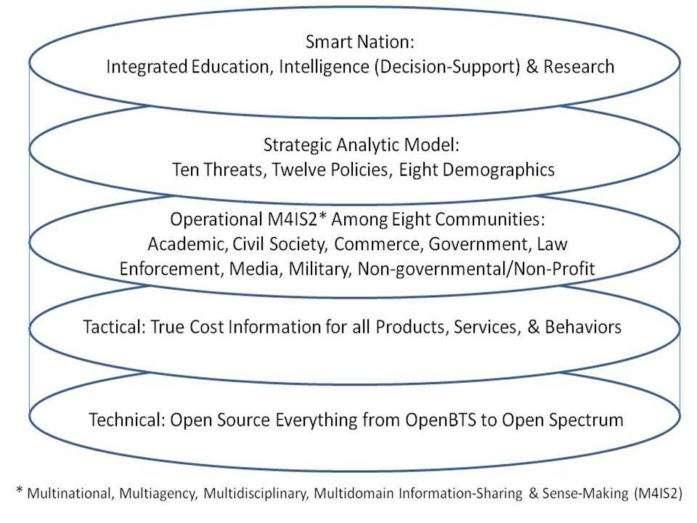
Technology Architecture
Notes:
This graphic pulls it all together. It is possible, in the astonishingly near future, to create Smart Nations, a World Brain, a Global Game, and with this architecture, harness the distributed intelligence of the Whole Earth.
For an early glimpse of what is possible, visit Crisis Mappers and see what they are doing with SMS messages, diaspora translations and map plotting, and the integration of various open source apps.

Slide 26
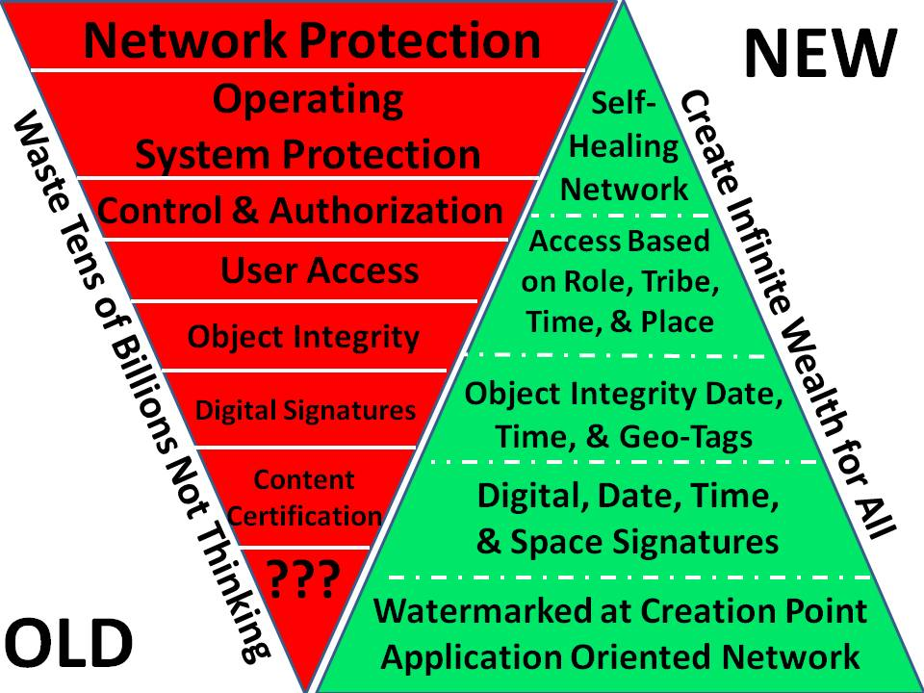
Notes:
I regret to say that my warning letter to the White House in 1994 made no impression on the US Government.
Everything we are doing in cyber-security today is wrong. I strongly recommend that Brazil, China, India, and Russia, among others, lead the development of a completely new global information infrastructure….at the same time, the Autonomous Internet is emergent outside of state or corporate control.

Slide 27
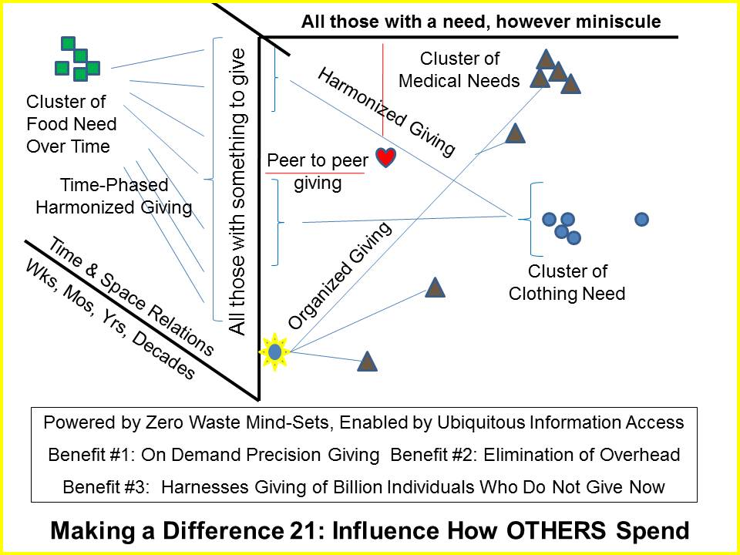
Local to Global Range of Needs Table
Notes:
This may be my most subversive graphic. If implemented, it does three things:
01 Explodes giving from the one billion rich, 80% of whom do not give now
02 Collapses the current archipelago of inefficient and dishonest aid schemes by holding them accountable in detail
03 Dramatically increases the efficiency of all coming together with ENOUGH at the household level of resilience.

Slide 28
Notes:
With or without the United Nations, Brazil, China, India, and Russia, among others, can create a World Brain and an open source everything (OSE) global information technology network that harmonizes how we all spend, invest, and behave into the future. The wasteful practices of the USA must not be replicated; the US approach to energy must not be followed. We can do so much better working on the basis of ethical evidence-based decision-support.

Slide 29
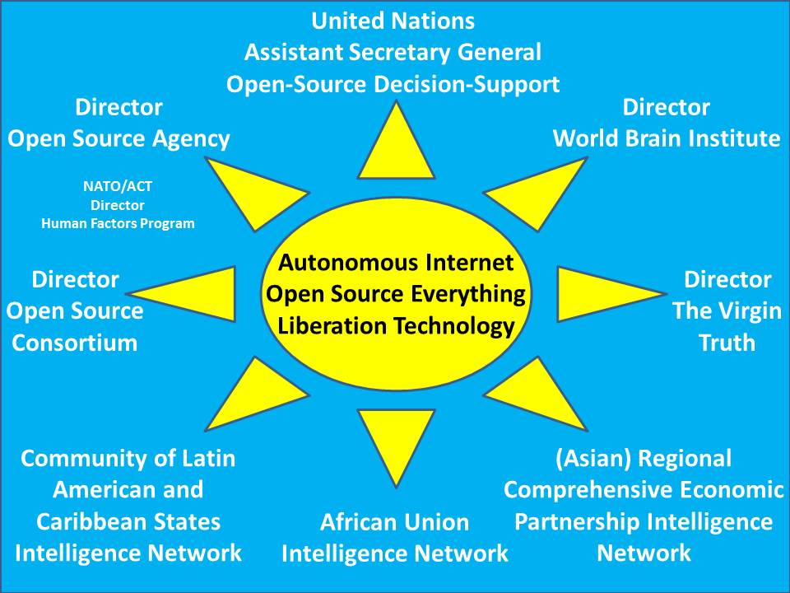
Notes:
With or without the United Nations I believe that among themselves, Brazil, China, India, and Russia, among others, should find $3 billion a year to fund the Open Source Agency (OSA) as a global asset, but accountable to all nations and all peoples, not controlled by the USA nor being a largely ineffective UN agency. Here I depict various potential elements for a new World Brain that provides every human with Internet access and a free education for life.

Slide 30
The truth at any cost lowers all other costs.
BE the Force!
Notes:
We now have 40 minutes for dialog. My record is 8 hours and 1 minute at Hackers on Planet Earth in 2012, but here and now, we have 40 minutes. I am also offering a round-table tonight, for two hours or more, in which I will present another 40 graphics for more careful discussion. Both this overview and the workshop briefings are posted to TinyURL forward slash 2013-Steele. Thank you again for your attention to my thoughts on the future.

