Slide 1
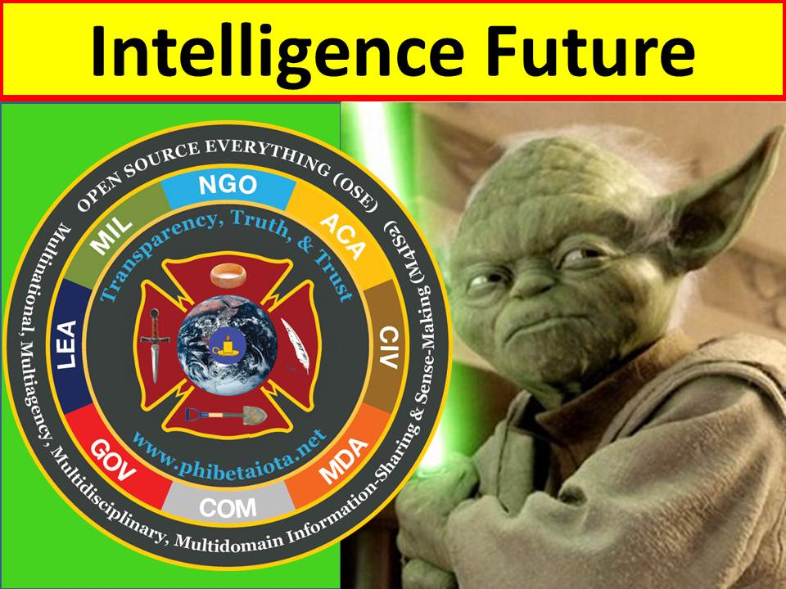
ON INTELLIGENCE
Workshop 2.6
http://tinyurl.com/2013-Steele
Notes:
Note: Words are pro forma. Delivered extemporaneously.
You can download this briefing, with words in Notes format, at Tiny URL forward slash 2013-Steele, where I have also placed the Overview briefing and a few other links.

Slide 2
ON INTELLIGENCE:
Whole of Government, Whole Earth,
NATO, SOF, & Doing the Right Thing
A discourse rooted entirely in my personal experience since 1976 (strategy, policy, acquisition, operations, & intelligence).
Robert David STEELE Vivas
Earth Intelligence Network, Phi Beta Iota Public Intelligence Blog
The Truth at Any Cost Reduces All Other Costs.
Notes:
Most of my views were developed and published in 1988-1994 but have been ignored. Now we have a new generation of leaders rising, bloodied by a ten year multi-trillion dollar war justified on the basis of 935 now-documented lies.
I believe they – and the young people coming into employment – thirst for truth, to the point that I am now refering to “Generation Truth.”

Slide 3
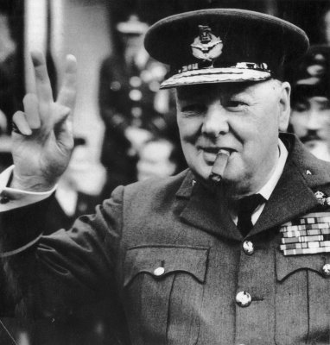
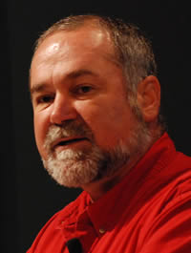
The Americans always do the right thing..….
they just try everything else first.
Sadly, we must never, ever, [ever] underestimate the capacity of the Americans to think of new wrong things to try before they might get it right.
Notes:
PAUSE. I fear the US will not make any useful changes in the next four years – perhaps even the next eight.
I plan to work for 20 more years, but my challenge is to find a government, international organization, or university that actually wants to implement my ideas.
Meanwhile, do not underestimate the Americans – they have a gift for discovering new ways to be wrong.

Slide 4
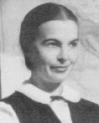
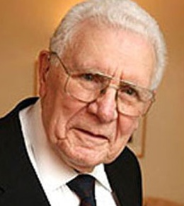
On the Shoulders of Others
(There is a need) to recognize that just as the essence of knowledge is not as split up into academic disciplines as it is in our academic universe, so can intelligence not be set apart from statecraft and society, or subdivided into elements...such as analysis and estimates, counter intelligence, clandestine collection, covert action, and so forth.
Rather … intelligence is a scheme of things entire. (Bozeman 1998: 177).
The intelligence institutions have neglected support of judgment. This is partly due to being disinvited to help shape the sovereign’s judgment, but also partly due to mistaking who the sovereign has become. The people’s judgment is now being poisoned by ideologues who have filled the void.
The situation is not honestly and soberly appreciated. Societal sense-making suffers due to the failure of the intelligence function and the craft to support it. (Senior US serving officer, 2012)
Reformations and transformations are not the same thing. Reformations are concerned with changing the means systems employ to pursue their objectives. Transformations involve changes in the objectives they pursue. (Ackoff, 2004)
Notes:
It has been my good fortune to combine a diversity of experience with a wealth of learning from others. Will Durant continues to be my primary mentor. Here I simply want to highlight three others; Ada Bozeman, a serving senior officer, and Russell Ackoff.
PAUSE. We are fragmented; we have lost our integrity; and we are still making changes on the margin instead of transforming toward doing the right thing.

Slide 5
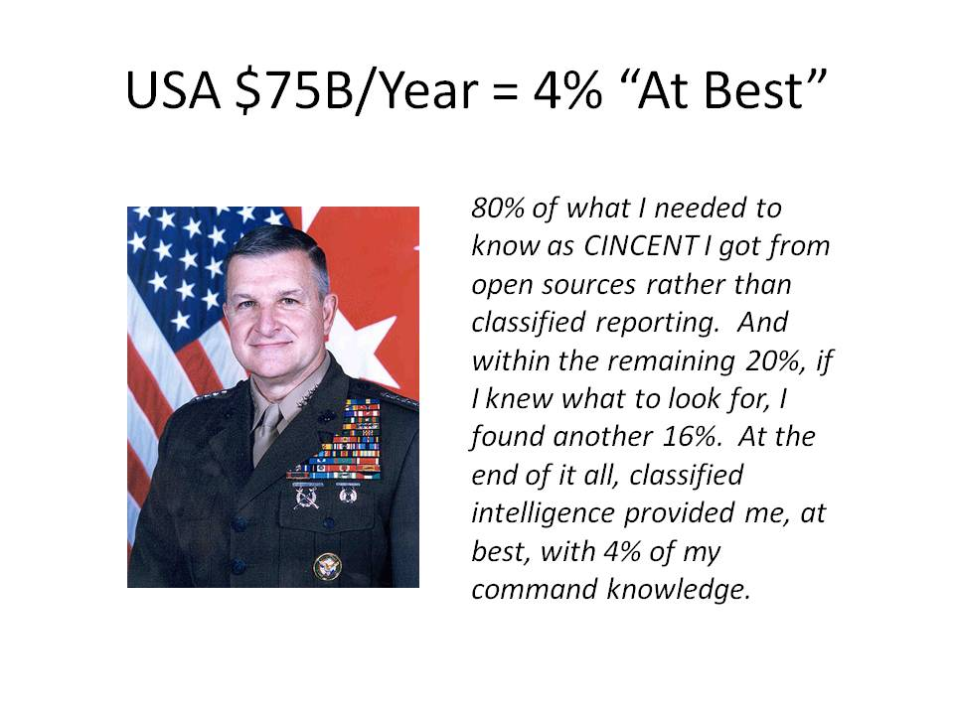
Notes:
This is reality. In fact-checking this quote for my next book I received an email that said that the original exchange with the J-2 determined that only 20% of everything the J-2 touched was secret; and that within that 20%, only 20% again was truly unique to the secret world.
4% at best from the secret world, and I venture to say, 10-15% at best from what passes for an open source world.

Slide 6
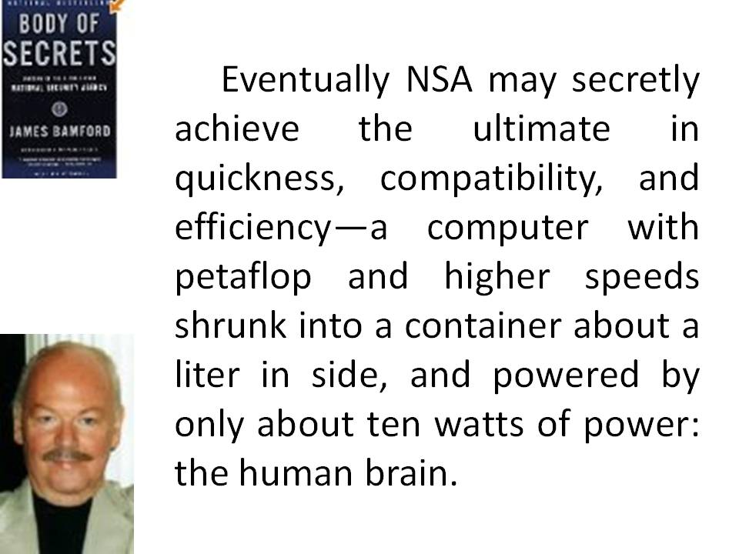
Notes:
This is the concluding sentence of Jim Bamford’s book Body of Secrets. I share with Sir David Omand the view that Human Intelligence (HUMINT) is central to all that we do.
We must broaden and deepen HUMINT while putting technical intelligence in its place, which is to say, do not collect what you cannot process, focus the processing on what the human analysts need. Just in time collection, processing, and analysis is an inherently human function.

Slide 7

Open Source Security
Imagine global security driven by collaboration -- among agencies, government, the private sector and the public. That's not just the distant hope of open-source fans, it's the vision of James Stavridis, a highly accomplished Navy Admiral. Stavridis shares vivid moments from recent military history to explain why security of the future should be built with bridges rather than walls.
What will 21st-century security look like? Navy Admiral James Stavridis suggests that dialogue and openness will be the game-changers.
We must build bridges. Sharing information is how we connect everything.
Admiral James G. Stavridis, USN
Former NATO SACEUR
Notes:
Alvin Toffler recommended me to NATO in 2000 when they could not afford him.
He believes, as Admiral Stavrides and I both believe, that information is a substitute for violence and a means of creating infinite wealth.
War is only profitable for bankers. It is not profitable for nations or peoples. NATO has a new commander, a moral man I am told, perhaps he will attend to these views.

Slide 8
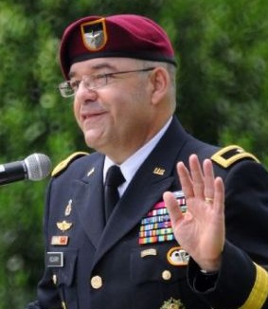
First Active Duty Civil Affairs Colonel to make flag since WWII
First Commanding Officer of the first US Army Civil Affairs Brigade since WWII
Earned Executive Agency for the Joint Civil Affairs Information Management System
Positioned to nurture White SOF to co-equal status with Black SOF, a vision articulated by General Peter Schoomaker, USA, then CINCSOC (1997)
LACKING: USG Whole of Government PPBS and global whole systems analytic model
Brigadier General Ferdinand Irizarry II
Deputy Commanding General
USAJFK Special Warfare Center and School
Notes:
Elsewhere, amidst some grave shortfalls in both intelligence and integrity across our senior leaders, both uniformed and civilian these past 12 years, there are those – such as Admiral Stavrides and his successor General Breedlove – and the officer shown here – BGen Ferd Irizarry, who may lead Special Operations (White) into the future – whom I would follow anywhere. Between NATO and SOF White, we have an opening for doing the right thing.

Slide 9
ON INTELLIGENCE
Theory of Intelligence
To what end?
Notes:
With due regard for earlier efforts to address the theory of intelligence, I suggest that the fundamental question has yet to be asked.
To what end do we “do” intelligence?
What is the purpose of intelligence?

Slide 10
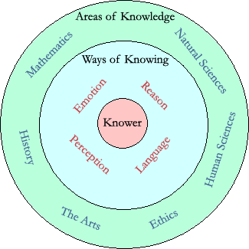
Theory of Intelligence I
Theory of Knowledge (Epistemology)
Intelligence Is:
Actionable Answers
Decision-Support
Evidence-Based
Holistic Process
Intelligence Is Not:
Applied Knowledge
Beliefs in Isolation
Consciousness
Covert Action
Espionage
Secret Information
Wisdom
Notes:
I will not be waxing eloquent – epistemology is my only big word today.
This is my view. We have lost ourselves in the process, while being blind to the vast majority of the sources & methods, because secrecy has destroyed accountability and perpetuated systems whose primary value is pork – corruption.
In my view, intelligence is about the creation of ethical evidence-based decision-support. Nothing more – or less.

Slide 11
Theory of Intelligence II
Purpose, Not Process
Intelligence should not be defined by Inputs
Requirements
Sources
Processing
Analysis
Production
Covert Action
Being Wrong
Intelligence should be defined by Outputs.
Answers to Specific Questions
Appraisals of Specific Situations
Forecasts of Specific Factors in Context
Being Right
Notes:
Put most succinctly, intelligence must be defined by its outputs, not by its inputs.
In the American system, people get promoted for spending money and hiring more people. They do not get promoted for doing more with less and no one is penalized for getting it wrong. Thomas Drake has it right – the American secret world is about moving money, it is not about producing intelligence.

Slide 12
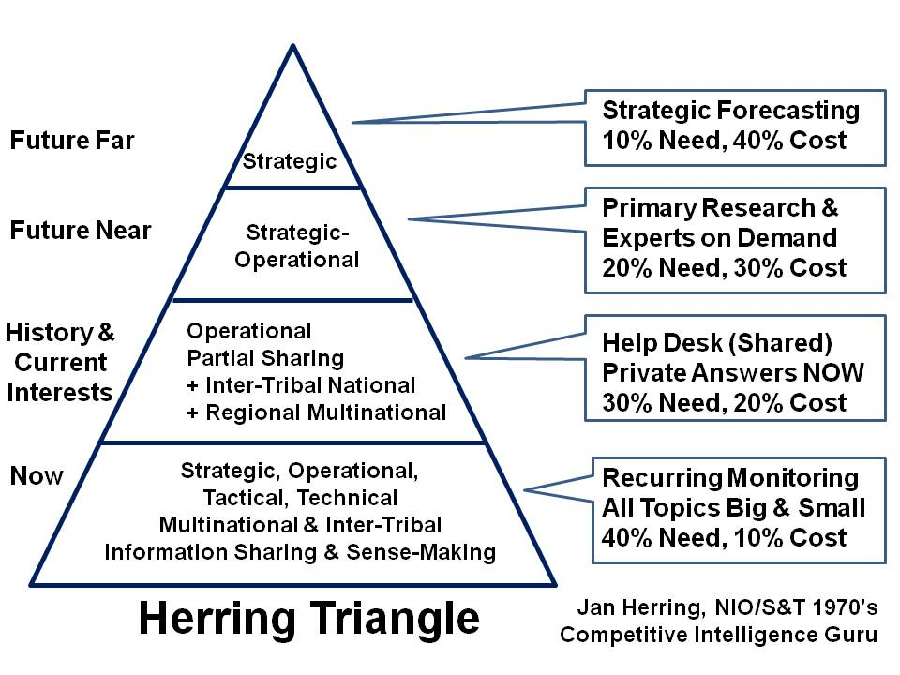
What Form Might Intelligence Be?
Notes:
Most do not execute the proven process of intelligence, or balance resources among four major levels of effort.
This particular concept was developed by Jan Herring, the first National Intelligence Officer for Science & Technology, and it is still, in my view, an essential starting point for both public sector and private sector decision-support.

Slide 13
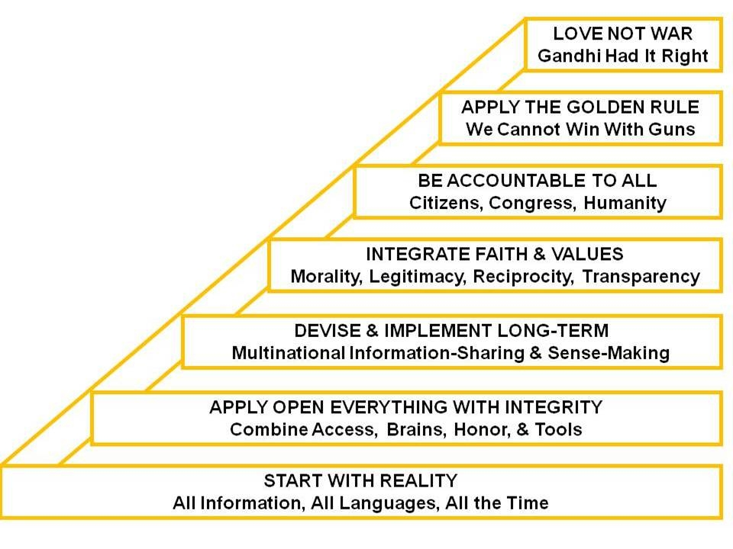
Intelligence for Peace & Prosperity
Notes:
Here I place intelligence – and particularly open source intelligence – in the proper moral and political context of long-term accountability and legitimacy.
Intelligence – decision-support – is something that we all require. For the US national intelligence community to continue to ignore their responsibility to adapt to the demands and the possibilities of the new era is – in my view – a persistent betrayal of the public trust.

Slide 14
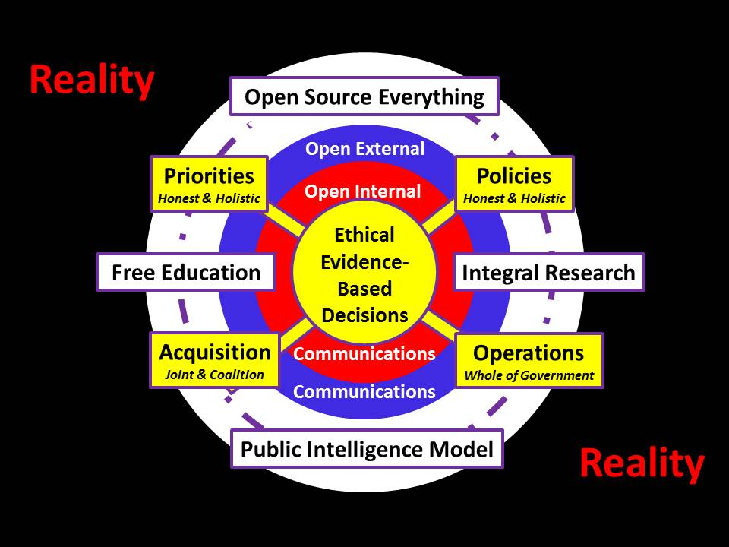
Illuminate True Costs
Educate All Publics
Eradicate Corruption
Harmonize Field Effects
Notes:
Intelligence is ethical evidence-based decision-support. Nothing more, and nothing less.
It must be used to support strategic priorities, all manner of policies, all manner of acquisition, and all operations by all parties – field harmonization.
We still need spies and secrecy, but only if rooted in a broad foundation of public intelligence with open communications.

Slide 15
ON INTELLIGENCE
Strategic Intelligence
For future generations…
Notes:
Colin Gray remains my touchstone for strategic thinking along with the usual suspects from the past. What I especially admire about Colin is his grasp of time – the one strategic variable that can not be bought nor replaced.

Slide 16
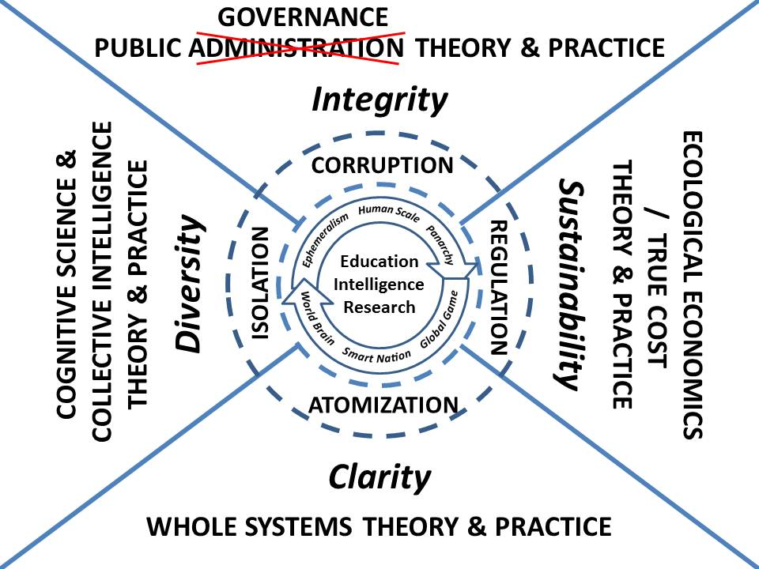
Notes:
In 2010 I supported a UNESCO project on governing water, and also did my book INTELLIGENCE for EARTH: Clarity, Diversity, Integrity, & Sustainability. This graphic shows the larger context for intelligence. Decision-support is needed for hybrid governance, for establishing consensus across all boundaries while fully developing whole systems analytic models and embracing true cost economics as a foundation for ground truth. Down the road I wish to fully integrate education, intelligence, and research. That is a strategic vision.

Slide 17
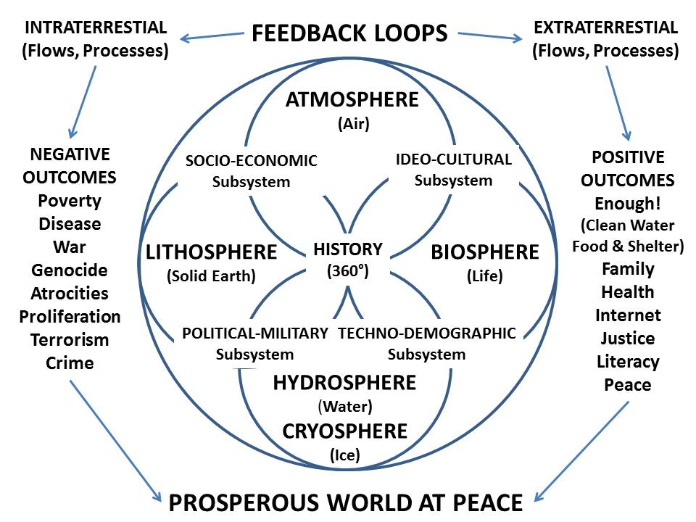
Whole Systems Analytics
Notes:
I completely understand that the US IC refuses to collect on all that it should because it assumes that the consumers of intelligence are responsible for that.
This is an assumption long over-due for termination. It is in my view essential that we recast intelligence as something that is done by both the traditional producers of intelligence and the consumers –and that this all be done in a holistic manner.

Slide 18
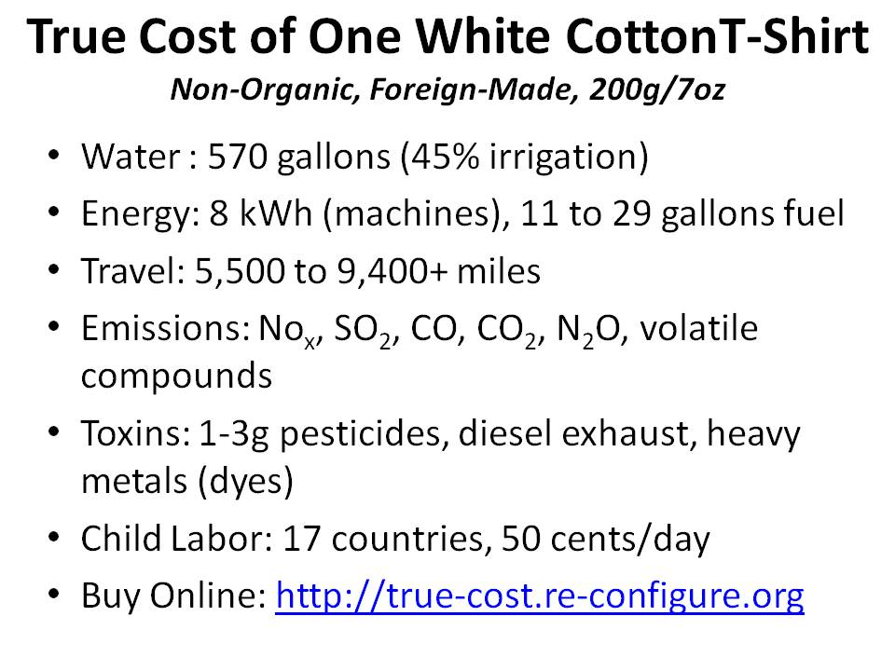
Notes:
My colleague Dr. Herman Daly has done more than any other to properly articulate the importance of true cost economics. I hope he is honored with a Nobel in his lifetime.
It took one of my most persistent associates a full year to document what you see here. Others have done similar work for other products, services, and behaviors. It is now possible to buy a single fish whose life history is online.

Slide 19

What Threats Should We Consider?
01 Poverty
02 Infectious Disease
03 Environmental Degradation
04 Inter-State Conflict
05 Civil War
06 Genocide
07 Other Atrocities
08 Proliferation
09 Terrorism
10 Transnational Crime
High-Level Panel on Threats, Challenges, & Change (including LtGen Dr. Brent Scowcroft),
A More Secure World: Our Shared Responsibility (United Nations, December 2004)
Notes:
I continue to be troubled by the moral and intellectual shallowness that permits an obsession with inter-state conflict and terrorism, to the exclusion of all else.
This list, in priority order, should be the foundation for intelligence with integrity at every level by every form of organization.

Slide 20
What Strategies & Policies Apply?
01 Agriculture
02 Diplomacy
03 Economy
04 Education
05 Energy
06 Family
07 Health
08 Immigration
09 Justice
10 Security
11 Society
12 Water
Mandate for Change
Various Presidential Transition Teams
Notes:
At the same time, the US Government fails to demand – or create -- ethical evidence-based decision-support for Whole of Government. Key policies are developed in isolation from one another, and within any given department – for example agriculture – many programs can be in direct opposition to one another.
Absent a holistic model that treats true cost economics as a foundation for evaluating returns on investment, we should not expect effective governance.

Slide 21
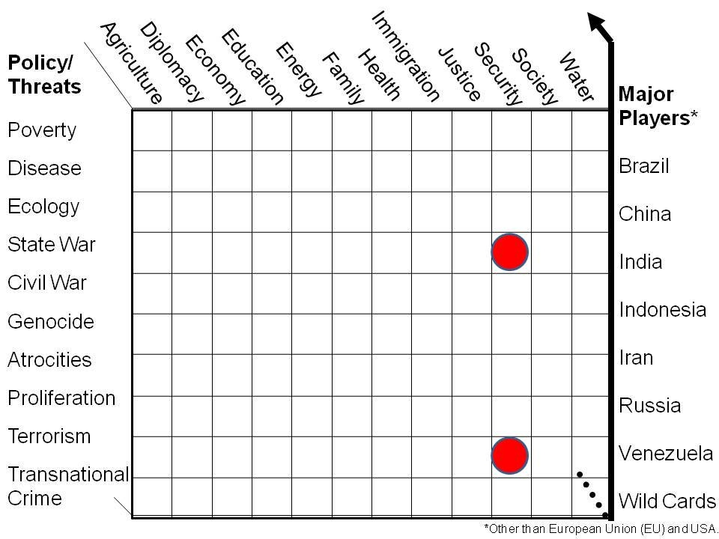
Preliminary Holistic Analytic Model
Core Gaps in Holistic Analysis
Essential to Future-Proofing
What US IC Focuses On..
Nigeria
Notes:
Now we see the threats and the policies together. I not only believe that the US IC must play a forcing function with respect to Whole of Government collection, processing, and analysis, but that the greatest threat to our future lies in the top three non-military threat areas.
These top three threats, across all the policy areas, are how we future-proof cities and states.

Slide 22
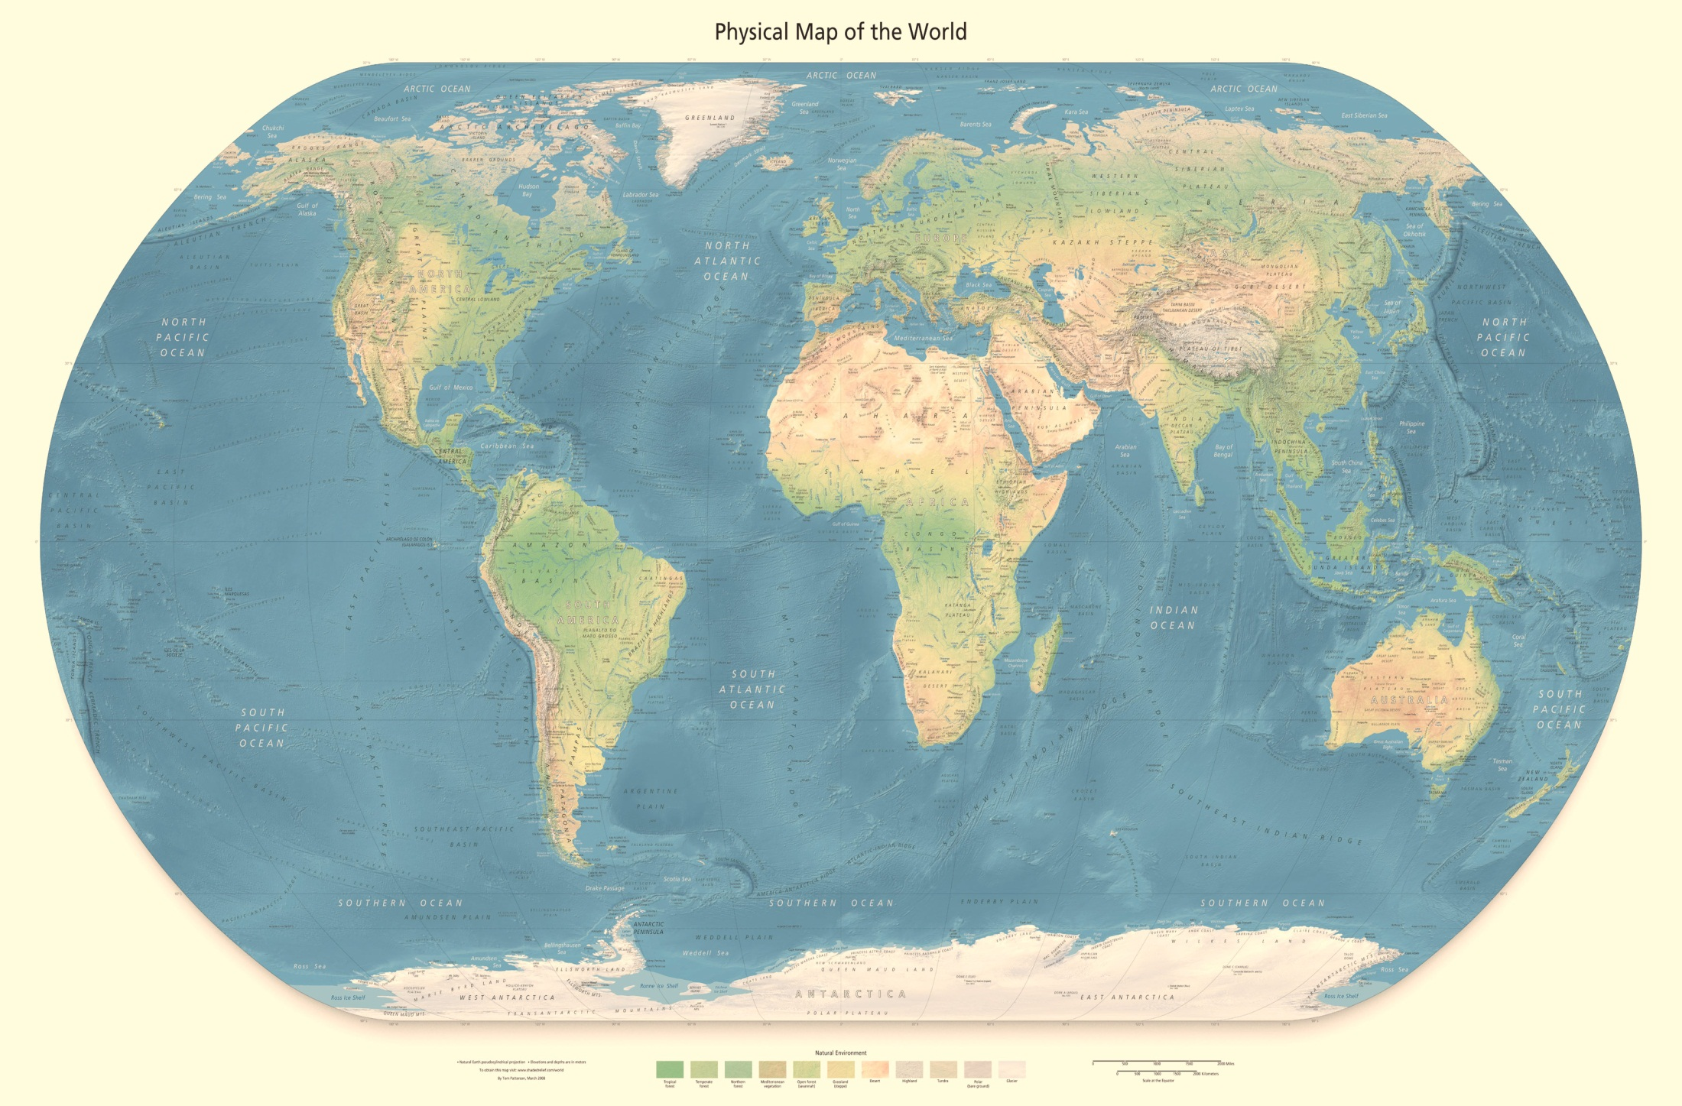
Who Owns the Future?
Demography Rules [Minister-Mentor Lee Kuan Yew]
Projected for 2050
India 1.7B
China 1.3B
USA 0.4B
Nigeria 0.4B
Indonesia 0.3B
Pakistan 0.3B
Brazil 0.22B
Bangladesh 0.19B
Philippines 0.15B
Congo DR 0.15B
Ethiopia 0.15B
Mexico 0.14B
Tanzania 0.14B
Russia 0.13B
Egypt 0.12B
Japan 0.11B
Viet-Nam 0.10B
Kenya 0.96B
Uganda 0.94B
Turkey 0.91B
Notes:
The Western Hemisphere has failed to make the most of the time since the end of WWII and the more recent end of the Cold War, a fictional conflict created by the arms merchants. Nothing matters more than how we all address the education and health of the global population.

Slide 23
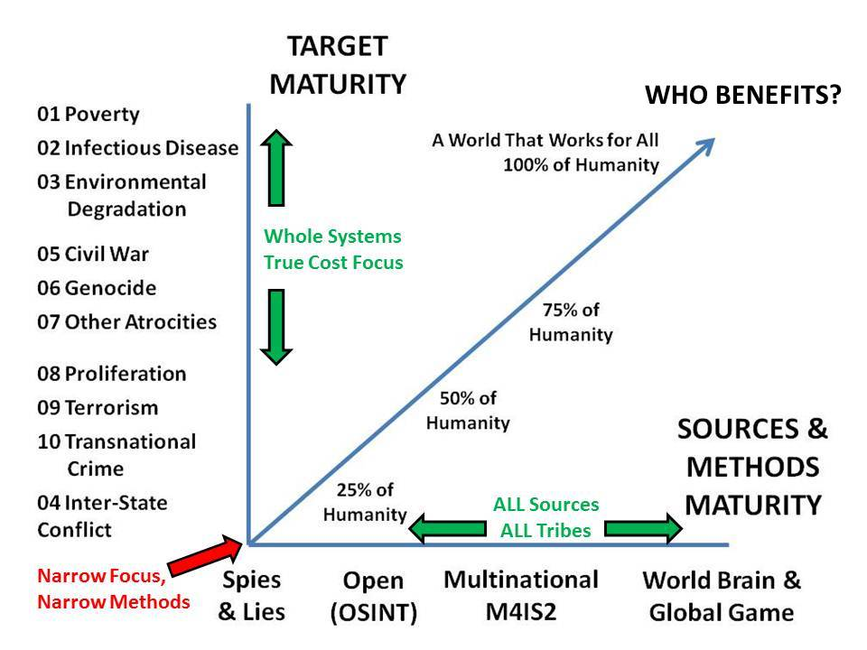
Evolutionary Path for Intelligence
Notes:
This is my most important graphic in the past decade, or so I believe.
You can see where most governments are still positioned, treating intelligence as secrets for the president and generally only in relation to national security writ violent.
It would be so easy – so inexpensive, to run the table out, I am just appalled that there is not a single mandarin willing to act on my ideas, and this one especially.

Slide 24
Utility of Open Sources
Economic and social threats, including 95%
Poverty 99%
Infectious Disease 95%
Environmental Degradation 90%
Interstate conflict 75%
Internal conflict, including 90%
Civil War 85%
Genocide 95%
Other Large-Scale Atrocities 95%
Nuclear, radiological, chemical, and biological WMD 75%
Terrorism 80%
Transnational organized crime 80%
2008 Open Source Intelligence [in Loch Johnson (ed) Strategic Intelligence Vol 2. Chapter 6]
Notes:
In 2004, I used the UN high-level threat panel’s finding, the first-ever consensus list, to speculate on the relative utility of open sources. I continue to marvel that the US refuses to be serious about open sources.*
* No, the OSC is not serious. 100 T-1 lines, and HUMINT took overt human sources away from them. The measure of US IC OSINT is in Global Trends 2030 – junk.

Slide 25
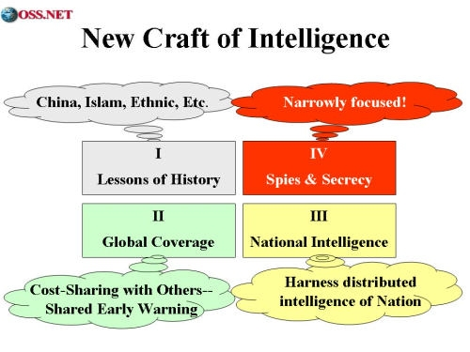
Context & Process for Intelligence
Notes:
Energized by NATO, and by my continuing relationship with the Strategic Studies Institute of the US Army, I developed a monograph and then a book on the new craft of intelligence in 2002.
These are such simple sensible concepts, one must conclude that anyone rejecting them is doing so not on their merits, but rather on the basis of another agenda far removed from the public interest.

Slide 26
Policy Intelligence
Greatest good for the greatest number.
Notes:
And now to policy where one word, one word alone, will suffice.
INTEGRITY.
As I have written online, there is no conflict between intelligence and politics provided both keep their integrity.
For myself, while I have not given up on America the Beautiful as an ideal, for me the past twenty years have been about INTEGRITY LOST.

Slide 27
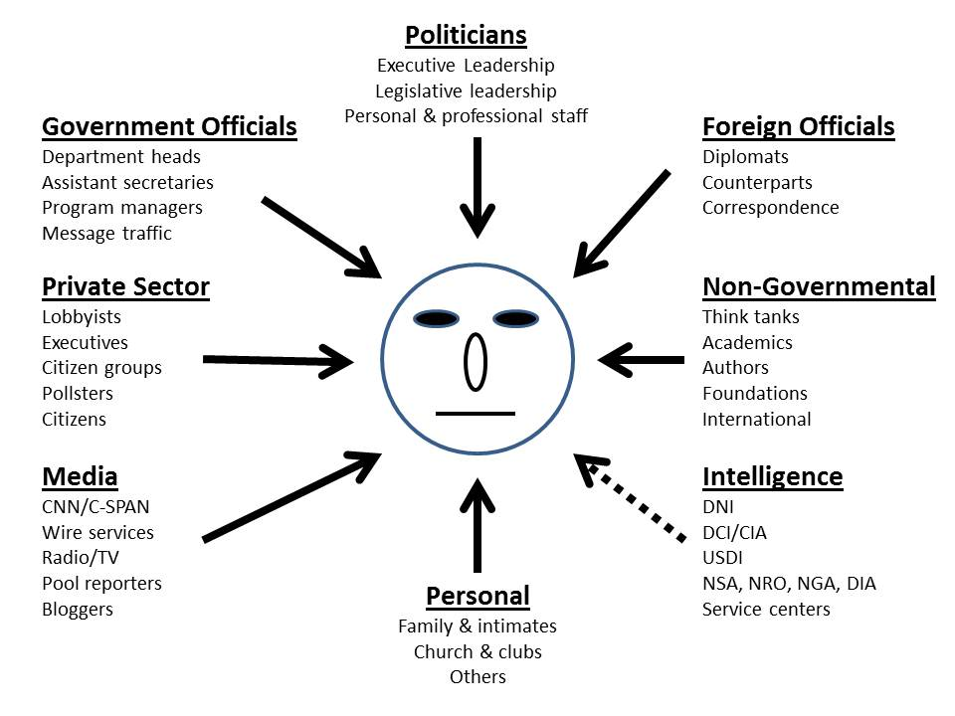
Why Is Intelligence So Feeble?
Money, Sex, & Spotlight Trump Secrets
Greg Treverton (1986)
Notes:
The politics of intelligence are a challenge.
Intelligence is the least influential, in part because by virtue of the secrecy it has chosen to maintain, it can be so easily ignored.
Until US intelligence learns how to do public intelligence in the public interest, it will continue to be a sideshow – an expensive sideshow.

Slide 28
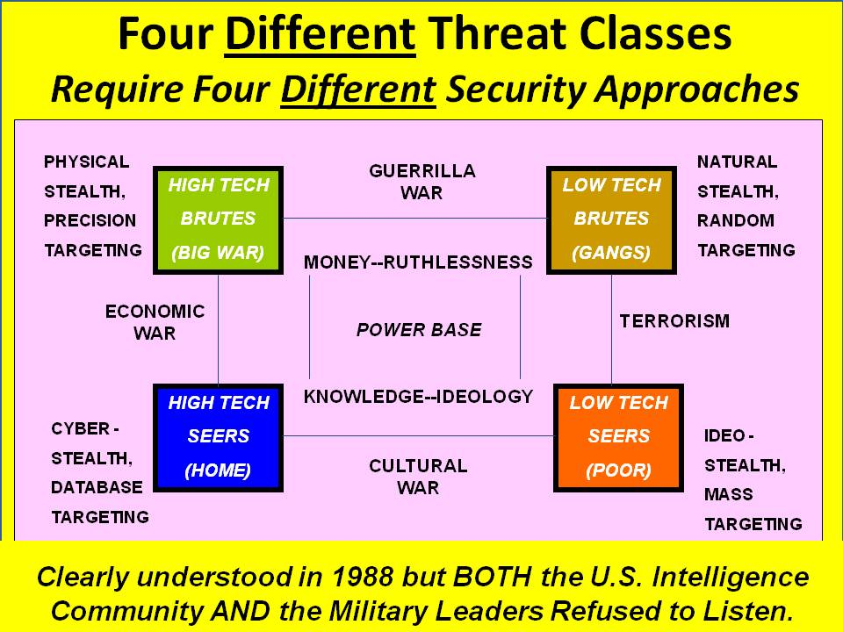
Four Distinct Threat Classes
Understood from 1988 Less Cyber, Cyber Added 1992.
BOTH US IC Leaders and DoD Leaders (Cheney) Refused to Acknowledge
Notes:
In 1992 I developed these four threat classes with the specific intent of justifying four different intelligence approaches including new capabilities; and also to eventually justify four forces after next, not just the one size fits all force that we still have today.
It takes decades to create and train capabilities suited to each of these threats; we have failed at all four.

Slide 29
Preliminary Holistic Analytic Model
Core Gaps in Holistic Analysis
Essential to Future-Proofing
What US IC Focuses On..
Notes:
Now we see the threats and the policies together. I not only believe that the US IC must play a forcing function with respect to Whole of Government collection, processing, and analysis, but that the greatest threat to our future lies in the top three non-military threat areas.
These top three threats, across all the policy areas, are how we future-proof cities and states.

Slide 30
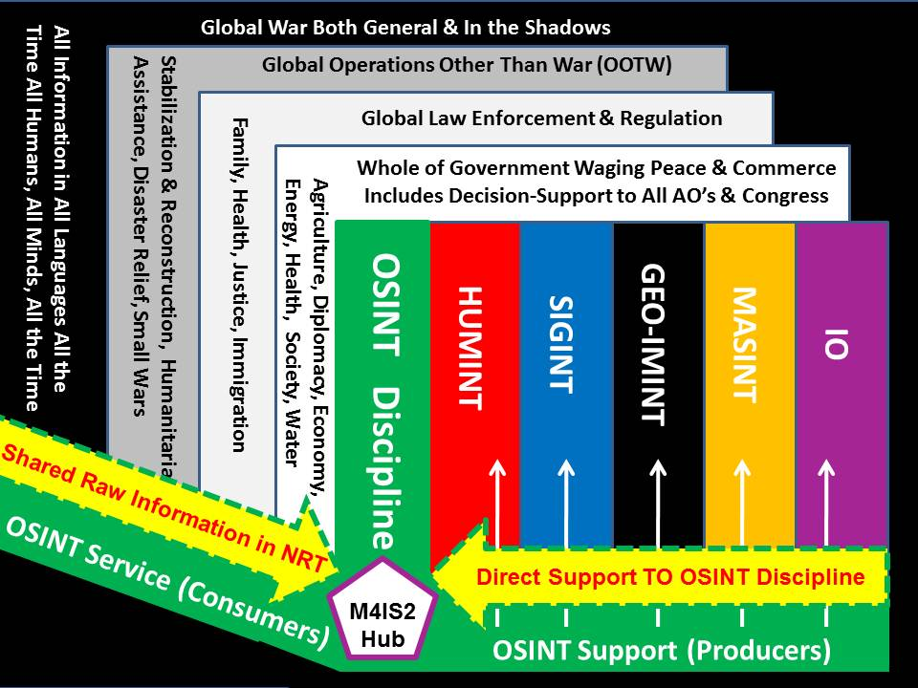
Full-Spectrum Intelligence
Notes:
In the ideal, all of our intelligence disciplines should be working together and providing decision support to all of our whole of government mission areas.
Among them, open source intelligence, a twin to human intelligence, offers the most promise, while the technical disciplines fight tooth and nail to remain retarded.
It is in this context that I have high hopes for M4IS2 – Multinational intelligence.

Slide 31
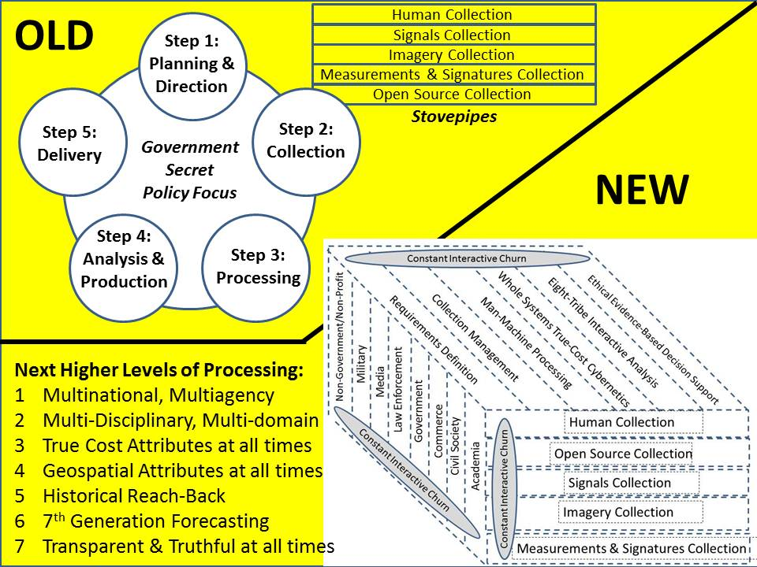
Notes:
In the US system, Cabinet officials and Congress represent the recipients of taxpayer revenue, not the citizens themselves. The Office of Management and Budget does not manage anything at all, and such policies as we have are generally isolated, incomplete, bespoke, often in conflict with one another, and expensive in their ignorance.
Here I show my proposed new form of Whole of Government intelligence.

Slide 32
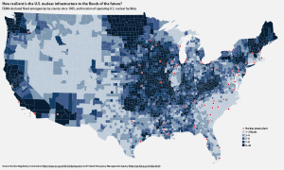
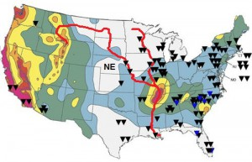
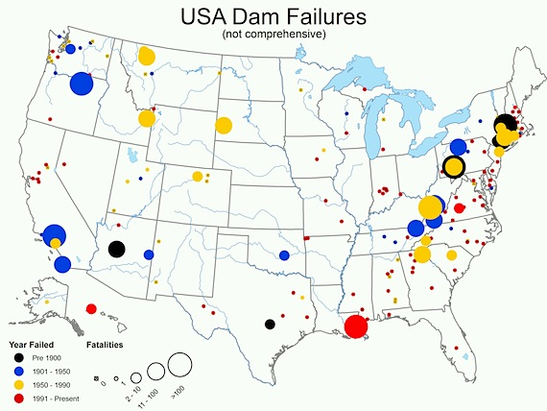
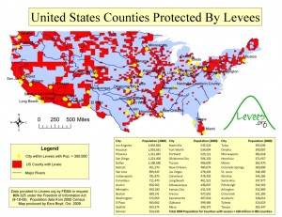
US Nuclear Plants in Flood Zones
US Nuclear Plants in Earthquakes Zones
Not Addressed Above: Aquifer Draw & Contamination, Surface Water Contamination
Notes:
This is a simple depiction of the water threat across the USA, and it barely scratches the surface.

Slide 33
Long Term (100 Years)
STRATEGIC
Poverty
Infectious Disease
Environmental Degradation
Inter-State Conflict
Civil War
Genocide
Other Atrocities
Proliferation
Terrorism
Transnational Crime
Agriculture
Diplomacy
Economy
Education
Energy
Family
Health
Immigration
Justice
Security
Society
Water
25 Years Out
TECHNICAL
12 Years Out
President
Vice President
State
Treasury
Defense
Justice
Interior
Agriculture
Commerce
Labor
Health & Human Services
Housing & Urban Development
Transportation
Energy
Education
Veterans Affairs
Homeland Security
Environmental Protection Agency**
Office of Management & Budget**
US Trade Representative**
US Ambassador to the UN**
Council of Economic Advisors**
Small Business Administration**
4 Years Out
Whole of Government Institutions*
Cross-Cutting Threats & Policies
1 Year Out
90 Days Out
OPERATIONAL
72 Hours Out
* In Order of Secession to Presidency
** Cabinet Rank Not In Succession
TACTICAL
Imminent
Notes:
Here, mindful of Colin Gray’s emphasis on time as the one strategic variable that can neither be bought nor replaced, I try to depict a holistic approach to the needs of Whole of Government across all threats and policies, but with the dimension of time added.

Slide 34
Human Intelligence
Human, the Force is…
Notes:
Intelligence – superb intelligence – can be done by humans without computers. The opposite statement is not true.

Slide 35
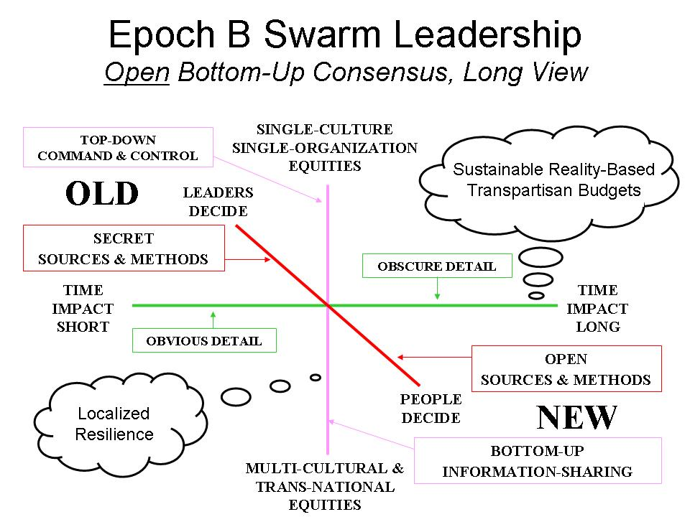
Notes:
I created this graphic a decade ago, and I fear it is not yet appreciated. It is the first graphic in my chapter, “The Evolving Craft of Intelligence,” in the Routledge Companion book coming out in August.
In this context, secret intelligence for the top-down unilateral approach is vastly less important than public intelligence that can inspire bottom-up multi-lateral consensus harmonizing the spending and behavior of larger coalitions on non-military threats.

Slide 36
Government
Law Enforcement
Secret Internal
Secret Shared
Sensitive Shared
Military
Business
Open (Public)
Information
Commons
Green
Media
Non-Profit
Yellow
Orange
Red
Academia
Civil Societies
Notes:
There are eight tribes of intelligence; it is not possible to be fully effective without harnessing the distributed intelligence of all eight of these tribes. The government is the most ignorant and least flexible of the eight tribes.
All tribes have secrets. Where we have failed terribly is in ensuring that we can all share the majority of the information that is not secret.

Slide 37
Human Information Pathologies
Censoring
Cheating Culture
Fog Facts
Forbidden Knowledge
Forgotten Knowledge
Incestuous Amplification
Lies
Lost History
Manufacturing Consent
Missing Information
Propaganda
Rule by Secrecy
Weapons of Mass Deception
Weapons of Mass Instruction
Notes:
In the course of my very broad reading in the past decade, I have created this partial list of information pathologies – all human, and all demanding concerted effort to overcome, particularly when policy and political leaders are loosely-educated and morally ambivalent.
This is our landscape, and in my view, the acme of skill for the intelligence professional should be to overcome all of these.

Slide 38
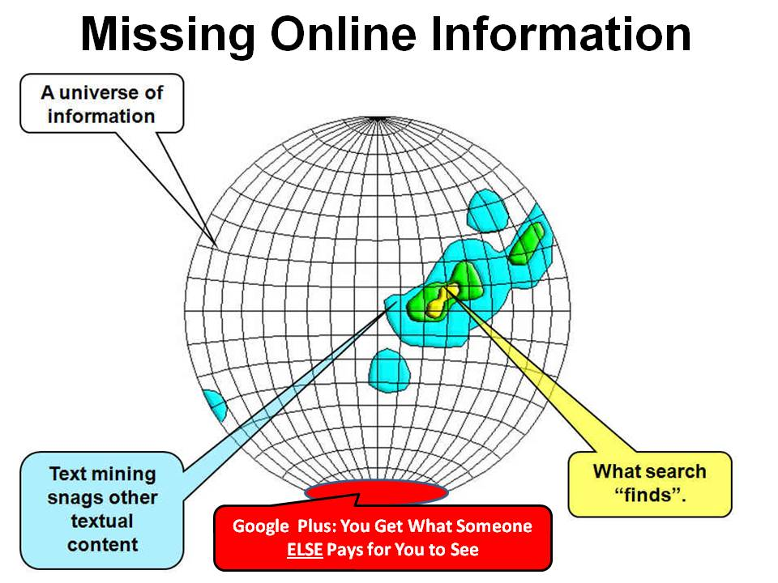
Notes:
When I testified the Aspin-Brown Commission in 1995 I was preceded by RAND, and they said – I do not make this stuff up – that everything in the open source world was on the Internet and they knew how to get it.
Still today, less than 2% of the digital information is indexed by Google, and the bulk of “local knowledge” is not online and not in English. Only the skilled human can achieve the precision reach we need.

Slide 39
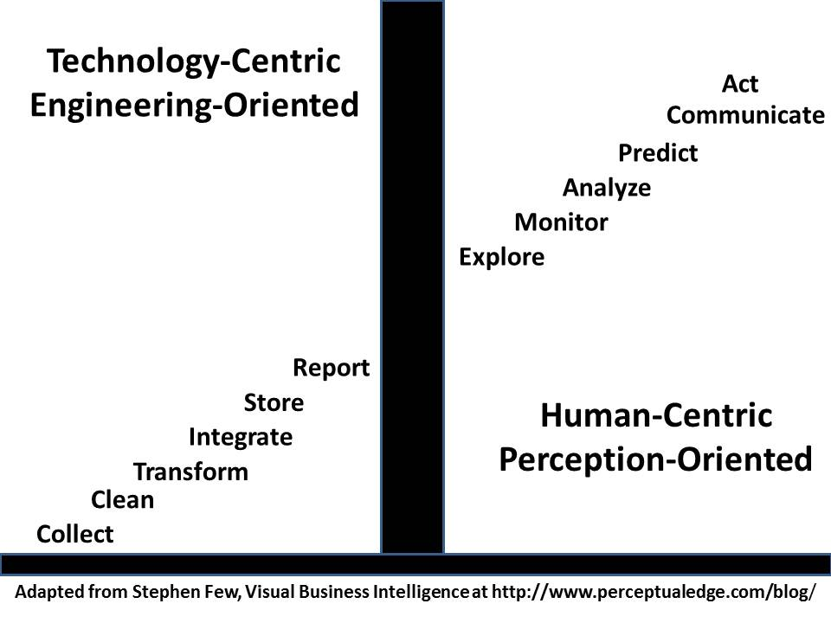
Humans Matter More!
Notes:
I have adapted this slide from Stephen Few of Virtual Business Intelligence.
Computers do repetitive tasks well. They do not deal with the unanticipated – and if our educational systems continue to decline, neither will our humans.
I am of the view that national intelligence must be rooted in a stellar general education system that lifts all minds, not just those of the elite 1%.

Slide 40
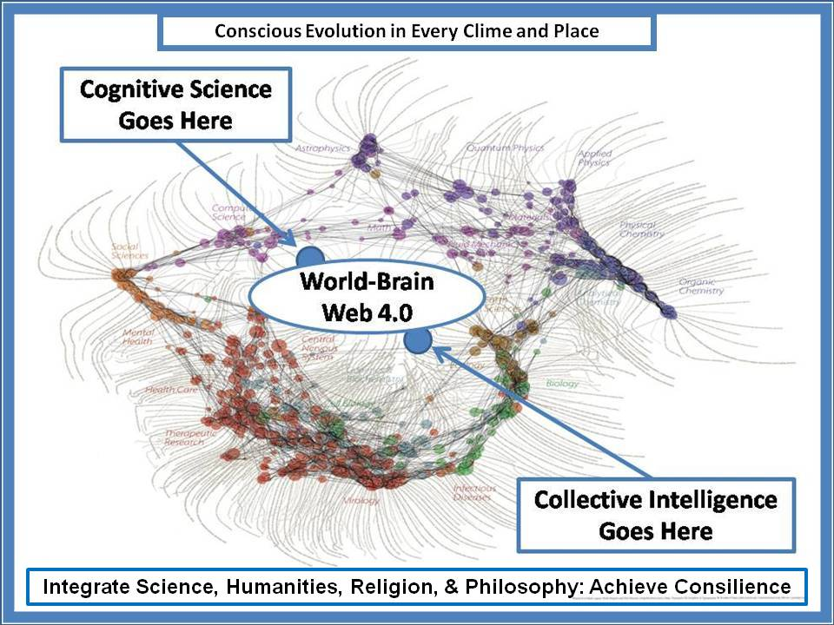
Fragmentation of Academic Knowledge
Notes:
My colleague Dick Klavens, a pioneer along with Eugene Garfield of citation analytics, created this depiction in the late 1990’s to illuminate just how fragmented our scientific disciplines and sub-disciplines have become.
This is the context within which we must transform national intelligence.

Slide 41
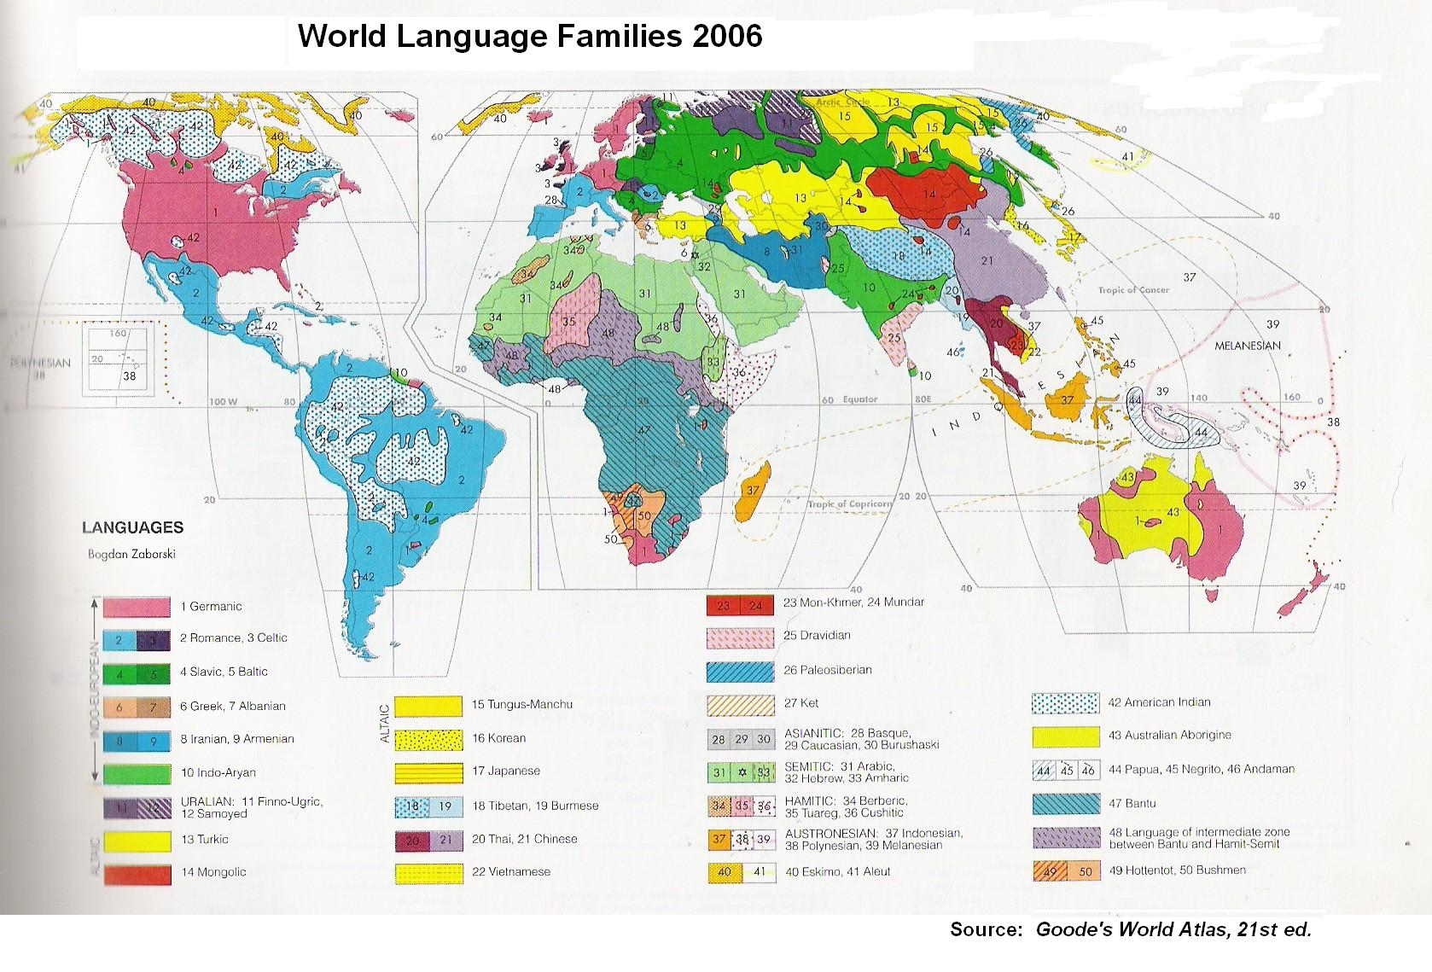
Languages In (Discovery)
Languages Out (Sharing)
Six UN Languages
Arabic
Chinese
English
French
Russian
Spanish
Practical Experience
33 Core
12 Arabic
Minimum for Global Coverage
183
Notes:
Lastly we have languages, ever the Achilles heel of Anglo-Saxon intelligence. My own experience finds 33 languages essential, including Catalan, Gailic, and Hebrew.
I understand from others that there are twelve versions of Arabic with significant nuanced differences that cannot be overcome in the moment – they must all be nurtured over decades so as to be persistently conversant and instantly available for field deployment as needed.

Slide 42
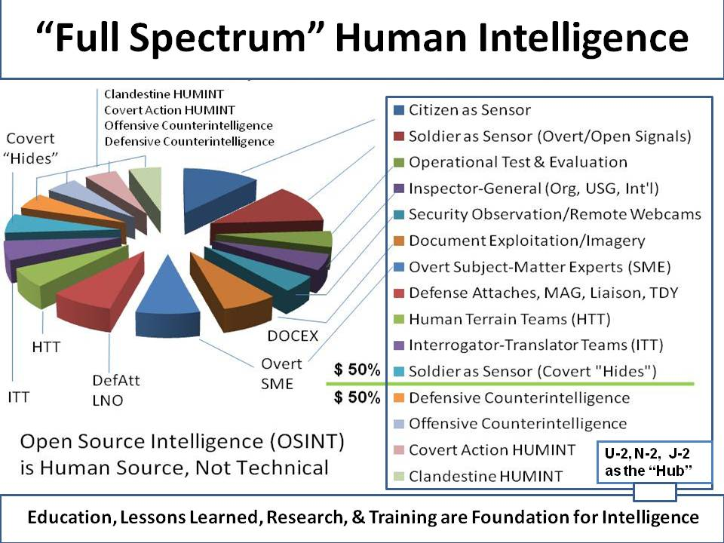
Notes:
This graphic is from my monograph for the U.S. Army Strategic Studies Institute. Humans matter more than technology.
Counterintelligence and clandestine humans must be treated with the greatest delicacy and regard, not as they are today, and for good reason.
At the same time, we must manage ALL of our human assets, both national and external, as part of a HUMINT whole.

Slide 43
Counter-Intelligence
Counterintelligence should be the center of gravity for the future of secret intelligence.
Counterintelligence must focus on our domestic enemies more so than our foreign enemies.
Counterintelligence must be able to expose and destroy domestic political and financial traitors.
Offensive counterintelligence is not being done and needs to be a long-term endeavor.
Counterintelligence cannot overcome the irresponsibility of NSA and others who refuse to be serious about cyber-security or even cyber-integrity.
The FBI is an ineffective and compromised bureaucracy.
Notes:
The greatest surprise to me personally these past twenty years has been the growth of my profound respect for and interest in counter-intelligence.
Here are just a few thoughts of mine. The damage done to the USA by its own home-grown traitors, whatever their motivation be it religious, ideological, or financial, is vastly more costly than any possible combination of external threats.

Slide 44
Acquisition Intelligence
Where, when, & how will this be used?
Notes:
The Marine Corps Intelligence Center was created in 1988 primarily because the other service intelligence centers were then and still are now completely dishonest. Sadly, the Marines appear to have become just another paper mill.
Acquisition intelligence is what assures a proper force structure, one trained, equipped, and organized to be effective against honestly-established threats.

Slide 45
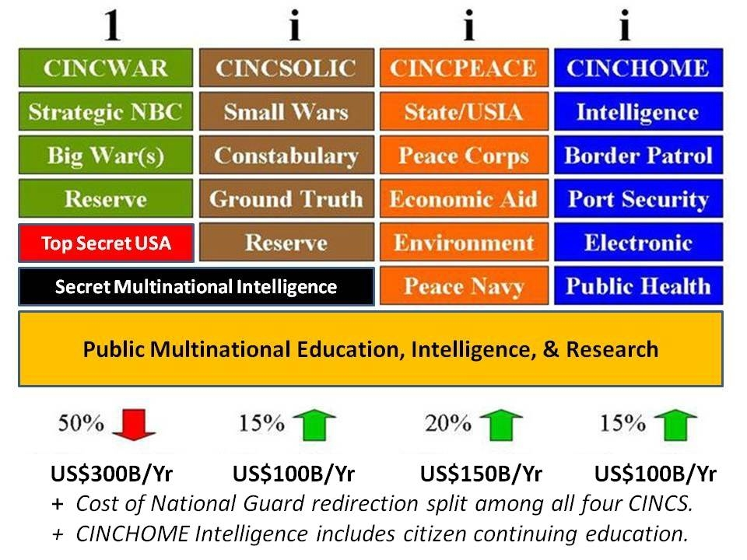
Force Structure Should Meet Needs
Notes:
I have participated in two force structure reviews, and understand how difficult it is to get mission area leaders to pay attention to facts.
Today the F-35 is the face of treason, along with the continuing “budget share” approach to defense acquisition.
Intelligence is supposed to support a holistic strategy, calculated policies, evidence-based acquisition, and whole of government operations. Ours does not.

Slide 46
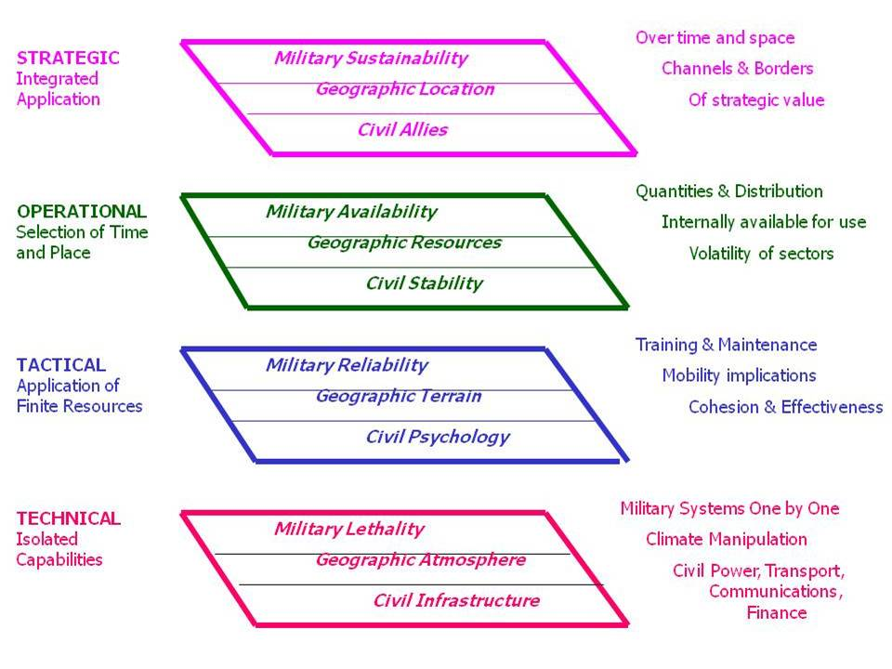
Holistic Analytics for Intelligence
C4I
INF
ENG
ARTY
ARM
AVN
C4I
AAA
INF
LOG
ENG
CSS
ARTY
IO
ARM
AVN
SEA
CIV
C4I
AAA
SPC
INF
LOG
ENG
CSS
ARTY
IO
ARM
SEA
AVN
CIV
AAA
C4I
SPC
LOG
INF
ENG
CSS
ARTY
IO
ARM
SEA
AVN
CIV
AAA
SPC
LOG
CSS
IO
SEA
CIV
SPC
Notes:
The Marine Corps Intelligence Center was created in 1988 because nothing the national, defense, or other service intelligence centers were doing was holistic, relevant to the Third World, or structured so as to support expeditionary mission area strategy, policy, acquisition or operations. This is the top level view of the analytic model we created, you can find all the gory details by searching for 1990 Expeditionary Environment Analytic Model.

Slide 47
Acquisition Generalizations
All Countries or Some Countries?
Coastal & Capital Areas & Main Channels or All Areas?
Warfighting Only or Full-Spectrum Peace & Relief Also?
Worst-Case Everything or Holistic Balance?
C4I Assumed or Mandated?
Continuous Threat Support to All Mission Areas?
Operational Test & Evaluation? With/Without FORMAT?
Threat is both conventional and unconventional
Ground threat complex & lethal
Air threat night/all-weather and integrated air defense systems
Naval threat from coastal guns and missiles severe
Insurgencies are a constant
Mountains, deserts, jungle, and urban environments require distinct approaches
Majority of the operational areas are hot and humid, standard aviation limited
Cross-country mobility a show-stopper
Line of sight distance under 1,000 meters
Bridge-loading & tunnel clearance issues
50% ports not usable, C-130 fields most common—we lack long-haul air
Cultural terrain far beyond our ken
Notes:
Here are a few generalizations from that period in my life. As best I can tell, no one today in the USA is addressing the seven factors I consider important.
The lower half of this graphic provides some of the generalizations we discovered when we did what we were supposed to do. Elsewhere I have published my views on our need for a 450 ship Navy, a long-haul Air Force, and an air-liftable Army – and our complete withdrawal from all our overseas bases.

Slide 48
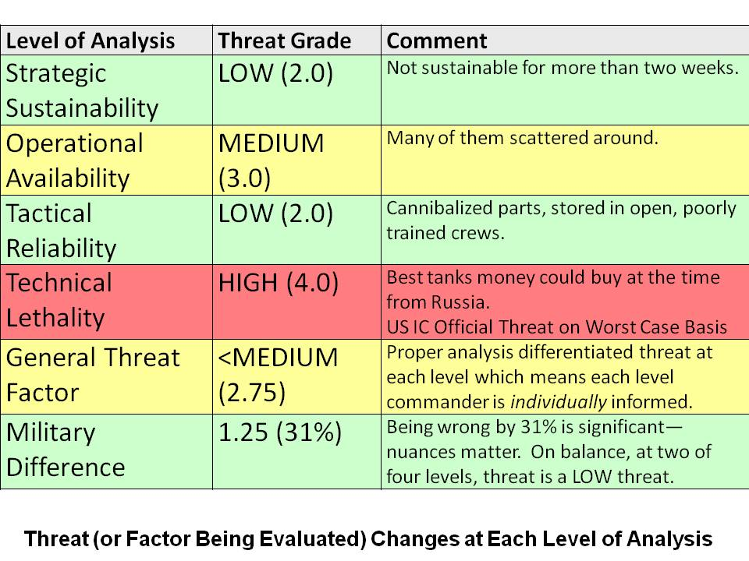
Threat Changes: T-72 in Libya
Notes:
In 1989, for the first time ever, I brought together every analyst across intelligence and operations having anything to do with the Russian T-72 tank as present in Libya.
Here is what I learned from them. Now imagine doing this honestly for every mission area across every country.

Slide 49
Doing Intelligence
What do we need to know, when, in what fashion, for optimal total sustainable effect?
Notes:
And now to my conclusion.
For me, intelligence is tailored decision-support. It should be available to and appreciated by every human being, and it should be delivered at two levels:
First, tailored to the specific individual one answer to one question at a time; and
Second, in the aggregate, tailored to the community as a whole, helping the individuals reconcile competing views.

Slide 50
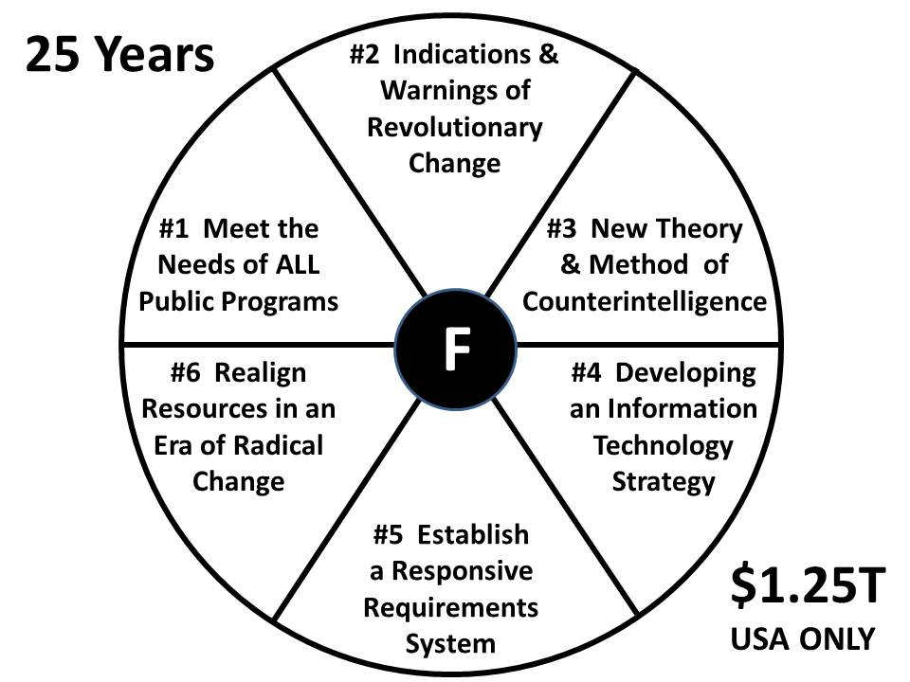
Fundamentals of Intelligence
25 Years – US$1.2 Trillion
Still Do Not Have This!
Whole of Government Decision-Support
Holistic Analytics with True Cost Economics
Counterintelligence on Domestic Enemies
Integrated Scalable IT
Open Requirements Showing Satisfaction & Connecting Clients
Spend with Integrity
Notes:
In 1990, still a government employee, I identified six fundamental challenges that we needed to address if we were to evolve into the 21st Century. Not only was I ignored, but we still do not have solutions for all six of these challenges today.
Speaking only of the US secret world, I see $1.25 trillion dollars wasted, on top of which we have another $10-15 trillion in high crimes and elective wars that secret intelligence did nothing to stop.

Slide 51
Requirements Definition
From Each Functional Area
For Each Mission Type
Program Development
Of Your Organic Capabilities
Unique to Function/Mission Support
Step 1
Mission A
Mission A
Step 4
Asst Scty A
HUMINT/OSINT
Mission C
RQMTS
DEF
Mission D
IMINT
CAPAB.
BLDG.
Mission C
MASINT
Asst Scty B
Asst Scty D
Mission D
Asst Scty B
SIGINT
External Fails THEREFORE
Your-Specific Capabilities Required & Put Into PPBS. Keep OMB Informed.
Mission B
Mission B
Collection Management
To Each Collection Discipline
Specifics and Deadlines
Evaluation
Of Each Collection Discipline
Specifics and Deadlines
External Satisfies
Step 2
Country A
Country A
HUMINT/OSINT
HUMINT/OSINT
COLL.
MGMT
IMINT
EVALUA-
TION
IMINT
Country C
MASINT
Country D
Country C
MASINT
Country D
SIGINT
SIGINT
Step 3
Country B
Country B
Notes:
Over the next 12 years, I hope, the secret intelligence budget will be cut back to $30 billion, and at least $15 billion of the savings will migrate toward new non-secret intelligence capabilities to be created and maintained by the traditional consumers of intelligence.
The key is in requirements definition, and in tracking requirements not met, something that is simply not done, so as to justify new non-IC capabilities..

Slide 52
New Rules
001 Decision-Support is the Raison D'être
002 Value-Added Comes from Analysis, Not
Secret Sources
003 Global Coverage Matters More
004 Non-Traditional Threats Are of
Paramount Importance
005 Intelligence w/o Translation is Ignorant
006 Source Balance Matters More
007 "Two Levels Down“
008 Processing Matters More, Becomes
Core Competency
009 Cultural Intelligence is Fundamental
010 Geospatial and Time Tagging is Vital
011 Global Open Source Benchmarking
012 Counterintelligence Matters More
013 Cross-Fertilization Matters More
014 Decentralized Intelligence Matters More
015 Collaborative Work and Informal
Communications Rise
016 New Value is in Content + Context + Speed
017 Collection Based on Gaps versus Priorities
018 Collection Doctrine Grows in Sophistication
019 Citizen "Intelligence Minutemen" are Vital
020 Production Based on Needs versus
Capabilities
021 Strategic Intelligence Matters More
022 Budget Intelligence Is Mandatory
023 Public Intelligence Drives Public Policy
024 Analysts are Managers
025 New Measures of Merit
026 Multi-Lateral Burden-Sharing is Vital
2004 NEW RULES for the New Craft of Intelligence
Notes:
These are the 26 new rules for the new craft of intelligence, easily found online as the full chapter. At the bottom is the full briefing for these rules, also with words in Notes format. All of these rules are by their very nature the opposite of what we persist in doing with our obsession about secret war. We have literally forgotten – and this generation may never have known – that the purpose of intelligence is to produce decision-support.

Slide 53
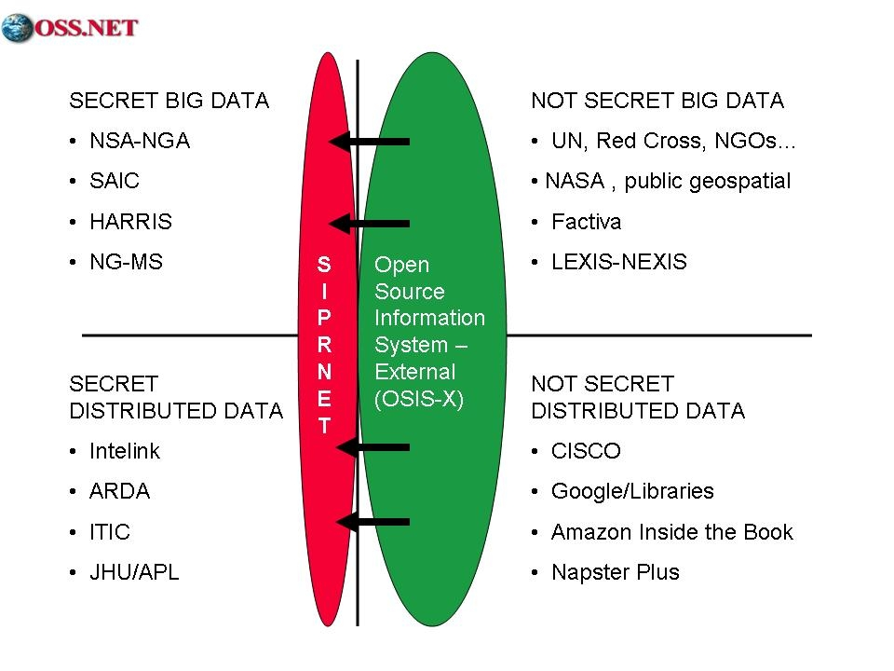
Feeding the High Side
Gwyn Whitaker & Robert Steele (2005)
Notes:
We still have three challenges:
01 Integrating the high side – 80 isolated systems— 2,500+ codeword compartments – and counting
02 Assuring the high side of access to the unclassified information
03 Integrating the unclassified and keeping it safe from classification and manipulation
I know how to do the second and third; I do not believe the first is possible.

Slide 54
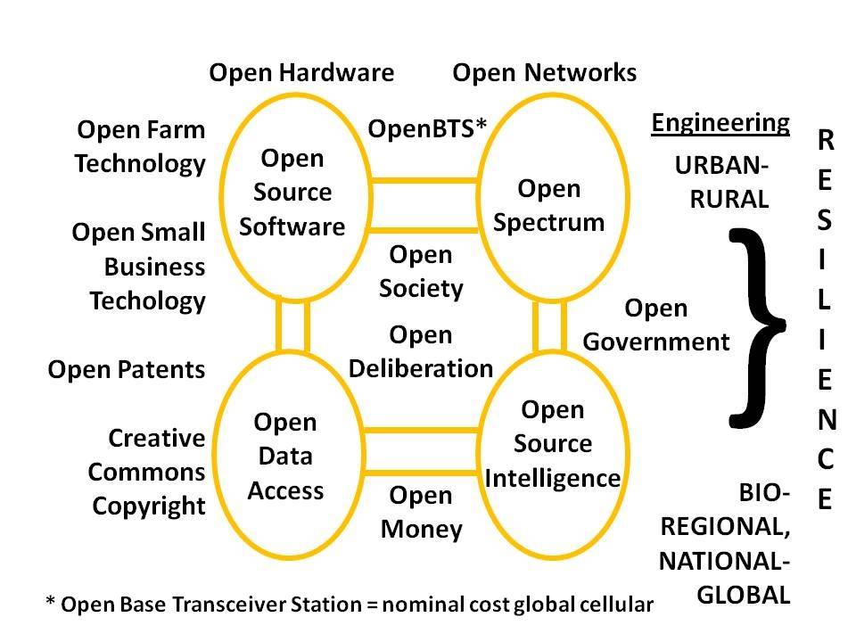
Open Source Everything (OSE)
Notes:
This is the first of four technical graphics. While I started the OSINT fight in 1988, in the past decade I have become persuaded that ALL of the opens can and must come together to achieve the affordable sustainable break-throughs that we require, especially in relation to sharing and cross-boundary sense-making in real time. The secret world will continue to decline in utility unless it embraces OSE as a foundation. OSE is our path to a World Brain & Global Game – and smart spies.

Slide 55
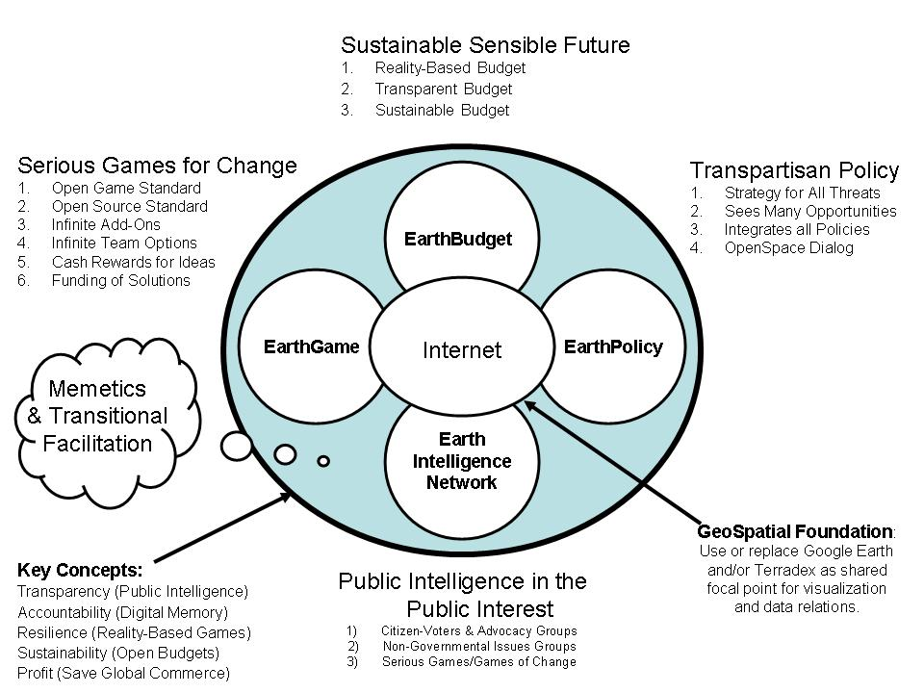
Six Bubbles
Notes:
These six bubbles are as conceptualized by Earth Intelligence Network. Among our 24 co-founders remains Medard Gabel, co-creator with Buckminster Fuller of the analog World Game, and architect of the digital EarthGame, one that could be built for just $3 million a year. Note how there is a budget element and a policy element, both open to the public. True cost information would be embedded within the EarthGame, showing cause and effect and related costs.

Slide 56
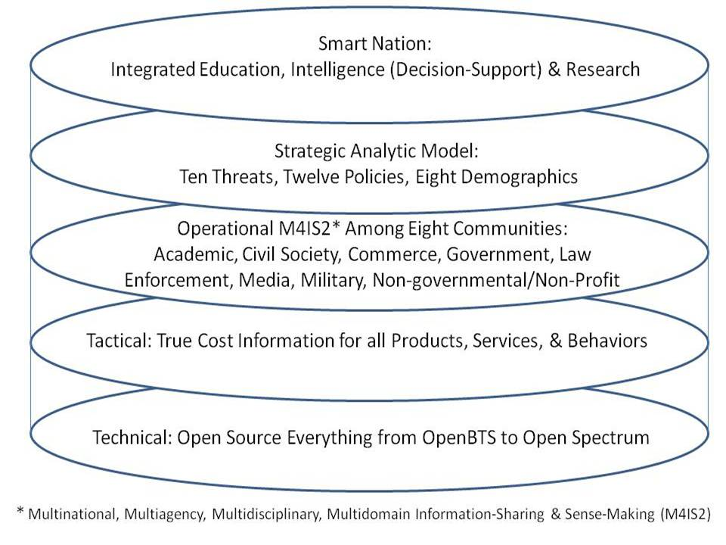
Technology Architecture
Notes:
This graphic pulls it all together. It is possible, in the astonishingly near future, to create Smart Nations, a World Brain, a Global Game, and with this architecture, harness the distributed intelligence of the Whole Earth.
For an early glimpse of what is possible, visit Crisis Mappers and see what they are doing with SMS messages, diaspora translations and map plotting, and the integration of various open source apps.

Slide 57
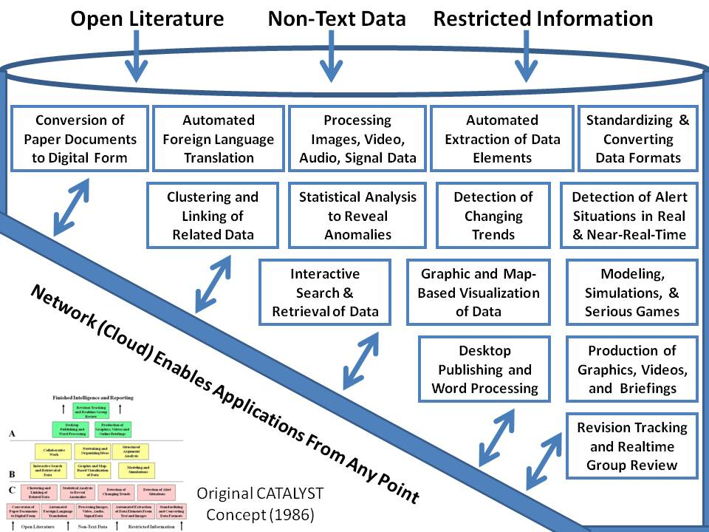
Analytic Tool-Kit for Intelligence
Diane Webb et al (1986)
Notes:
Others at CIA knew in 1986 precisely what analysts needed in the way of desk-top functionalites. As a founding member of the Advanced Information Processing and Analysis Steering Group I still remember being shocked by our discovery that there were over 20 such projects across the agencies, with NSA having multiple versions, each spending $10M a year or so but on a different vendor, different prime software, etcetera. We still do not have this a quarter century later. Why not?

Slide 58
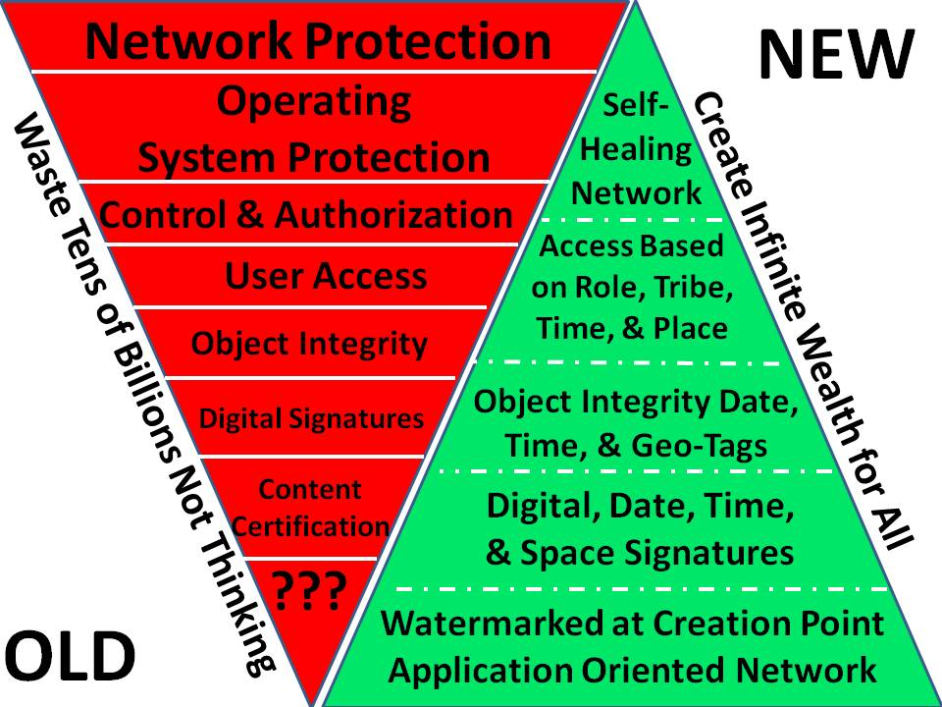
Notes:
I was one of the original Information Warfare and cyber-intelligence pioneers in the 1990’s, and I regret to say that my warning letter in 1994 made no impression on the US Government.
Everything we are doing in cyber-security is flat out wrong. I strongly recommend that Brazil, China, India, and Russia, among others, lead the development of a completely new global information instructure.

Slide 59
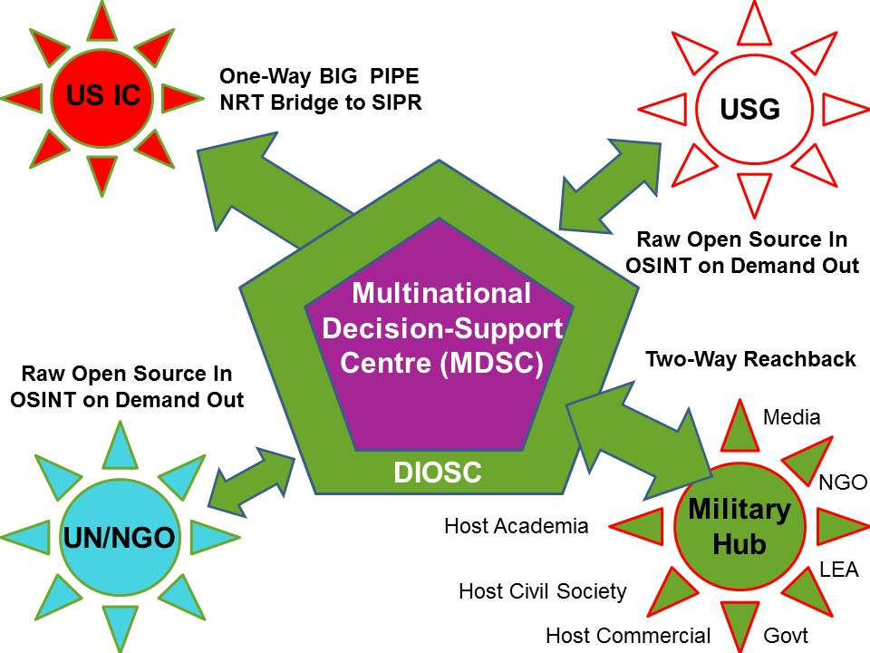
Multinational - Strategic
Notes:
This is the vision I briefed to the Coalition Coordination Center (CCC) in Tampa in 2006. What they did for logistics we need to do for intelligence. There are four special relationships depicted here.
Perhaps most important is the use of national militaries as the C4I hubs for interlocking reach-back into the eight tribes of each respective nation.
Reciprocity will be vital across this scheme.

Slide 60
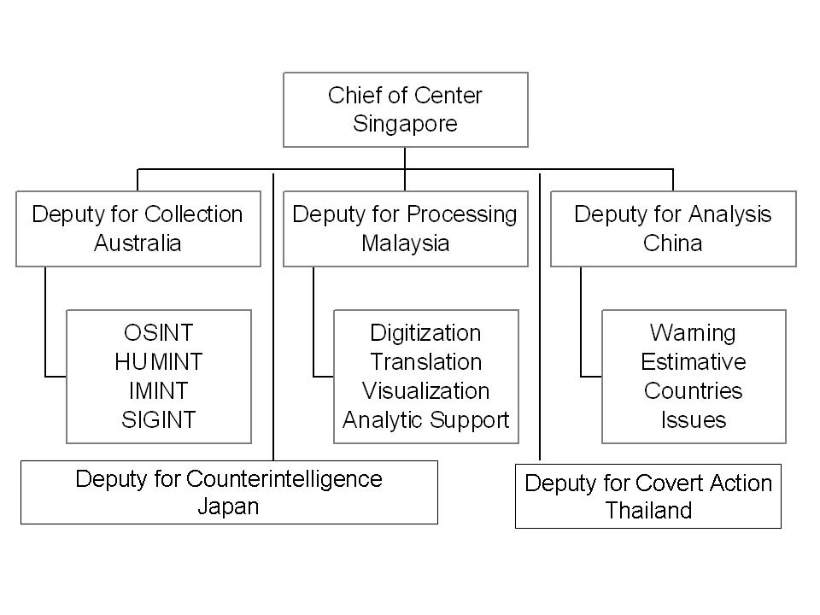
Multinational - Operational
Notes:
For over a decade if not longer I have been calling for the closure of unilateral stations under official cover, and their replacement with multinational stations.
The 80-20 rule works for me. Think of these as focusing 80% of their financial, technical, intellectual, and cultural capacity on open sources, and the other 20% on deep secret sources.

Slide 61
Notes:
Most do not execute the proven process of intelligence, or balance resources among four major levels of effort.
This particular concept was developed by Jan Herring, the first National Intelligence Officer for Science & Technology, and it is still, in my view, an essential starting point for the Open Source Agency.
To prosper, we must meet the decision support needs of all elements of society.

Slide 62
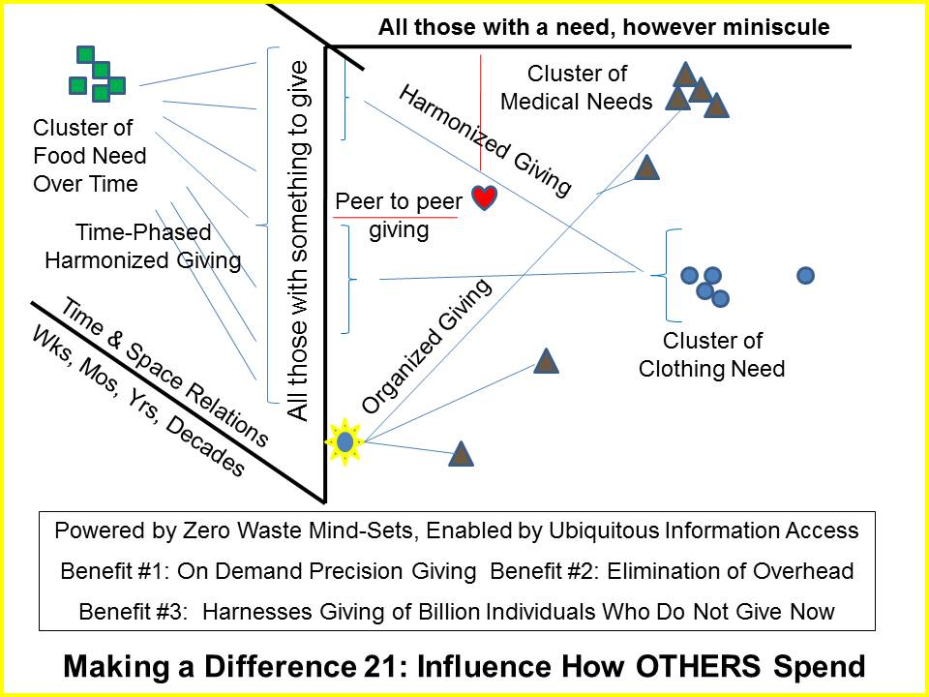
Local to Global Range of Needs Table
Notes:
This may be my most subversive graphic. If implemented, it does three things:
01 Explodes giving from the one billion rich, 80% of whom do not give now
02 Collapses the current archipelago of inefficient and dishonest aid schemes by holding them accountable in detail
03 Dramatically increases the efficiency of all coming together with ENOUGH at the household level of resilience.

Slide 63
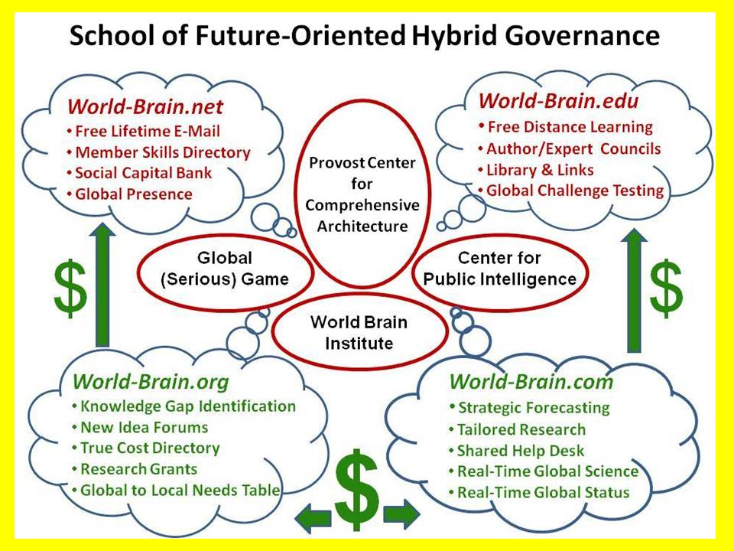
Notes:
I own three of the four World-Brain URLs and will donate them to any university willing to fund me for two years as we raise funds for everything depicted here. It will be self-supporting by year five at the latest.
I believe there is a huge market for public intelligence “by the drink,” but the various pieces are not quite ready for integration.

Slide 64
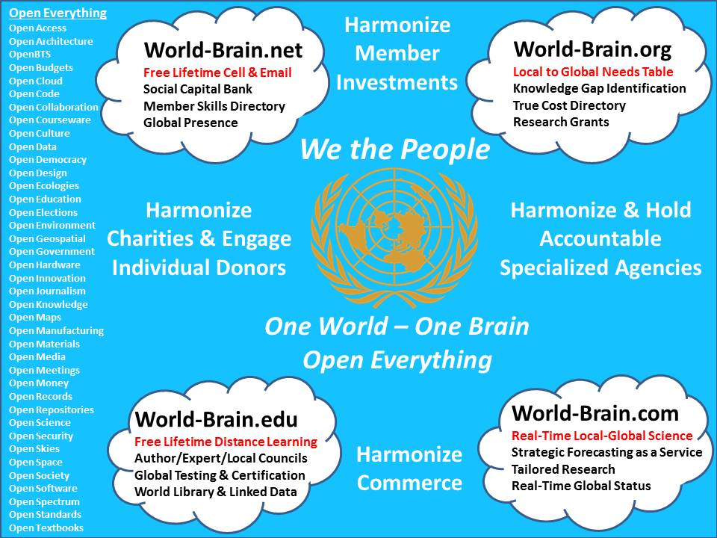
Notes:
With or without the United Nations, Brazil, China, India, and Russia, among others, can create a World Brain and an open source everything (OSE) global information technology network that harmonizes how we all spend, invest, and behave into the future. The wasteful practices of the USA must not be replicated; the US approach to energy must not be followed. We can do so much better working on the basis of ethical evidence-based decision-support.

Slide 65

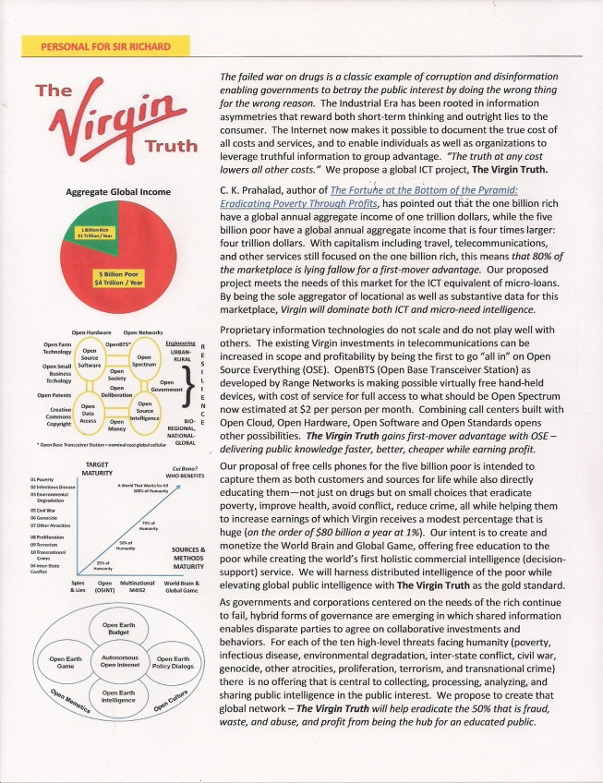
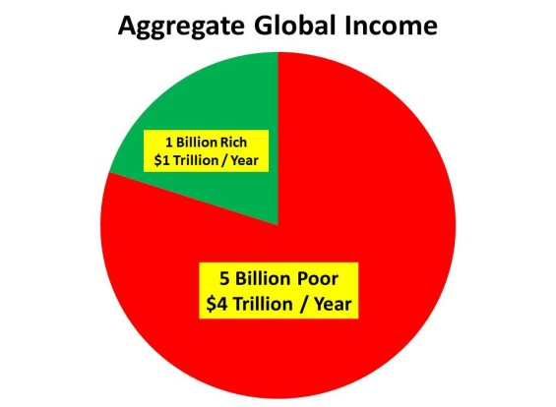
Wild Card: The Virgin Truth
The Virgin Truth gains first-mover advantage with OSE – delivering public knowledge faster, better, cheaper while earning profit.
The Virgin Truth will help eradicate the 50% that is fraud, waste, and abuse, and profit from being the hub for an educated public.
Notes:
Some of you may find this of interest. It was delivered to Sir Richard by hand of a retired MI-6 officer who received it from Alfred Rolington, perhaps the most successful CEO in the open source world along with Mats Bjore in Sweden.
I earnestly believe that free cell phones and free Internet access along with free education will create wealth from which a percentage can be derived by the ISP.

Slide 66

Wild Card: NATO
“Open Source Security”
1st of 3 Multinational Decision-Support Centres
Notes:
NATO is a wild card. Admiral Stavrides was on to a very important idea, and I can only hope that his successor will continue to be interested in these possibilities.
I would of course be delighted to help build the world’s first M4IS2 Decision-Support Centre on the shores of the Mediterranean, and then see Chile and Singapore or Indonesia replicate and enhance their own variation of this capability.

Slide 67
United Nations
Assistant Secretary General
Open-Source Decision-Support
Director
Open Source Agency
Director
World Brain Institute
NATO/ACT
Director
Human Factors Program
Autonomous Internet
Open Source Everything
Liberation Technology
Director
Open Source Consortium
Director
The Virgin Truth
Community of Latin American and Caribbean States Intelligence Network
(Asian) Regional Comprehensive Economic Partnership Intelligence Network
African Union Intelligence Network
Notes:
All of my efforts to encourage the US President and Director of National Intelligence, the Secretary General of the UN and Ambassador Rice, Secretaries Kerry and Hagel, have come to naught.
This is my complete vision. I could have this up and running within the year given only $125 million to start.
PAUSE

Slide 68

Notes:
China has already taken steps to convert those that wish to the yuan as a reserve currency, and to also offer an alternative to the SWIFT banking system that has been turned against Iran, very unwisely in my view. I believe the time has come for the eight greater demographics to test a new multinational information-sharing and sense-making toward their mutual benefit. In each region of the world, ethical evidence-based decision support is the best tool for creating peace & prosperity.

Slide 69

Notes:
This is my final graphic. As you might imagine, across nine books and many articles, briefings, chapters, and lectures as well as testimony, I have given this a great deal of thought. In my view, this graphic captures what we should be doing but do not do. If we are to be successful intelligence professionals in the 21st Century, this is our starting point. From where I sit, the US IC gets an F across the board, isolated bits notwithstanding.

Slide 70
The truth at any cost lowers all other costs.
BE the Force!
Notes:
The truth at any cost lowers all other costs.
You can find this briefing with words in Notes format, at Phi Beta Iota the Public Intelligence Blog, which also offers a free subscription to daily posts by over 25 contributing editors.
I am actively seeking a home for these ideas; I am globally mobile – this is how I want to spend the next 20 years of my life.
Thank you.

