Slide 1
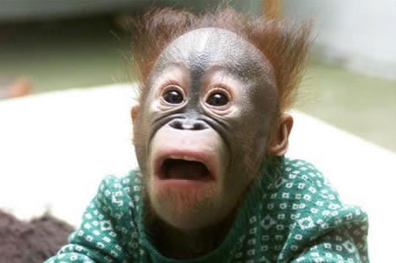
What Scares the Living IT Out of Me The History of the Future (Un-PC Views on security)
Winn Schwartau, Founder, Security Experts
www.WinnSchwartau.Com
www.TheSecurityAwarenessCompany.Com

Slide 2
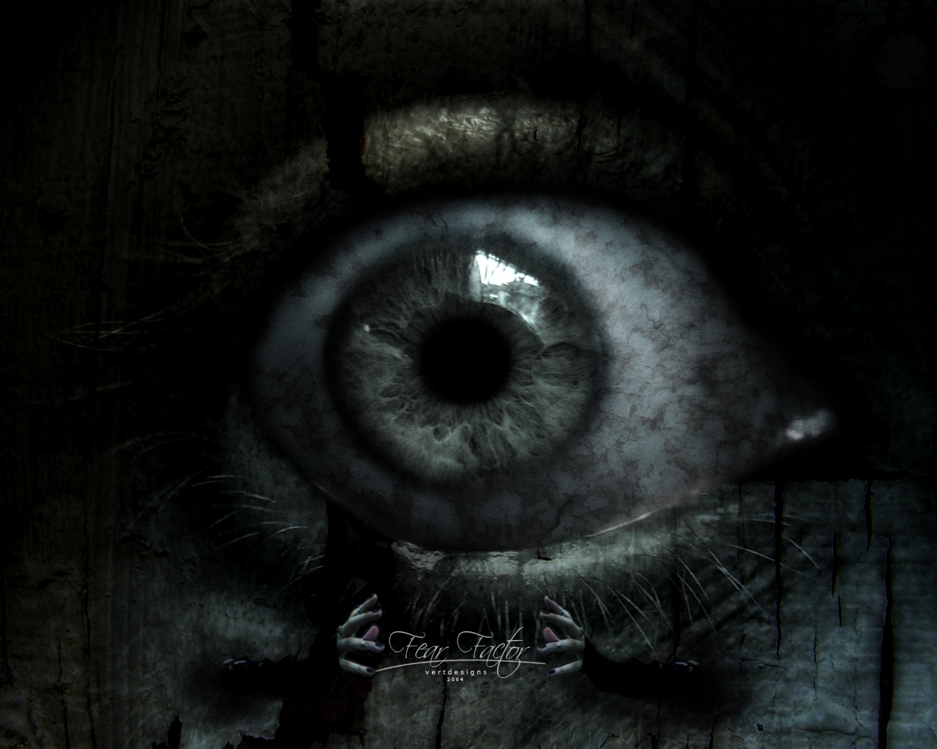
The sum of all fears
Idiots in politics
Ignorance in business
Apathetic about warnings
Arrogance about Preparation
THIS one REALLY scare the Livin’ IT out of me…

Slide 3
Not if, but when…

Slide 4
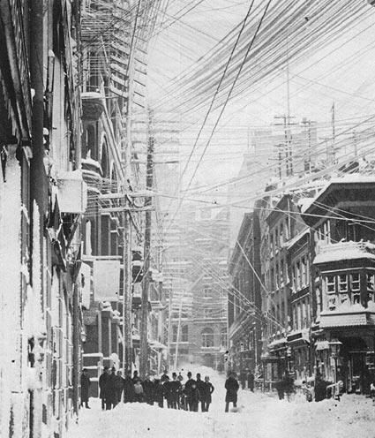
Carrington Effect: 1859
2 September, 1859
Skies all over planet Earth erupted in red, green, and purple auroras.
Newspapers could be read as easily as in daylight.
Auroras pulsated even at near tropical latitudes over Cuba, the Bahamas, Jamaica, El Salvador, and Hawaii.
Telegraph systems worldwide went haywire.
Spark discharges shocked telegraph operators and set the telegraph paper on fire..

Slide 5
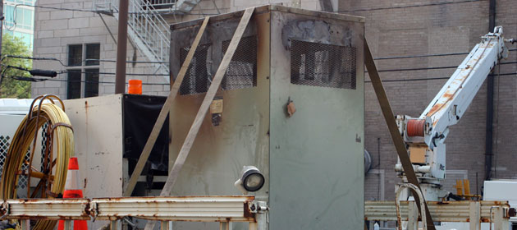
Carrington Effect: 1972-2012
August 4, 1972
Huge solar flare knocked out telephone communication across Illinois.
AT&T redesigned its power system for transatlantic cables
March 13, 1989,
Geo-storms plunged Québec Canada and 6 million people into blackness
December, 2005
Aurora-induced power surges melted power transformers in New Jersey.

Slide 6
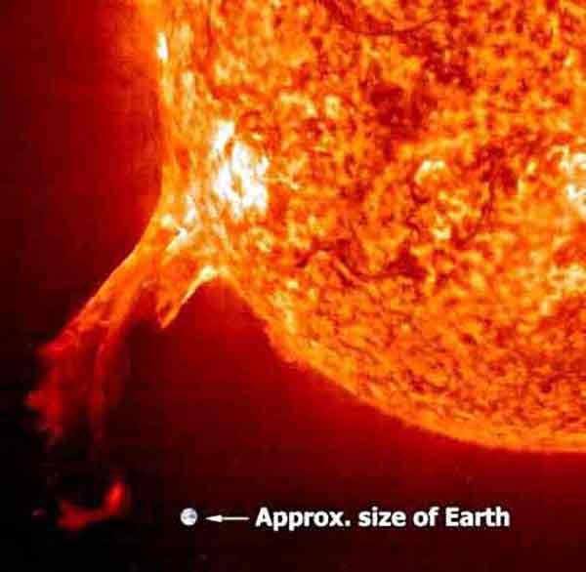
Carrington Effect: 2012+
Notes:
Nothing serious will happen if accurate forecasting of the solar storm is done. If we shut down all power grids during the solar storm, nothing will happen. Put the satellites into the Safe Mode and they are all safe.

Slide 7
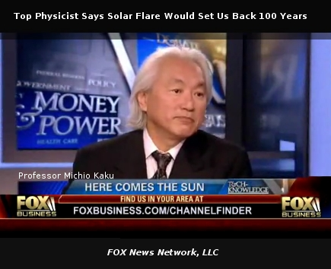
Carrington: worst case
Damage to the 900-plus satellites currently in orbit:
$130 - $270 billion
10 year rebuilding of infrastructures

