Slide 1
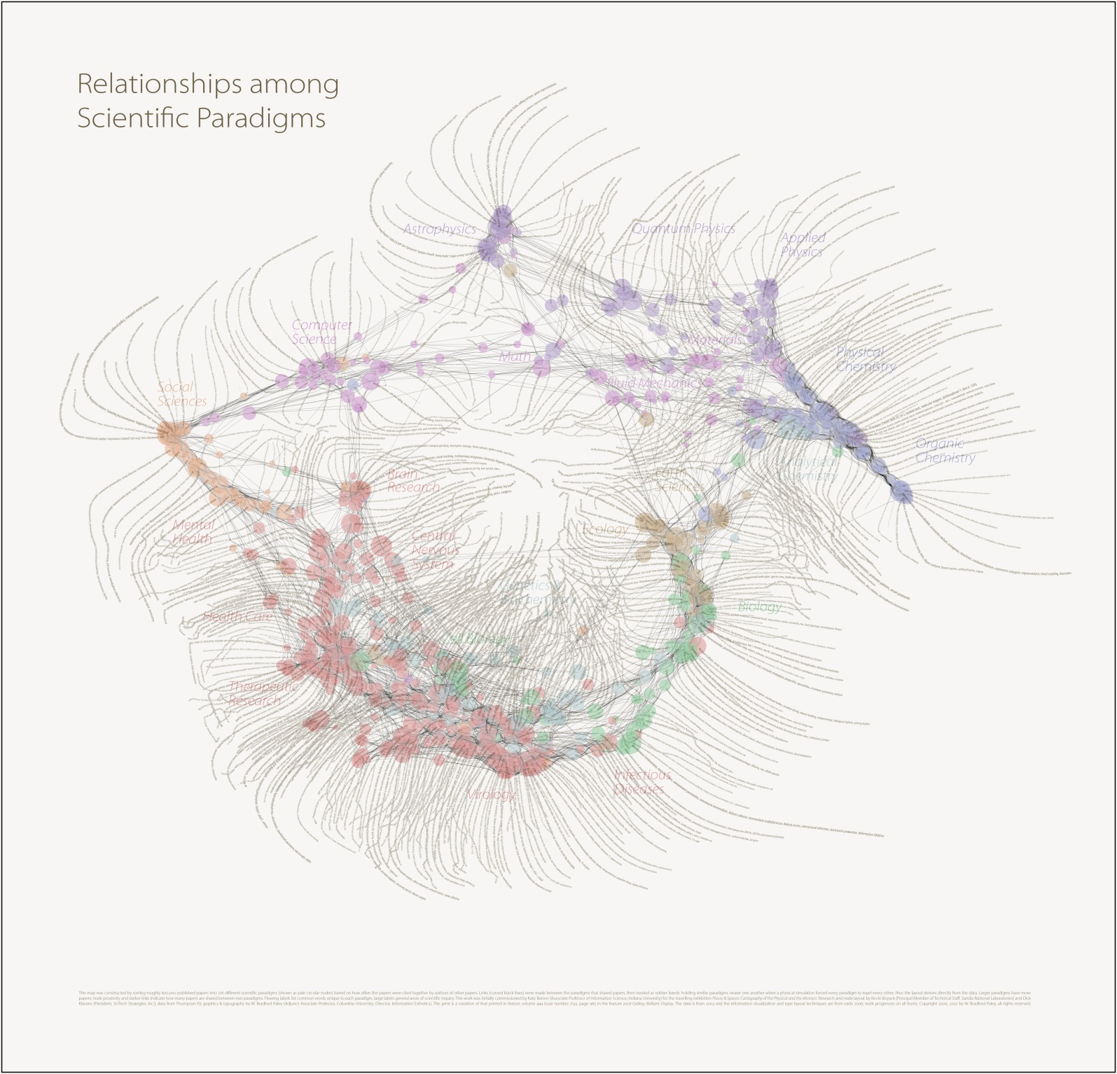
Brain
Mind
Network
Education
Knowledge
Learning
Information
Intelligence
Research
Collective Intelligence
Digital Economy
Censorship
Deception
Propaganda
Readings in Education, Intelligence & Research -- Robert David STEELE Vivas
Online Self-Study Aid – 28 March 2014

Slide 2
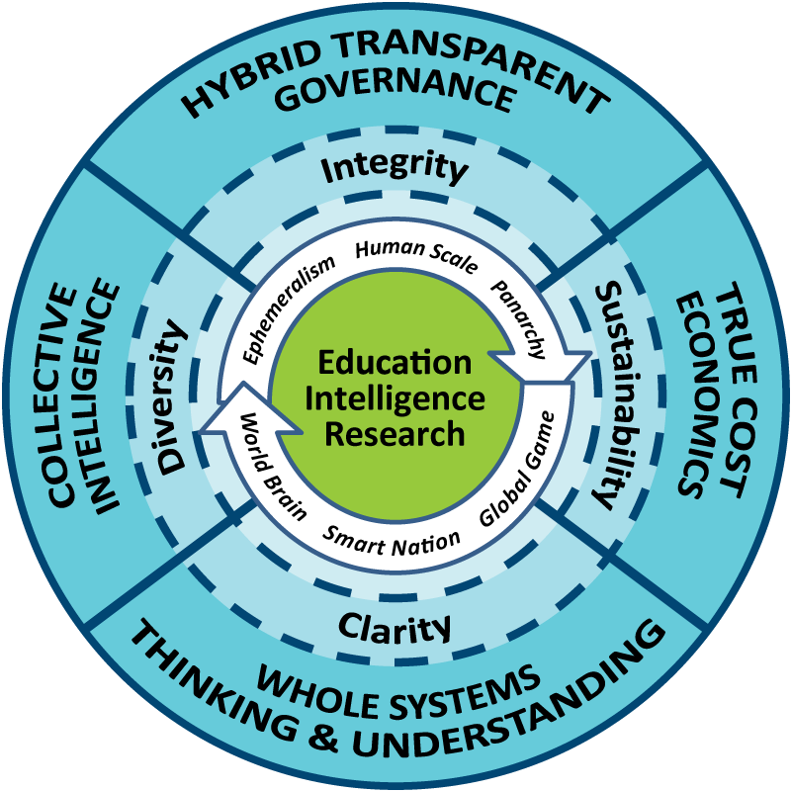
This online self-study guide is a starting point.
It is also a model for how teams of readers can present their results.
Note that each slide has a link to a full text review that in turn links to the Amazon page for each book, and other books.

Slide 3
1938
Highlights:
01 “The whole human memory can be made accessible to every individual. It need not be concentrated in any one place.”
02 If informed and engaged, Public Opinion could restore common sense and popular control of the public world.
03 The communication functions of the world brain would include a highly effective information retrieval system, selective dissemination of information, efficient communication facilities, effective presentation, popular education, public and individual awareness for all issues, and facilitate social networking between organizations, groups, and individuals.
Full-Text Review with Links

Slide 4
1946
Highlights:
01 Neither languages nor technologies are a barrier to humanity rising – the barrier is the lack of a Great Vision that integrates the sciences, the humanities, religions and philosophy.
02 No amount of top-down planning will do. What matters is enabling all humans to access all information in all languages all the time, so they can make informed decisions at ground level.
03 Consciousness leads to extra-sensory perception and a social “mind” capable of mobilizing energies, unifying programs, and providing the means for achieving a prosperous world at peace.
Full-Text Review with Links

Slide 5
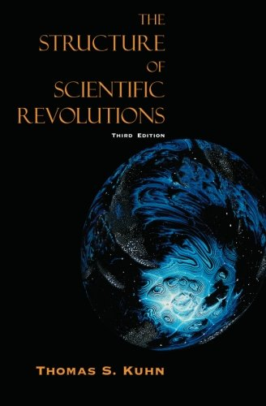
1962
Highlights:
01 Paradigm shifts are always forced – the status quo powers never, ever, invite a paradigm shift.
02 Paradigm shifts are always sudden. You cannot plan for the moment, it happens.
03 Until the paradigm shift occurs, the incumbent mandarisn can comfortably explain everything with their existing paradigm.
My own comment: “thinkers” today are inbred, lazy, generally mono-lingual, and culturally ignorant. Inspired thinking is the exception, not the rule.
Full-Text Review with Links

Slide 6
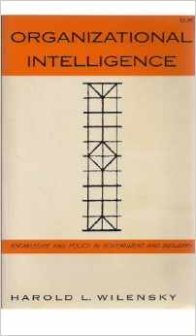
1967
Highlights:
01 Explores how knowledge shapes (or does not shape) policy in both governent and industry
02 Information converted into intelligence integrates clear, timely, reliable, valid, adequate, and wide-ranging.
03 Intelligence failures stem in part from hierarchy (which conceals and misinterprets), specialization, rivalry, and other institutional dysfuntionalities.
04 There remains a great shortage of generalists able to select, discriminate, and integrate.
05 Information technology elevates the hard variables, represses the soft variables
06 Those at the top are out of touch; good judgment is rare, decisions are not fully informed nor deliberative.
Full-Text Review with Links

Slide 7
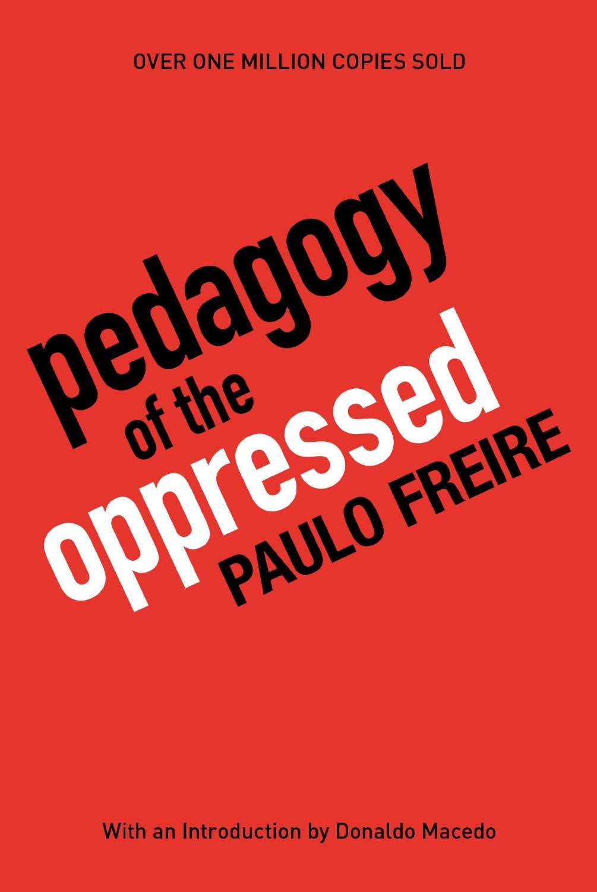
1968
Highlights:
01 Education is running on empty, teaching old knowledge without teaching critical thinking or how to create new knowledge
02 Class – elite versus the masses – not race – is the dividing line between good and bad education
03 Modern education teaches a culture of silence and lethargy instead of dignity, liberation, and the ability to change
04 Illiterates are not stupid! They just cannot read
05 Recognizing reality is liberating for both the oppressed and the oppressor
06 Educating the five billion poor must begin with listening to them
Full-Text Review with Links

Slide 8
1984
Highlights:
01 In the age of information employees deal with ideas instead of things. They are “Gold Collar” workers.
02 Gold Collar workers require different education, training, management, and compensation models from factory workers.
03 We knew in the 1970’s and 1980’s that we needed to change our human resource system – but political and economic leaders refused to make changes or new investments while social leaders refused to confront the political and economic leaders.
Full-Text Review with Links

Slide 9
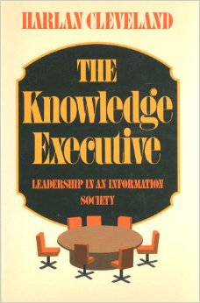
1985
Highlights:
01 Leaders in the past managed physical and human resources. Now they must manage information as the primary resource.
02 Schools must change to teach the integration of all formerly distinct branches of knowledge, while also teaching how to study cause and effect
03 "If there was ever a moment in history when a comprehensive strategic view was needed, not just by a few leaders in high (which is to say visible) office but by a large number of executives and other generalists in and out of government, this is certainly it. Meeting that need is what should be higher about higher education."
Full-Text Review with Links

Slide 10
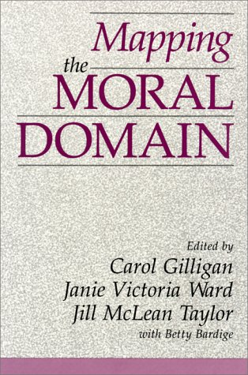
1988
Highlights:
01 Women are compassionate, focus on caring and context; men are “objective” and focus on justice and facts
02 Women are conscious of community and social value; men focus more on the individual and value in isolation
03 Adaptation, diversity, valuation of relationships are all inherently feminine value attributes.
04 Women tend toward balance and feelings and holistic interpretations, men toward narrow focus on the rational.
Full-Text Review with Links

Slide 11
1989
Highlights:
01The evolution of our brains and our ability to sense cataclysmic change that takes place over long periods of time is simply not going fast.
02 One of the more compelling points the authors make is that not only are politicians being elected and rewarded on the basis of short-term decisions that are by many measures intellectually, morally, and financially corrupt, but the so-called knowledge workers--the scientists, engineers, and others who should be "blowing the whistle," are so specialized that there is a real lack of integrative knowledge.
03 We desperately need to develop holistic long-term thinking skills.
Full-Text Review with Links

Slide 12
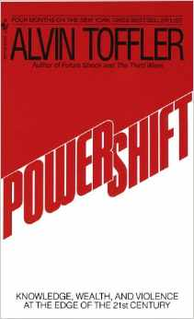
1991
Highlights:
01 An entirely new system of wealth creation is emerging
02 Our legacy investments in computers and communications are now a negative as everything changes so quickly
03 Information wars will be common and eventually bureaucracies will be eliminated
04 Global Gladiators – religions, corporations, and terrorists – are the winners in the new information context
05 Intelligence (decision-support) matters more in the information era; much of it will be privatized.
Full-Text Review with Links

Slide 13
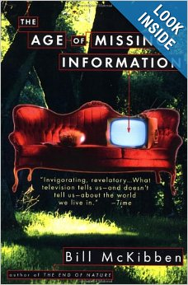
1993
Highlights:
01 Information is not a substitute for nature.
02 Information explosion is drowning our senses and cutting us off from fundamental understanding of our limitations and the limitations of the world around us.
03 Television really did kill history – rehashes last 40 years and ignores previous 4000.
04 Worst disasters move slowly and television does not see them.
05 We are not really in an information age – more like a multi-media age that does not make sense.
Full-Text Review with Links

Slide 14
1993
Highlights:
01 Our administrative structure is wrong
02 We need to raise our sights and strive to teach everybody all the time
03 Information technology is a challenge and an opportunity
04 Multinational, multiagency research is vastly superior to uninational single discipline research
05 Need to connect the world’s research libraries (and everything in-between)
06 Creating the global encyclopedia and world brain should be a priority
07 Life-long learning for all is essential.
Full-Text Review with Links

Slide 15
1994
Highlights:
01 Education is in crisis – it imposes pain and boundaries instead of joy and freedom
02 When boundaries are wrong-headed, teaching to transgress is righteous
03 Education is an antidote to racism, materialism, and militarism (citing MLK)
04 Standards suppress learning, norms neutralize diversity and discovery
05 Teachers who are authoritarian and refuse to engage are social mis-fits
06 Students need space for sense-making and reconciliation of ideas.
Full-Text Review with Links

Slide 16
1995
Highlights:
01 Universities and communities need each other and must teach each other and learn from each other.
02 Universities must become engines for social and economic progress across their communities, not simply play with knowledge in isolation.
03 Outreach can be and should be specialized – find out who needs what knowledge and give it to them.
04 The university does not exist solely to serve registered students. Parents, social agencies, small businesses, corporations, local governments, all have specialized needs that the university can help to meet.
Full-Text Review with Links

Slide 17
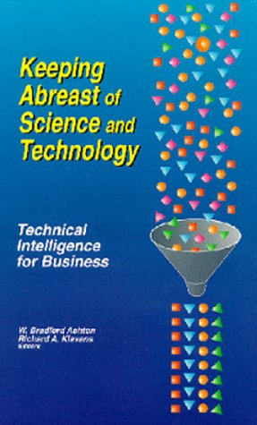
1997
Highlights:
01 US scientific & technical intelligence (decision-support) is in its infancy.
02 US S&T is US-centric and far from grasping what everyone else is doing.
03 US S&T does not understand operational security or counterintelligence.
04 US S&T relies too heavily on registered patents.
05 US S&T has too few practical success stories.
My own comment: The US Government has failed the public twice in this arena. First, NSA created back-doors that made it easy for others to steal S&T; second, the Open Source Intelligence movement is still frozen at birth.
Full-Text Review with Links

Slide 18
1997
Highlights:
01 Knowing too much too fast can be dangerous.
02 There are things that most people should not know even if they can.
03 Who decides? Or how does a society decide what should be forbidden knowledge?
04 Do nations need a national knowledge policy or a natoinal information strategy?
05 Overall, the author speaks to the convergence of power, knowledge, and love to achieve an enlightened intelligence network of self-governing moral people who can defend themselves against evil knowledge and prosper with good knowledge.
Full-Text Review with Links

Slide 19
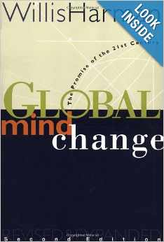
1998
Highlights:
This is a wonderful indictment of the Western scientific tradition. The author shows a clear connection between existing global problems (ethnic violence, water scarcity, pollution, poverty, criminalization of society) and the earlier Western decisions to adopt scientific objectivity (with all of its inherent bias and ignorance) as well as the primacy of economic institutions such as have given rise to the consumerist society, regardless of the external diseconomies, the concentrations of ill-gotten wealth, and the cost to the earth resource commons. The author is especially strong on the need to restore spirtuality, consciousness, and values to the decision-making and information-sharing architecture of the world–only in this way could community be achieved across national and ethnic and class lines, and only in this way could environmental sustainability and justice (economic, social, and cultural) be made possible.
Full-Text Review with Links

Slide 20
1999
Highlights:
01 White House is corrupt.
02 CIA is unprofessional and ignorant – CIA analysts cannot trust CIA spies to tell them the truth about anything.
03 If the media (itself corrupt) does not cover a major story such as Iran-Contra and CIA running drugs, then this is not “known” to the public and is therefore “lost history.”
04 National Public Radio, Associated Press, and New York Times are specifically documented as either killing stories, or publishing false and misleading information.
05 US Government does run covert propaganda programs against its public.
Full-Text Review with Links

Slide 21
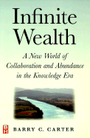
1999
Highlights:
01 The existing bureaucratization of the economy at every level is costing so much as to place all organizations at risk.
02 The sooner every individual begins the process of inventorying their personal capabilities and creating the networks for offering their personal services and knowledge via the Internet to all comers, the sooner they will be able to share in the profits associated with their direct individual contributions to the new economy.
03 Get rich together – as a network – or get left behind.
Full-Text Review with Links

Slide 22
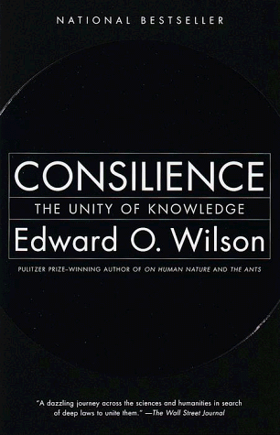
1999
Highlights:
01 Author set out to answer the question “Why do the sciences need the humanities?
02 Consilience is the “jumping together” of knowledge across boundaries, and the greatest enterprise of the mind.
03 Biology, ethics, social science, and environmental policy must all come together to properly resolve a global environmental issue, but actually do not-the learned individuals are fragmented.
04 The public, not only the policymakers, must have access to the unified knowledge.
Full-Text Review with Links

Slide 23
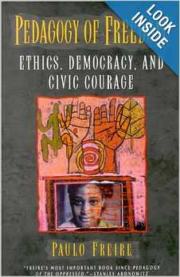
2000
Highlights:
01 Education should be an ethical calling devoted to holistic learning
02 Education is how you shape the future
03 Curiosity + education across humanity = infinite wealth creation
04 Thinking is an act of creation and must be communal, characterized by sharing and interaction – an endless cycle
05 Education must be based on reality and truthful about oppression and root causes of poor conditions
05 Education is ultimately about learning the true costs of all forms of human action
Full-Text Review with Links

Slide 24
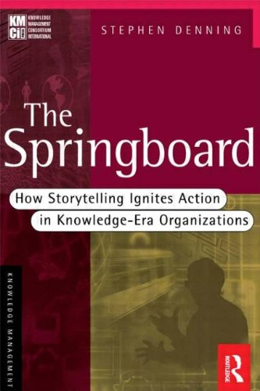
2000
Highlights:
01 Inadequacy of the industry standard briefing, consisting of complex slides with complex ideas outlined in excrutiating detail
02 A story-telling approach can accomplish two miracles:
a) explain complex ideas in a visual short-hand that causes even the most jaded skeptic to “get it,” and
b) do this in such a way that the audience rather than the speaker “fills in the blanks” and in so doing becomes a stakeholder in the vision for change
Full-Text Review with Links

Slide 25
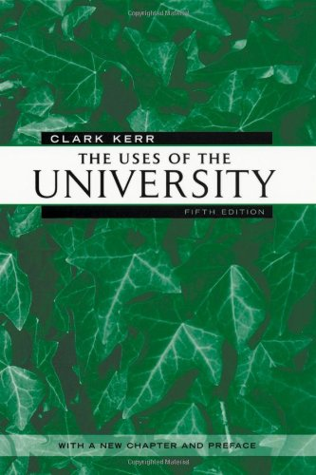
2001
Highlights:
01 Universities are failing in near-catastrophic terms – aging uncaring faculty; vanishing of liberal arts, commercialization (prostitution) of graduate research
02 America spends more on prisons than on universities
03 Suggestions include new emphasis on university support to primary and secondary education, using information technology to connect universities to businesses, exploration of distance learning, and resurrection of mid-career continuous learning
04 Citing Alfred North Whitehead: any society that “does not value trained intelligence is doomed.”
Full-Text Review with Links

Slide 26
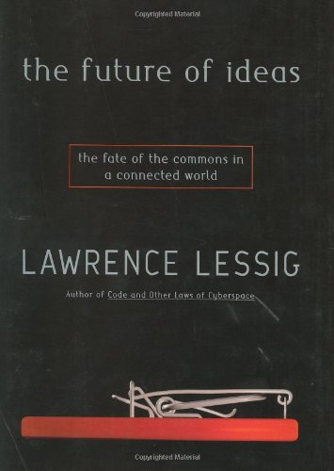
2001
Summary:
The author is laying bare the raw threats to the future of the electronic commons. He discusses in detail how very specific government policies to sell and control bandwidth, and very specific corporate legal claims being backed by “the people’s” lawyers within government, are essentially “fencing” the Internet commons and severely constraining both the rights of the people and the prospects for the future of ideas and innovation. What is happening to the Internet through legal machinations that are largely invisible to the people is a travesty, a crime against humanity even if permissible by law, and perhaps grounds for a public uprising demanding the recall of any official that permits and perpetuates the theft of the commons by corporations and their lawyers.
Full-Text Review with Links

Slide 27
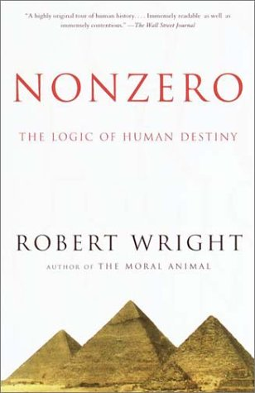
2001
Highlights:
01 Barbarians are “mixmasters” of clture who take down zero-sum cultures (empires)
02 Oppression (win-lose) robs the system of time and energy that would otherwise feed cultural evolution
03 Sharing information is the ultimate “non-zero” act – this feeds reciprocal altruism and social self-organization
04 Multiculturalism is a form of immunization against mono-cultural failure
05 The “noosphere” is nurtured only when the broadest possible portion of the population is literate and engaged.
Full-Text Review with Links

Slide 28
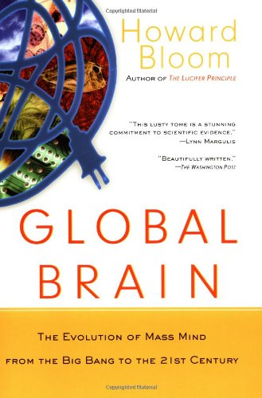
2001
Highlights:
01 Biology, not technology, rules.
02 Five major elements of global inter-species and inter-group network intelligence are the conformity enforcers; the diversity generators; the inner-judges; resource shifters; and inter-group tournaments.
03 Half a person’s brain cells are killed off by cultural-driven framing.
04 Non-conformists—diversity generators—are priceless but tend to be shut out just when they are needed most.
05 We lack metrics for understanding the economic productivity role of information sharing and sense-making.
06 Mass mind has been kidnapped and is suffering from a staged mass hallucination.
Full-Text Review with Links

Slide 29
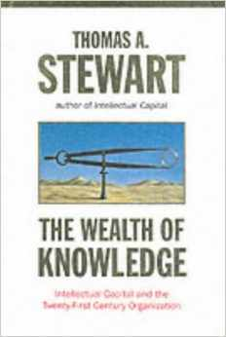
2002
Highlights:
01 Focus is on paying attention to truth and seeking the truth through networks of trust
02 As world gets more complicated training becomes more critical – on a continuous basis
03 All existing models of governance and management are obsolete
04 Intelligence (decision-support) is not just for individual decision-makers, it should be created for entire industries
05 Stop making things and marketing them – focus instead on being able to meet new needs in near-real-time
Full-Text Review with Links

Slide 30
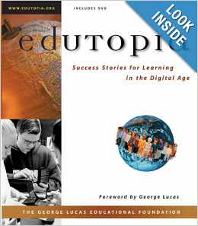
2002
Highlights:
Chapter Nine discusses a dozen promising practices that work:
01 Peer Instruction
02 Cross-age tutoring
03 Bringing local experts into the classroom
04 Multi-age classrooms
05 Cooperative learning
06 Class-size reduction
07 Team teaching
08 Looping (teachers stay with same students for several years)
09 Block scheduling
10 Schools within schools
11 School teams
12 Community service
This is a superbly crafted multi-media teaching tool that every teacher, parent, and administrator will learn from and be strengthened by.
Full-Text Review with Links

Slide 31
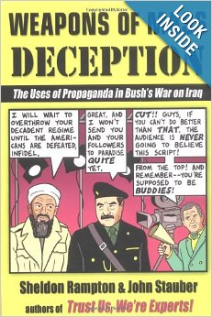
2003
Highlights:
01 Professionally-prepared, well-documented catalog of the “platform of lies” that the incumbent (2000-2004) US Administration pressed upon the public in the course of executing six wars and two occupations, at great expense.
02 Documents US “historical amnesia”
03 Documents inability of the USG to listen to its own public or other publics
04 Documents a frighteningly compelling comparison of Bush-Cheney public information campaigns with those of Hitler-Goering.
05 Is dissent treason? Is declaring dissent treason itself treason?
Full-Text Review with Links

Slide 32
2003
Highlights:
01 Human Dynamics require open space technology (another book by the same author) and whole systems thinking to achieve sustainable win-win consensus.
02 Conflict is good – it highlights points of disagreement and opens the way for transcending conflict to produce peace
03 Muddling through is a better approach to conflict than command & control because it enables self-organization at the edges – this is what makes transformation possible.
04 Being open to EVERYBODY, being able to LISTEN to everybody, and AVOIDING top-down mandates that are generally in error, enables peace.
Full-Text Review with Links

Slide 33
2003
Highlights:
01 Universities have prostituted themselves across athletics, research, and education.
02 Athletics, nominally a revenue stream, have a negative true cost much greater than realized
03 The commercialization of research and the creation of customized executive education have undermined independent scholarship
04 This is not a problem that can be fixed by any one university or even the larger community of universities – it is a national issue demanding a national political and public commitment to restore the primacy of education as a foundation for national strength
Full-Text Review with Links

Slide 34
2003
Highlights:
01 Holistic knowledge, not specialist knowledge in isolation, is what matters
02 Understanding each other, not depth of personal knowledge, is critical factor in advancement of human condition.
03 Appreciation for our Earth (true cost economics) and humanity (cultural intelligence) must precede our becoming intelligent as a species.
04 Individual intelligence is nothing without social intelligence – both are requires to detect error and illusion, to confront uncertainty, and to advance the human condition.
Full-Text Review with Links

Slide 35
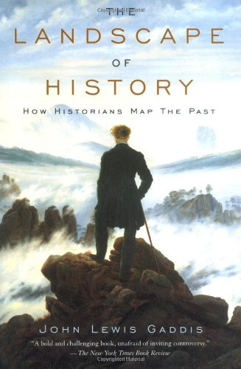
2004
Highlights:
01 Bluntly critical of political science and social science communities for failing to engage in methodical research
02 History is a “denied area” for most
03 Across the disciplines there is a disregard for history and a lack of appreciation for culture and religion as fundamental aspects of the total intelligence picture
04 Islam is but one of many examples of how we create “denied areas” for ourselves by failing to apply analytic tradecraft with integrity.
Full-Text Review with Links

Slide 36
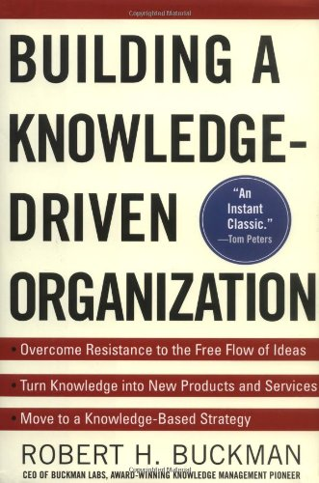
2004
Highlights:
01 Technology is the easy part – changing the culture from information hoarding to information sharing is the hard part
02 Stovepipes of control are also stovepipes of information that is not being shared
03 All information technology and all information management needs to be under one person who reports to CEO
04 If you are not rolling over half your software and hardware every year, for 100 renewal every two, you’re failing
05 85% of what you know or need to know is not in databases – it is in your human network and that’s the gold
Full-Text Review with Links

Slide 37
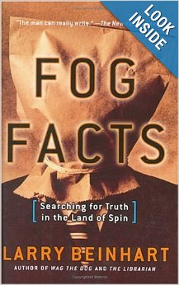
2005
Highlights:
01 “Fog facts” are facts that are out in the open, but “invisible” in the sense that no one acts on them.
02 “The Big Lie” is the opposite of Fog Facts, and all the more effective for being loud, repeated, and simplistic.
03 The author concludes that there is a war today, not between civilizations, but between faith-based and reality-based communities.
04 Truth – and acting on truth – is easier at the local level.
Full-Text Review with Links

Slide 38
2005
Highlights:
01 Water and the governance of water may be the most important educational, social, and economic issue of our time.
02 Water cannot be understood nor governed in isolation from all surrounding socio-economic and other contextual issues.
03 The greatest obstacle to informed governance of water is the plethora of artificial political and economic boundaries and “rights” that are disconnected from reality.
04 Information-sharing and open shared sense-making is the one means of overcoming obstacles and achieving sustainable outcomes.
Full-Text Review with Links

Slide 39
2005
Highlights:
01 Synergy, bioeconomics, and cybernetics converging for good of all.
02 Holistic Darwinsim takes a new perspective on evolution, focusing on bio-economics – the functional costs and benefits of cooperative phenomena.
03 The more complex a society becomes, the more vital it is that feedback loops become faster, better, cheaper.
04 Politics is the dysfunctional intellectual and moral precursor to human cybernetics – the social sciences have failed to offer normative, adaptive, affordable, and compelling alternatives to prevailing models that are corrupt and therefore wasteful and toxic to humanity.
Full-Text Review with Links

Slide 40
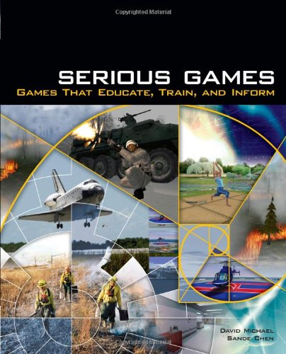
2005
Highlights:
01 Game world today is fragmented – each sector has its own, isolated from the whole – there is no EarthGame
02 The Serious Games world is not as developed as one might hope – a number of conferences, books, and web sites but there is a general lack of coherence.
03 Games are not inter-operable nor are the rooted in comprehensive real data.
04 Games do offer an alternative to rote education, to include team learning and cross-cultural learning.
Full-Text Review with Links

Slide 41
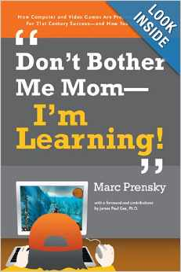
2006
Highlights:
01 Digital learning should be fun and can be gamed
02 Games can be factual – real decisions, real budgets, real costs, real outcomes
03 Games exist but the schools are not using them nor helping the students or parents find them
04 Games can be interactive and team-based, bringing students together, or students and teachers, or students and parents, or student groups from diferent schools, countries, cultures
Full-Text Review with Links

Slide 42
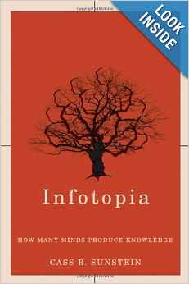
2006
Highlights:
01 Education is the necessary continuous foundation for deliberation
02 There are four big problems in the history of deliberation: amplified errors, hidden profiles and the favoring of familiar old knowledge, cascades & polarization, and narrow groupthink
03 Wikis and predictive markets are two innovations enabled by the Internet
04 The Holy Grail of Infotopia is the combination of full participation and full disclosure – everyone plays and everyone tells the truth.
Full-Text Review with Links

Slide 43
2006
Highlights:
01 Absence of a shared language between and among disciplines (fields of study) joins absence of shared data to create a vacuum in human knowledge.
02 Democracy demands a shared language and the ability to foster a dialog that creates value.
03 In the absense of an over-arching holistic world systems framework, individual disciplines lack relevance and value.
04 Ethical people are more important than science in isolation. Without ethical people, science will not map root causes or devise holistic solutions.
Full-Text Review with Links

Slide 44
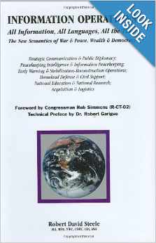
2006
Highlights:
• inter-agency sharing of non-secret information is much more important than precision delivery of secrets to the top guy;
• unclassified information on operations, logistics, beliefs, etc. is much more important that technical secret information; and
• there is a larger process called "Information Operations" (IO) that has been mis-defined in the US as offensive cyberwar and PSYOP
• IO is the full and constant integration of global coverage in all languages all the time (including historical and cultural knowledge);
• the technologies of sharing, translating, and understanding; inclusive of online video gaming;
• crafting of inter-agency BEHAVIOR and BUDGETS (means) to achieve useful ends.
In short, it's not about secret intelligence; it is about global awareness and ethical behavior
Full-Text Review with Links

Slide 45
2007
Highlights:
01 The author synthesizes natural sciences, developmental psychology, political thought, philosophy, and spiritual traditions. This helps to understand the DNA of the body-mind-soul.”
02 Need to respect distinctions between science, philosophy, and spirituality while seeking to integrate them in practice
03 There are multiple levels of social consciousness – what is perceived as “truth” changes at each level
04 Integral consciousness finds *new* solutions via “vision-logic” centered in volition (good intention) rather than cognition. VALUES & WORLDVIEW rule.
Full-Text Review with Links

Slide 46
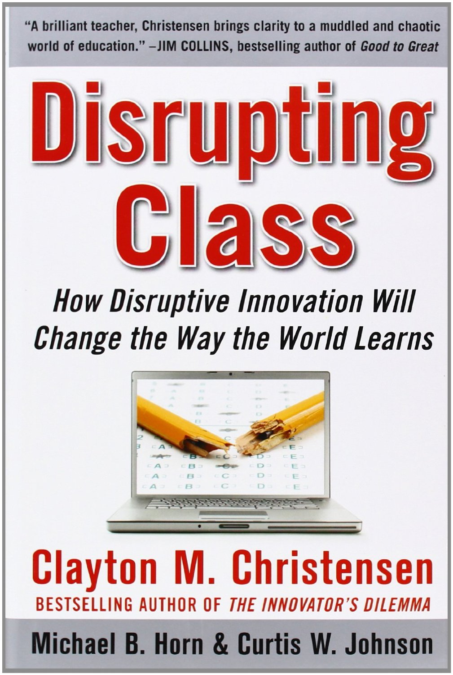
2008
Highlights:
01 In theory, schools are supposed to inculcate democratic values, keep the country competitive, eradicate poverty, and provide something in the way of learning for everyone.
02 Self-paced instruction and new forms of linking across cultures and languages are the next big thing.
03 Book is about information technology innovation, fails to address art, music, theater, social work, apprenticeships…
04 Harnessing user-generated content to explode what can be learned and how is the revolution after next.
Full-Text Review with Links

Slide 47
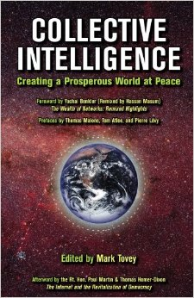
2008
Summary:
The era of collective intelligence has begun in earnest. While others have written about the wisdom of crowds, an army of Davids, and smart mobs, this collection of essays for the first time brings together fifty-five pioneers in the emerging discipline of collective intelligence. They provide a base of tools for connecting people, producing high-functioning teams, collaborating at multiple scales, and encouraging effective peer-production. Emerging models are explored for digital deliberative democracy, self-governance, legislative transparency, true-cost accounting, and the ethical use of open sources and methods.
Full-Text Review with Links

Slide 48
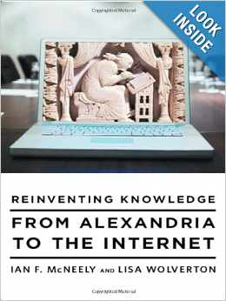
2009
Highlights:
01 YES, Internet has led to an order of magnitude or more knowledge creation and sharing
02 NO, the Internet has not led to a dramatic change in the definition of knowledge or the role played by knowledge in governance or business or any other domain
03 My comment: Internet is not helping make sense, track true costs, or eradicate corruption
04 It’s not about knowledge – it’s about restoring community and the role of community and consensus in making decisions
Full-Text Review with Links

Slide 49
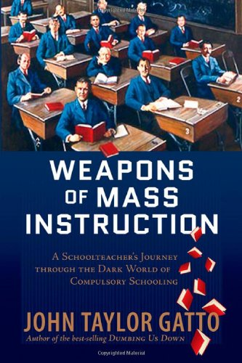
2009
Highlights:
01 Public schools are the ultimate means of creating a docile non-thinking public.
02 It’s purpose is to emphasize the vocational or disciplinary aspect and avoid the political or philosophical reflection aspect of education.
03 Compulsory schools reduces self-reliance, ingenuity, courage, competence and other frontier virtues.
04 Standardized tests institutionalize dishonesty
06 Rote learning is a form of information deprivation – a form of state religion – that helps the elite retain an information advantage over the masses.
Full-Text Review with Links

Slide 50
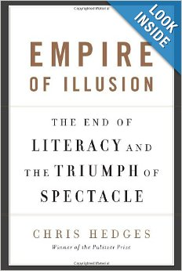
2009
Highlights:
01 Free market capitalism and rush to globalization have rotted the foundation of America – both parties are to blame
02 Celebrity culture and cult of distraction and superficial leads to junk politics and junk economics. “Pseudo-events destabilize truth.”
03 Pornogrpahy is a major means by which segments of the public are stupified (gambling, games, social media)
04 Universities are a sham, specialists are illiterate, students learn by rote and cannot think for themselves
05 Corporations have hijacked everything from community and politics to love and wisdom
Full-Text Review with Links

Slide 51
2009
Highlights:
01 Social education goes far beyond the schoolhouse; recommendations:
1. Expand mental health investments
2. Teach children resilience skills
3. Avoid performance pay
4. Ban advertising for children
5. Increase redistribution (and empowerment of) the poor
6. Discourage gambling
7. Discourage commuting
8. Encourage residential stability (neighborliness)
9. Nurture work-life balance
10. Expand consumption taxes
11. Measure satisfaction
12. Strive to satisfy
13. Build social capital
02 Invest in information as a public good, value social IQ, support the economy of regard for one another
Full-Text Review with Links

Slide 52
2009
Highlights:
01 Connecting people is more important than collecting facts.
02 Evolution is defined by win-win solutions, not by win-lose solution that are unsustainable.
03 Integration of diversity, constant alignment with reality, and harmonization of interests of all causes magic to happen.
04 Education should enable systemic awareness, systemic health, and systemic learning.
Full-Text Review with Links

Slide 53
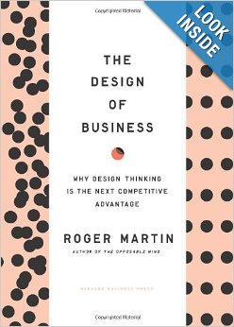
2009
Highlights:
01 Addresses the core need to design beyond the Industrial Era where Six Sigma stops.
02 Design thinking is abductive thinking – intuits new ways
03 Design thinking moves knowledge from mystery to heuristics to algorithms to computer code
04 Design thinkers must persist in face of resistant/repressive cultures
05 Design thinking is marginalized by demands for past examples, aversion to change, and demands for results in too short a timeframe.
06 We are our own worst enemy.
Full-Text Review with Links

Slide 54
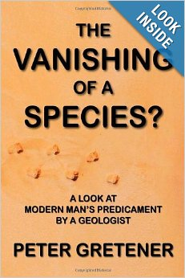
2010
Highlights:
01 Earth will survive just fine – humanity might not
02 Man as toolmaker has outpaced man as conscious being – all “leaders” have failed to develop human resources as fast as they have exploited physical resources
03 Population explosion is central challenge – particularly when public loses respect for the law and public lacks integrity generally
04 Failing to rear the young, to include full-time mothers and schools that education instead of just train, is our greatest failure
05 Revolution is good - the revolution we require is one of human consciousness.
Full-Text Review with Links

Slide 55
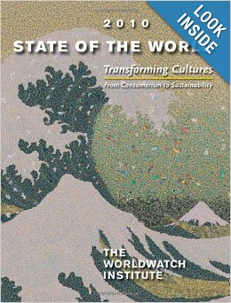
2010
Highlights:
01 Education must be focused on transforming culture. Absent such a focus, societies do not learn.
02 Education must focus on the human role within a much larger vast complexity of life – not just on teaching a “trade.”
03 The fastest means of unifying all of the academic disciplines – the sciences and the humanities – is to focus on sustainability of the Earth and all of its species as the common factor.
04 Integrating “true cost economics” into every discipline is a starting point for holistic education.
07 Teach 7 R’s: Reduce, Reuse, Recycle, Respect, Reflect, Repair, Responsibility
Full-Text Review with Links

Slide 56
2010
Highlights:
01 The author integrates information science, information psychology, information sociology, information politics, and information culture.
02 Heart of the book focuses on how open access is essential but our content is still very immature – with specialist search being terrible
03 Knowledge is no longer the primary domain of the academic world – our architecture has not caught up with this reality
04 No one, anywhere, is serious about real time science or real time information sharing and sense-making
Full-Text Review with Links

Slide 57
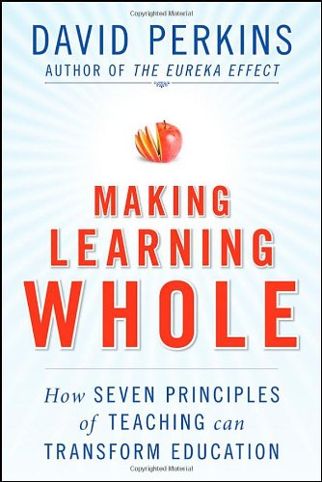
2010
Highlights:
01 Teach everything in context – other disciplines, other players, other challenges, learn to learn the hidden.
02 Rote memorization undermines learning of generic principles.
03 Learning to find problems is at least as important as learning to solve problems identified by others.
04 Knowledge is multifaceted and includes, beyond “facts,” logic, probability, and intuition.
05 The acme of skill in education is learning to recognize ignorance – areas of uncertainty, errors, taboos, the unknown unknowns.
Full-Text Review with Links

Slide 58
2010
Highlights:
01 Ossified thinking patterns harm us:
· a rational pattern locks in optimal solutions that rapidly become obsolete
· a focused pattern is blind to reconfiguration options and the influence of external relationships
· a principled pattern fails to apprehend and develop the unique opportunities of a situation
· a interested pattern undercuts common interests that are already imperiled
02 Reflexive practice is the alternative – adaptive, holistic, open-minded.
Full-Text Review with Links

Slide 59
2010
Summary:
We are entering an era in which global networks and the sharing of information can create revolutionary wealth at the micro-level, while enabling the harmonization of investments at the macro-level. This is an era in which transparency of cost and effect will eradicate corruption, fraud, waste, and abuse at the same time that it makes possible global to local engagement and collaboration such that we can create a prosperous world at peace. This is an era in which we will see a bottom-up conscious evolution of humanity that liberates and leverages the one inexhaustible resource we have: the human brain.
Full-Text Review with Links

Slide 60
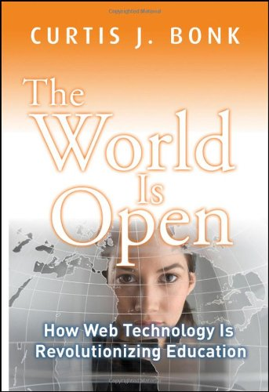
2011
Highlights:
01 Our educational “delivery system” is broken and shows no sign of adapting to student and faculty needs or newly available technologies.
02 The ten key trends for those universities that do wish to adapt:
Web-Searching
Blended Learning
Free/Open Source Software (F/OSS)
OpenCourseWare
Learning Portals
Learners as Teachers
Electronic Collaboration
Alternative Reality/Serious Games
Mobile Real-Time Learning
Networks of Personalized Learning
Full-Text Review with Links

Slide 61
2011
Highlights:
01 Six major factors of happiness not now impacted significantly by education
Marriage
Social Relationships
Employment with Trust in Management
Perceived Health
Religion in sense of Community
Quality of Government
02 QUOTE: “At present, few government officials and educators pay enough attention to preparing young people for a full and rewarding life.” [p. 177]
03 Education has lost art of teaching liberal arts and broad learning and learning how to think – gone too far toward vocational and pre-professional education.
Full-Text Review with Links

Slide 62
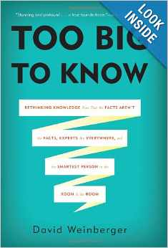
2012
Highlights:
01 Everything we do now with hierarchical organization, hoarded information, restricted accesses, and isolation from the full range of external sources and methods, is wrong for the times.
02 Recommendations: open up access; provide the hooks for intelligence (meta-data); link everything; leave no institutional knowledge behind; teach everyone.
03 True learning occurs within networks of learning – we are not sufgfering from information overload as much as from filter failure.
04 TRUST is what determines the successful rendering of information into intelligence
Full-Text Review with Links

Slide 63
2013
Highlights:
01 Education is a protected cartel and a dinosaur of an industry – the factory model is not working.
02 Decentralization, Adaptability, Transparency, and Accountability are the recommended precepts for change.
03 Credentials for long-term study have lost value while credentials for specific competencies are rising.
04 Human capital matters much more now but must be able to learn on the fly and continuously, be adaptable, collaborate effectively, be accountable, and continuously build social and financial equity.
Full-Text Review with Links

Slide 64
2013
Highlights:
01 The Industrial Era is collapsing – this is a good thing
02 Apocalypse is about revelation of new possibilities not the end of all
03 The primary bridge for transformation, the primary solution, is spiritual.
04 We have been our own worst enemies, inclusive of our acceptance of a debt economy, and dumbing-down
05 We have an opportunity to grow, to restore our unity with nature
Full-Text Review with Links

Slide 65
2015
Highlights:
01 Intelligence is evaluated on the basis of its outputs – ethical evidence-based decision-support – not about inputs (sources and methods).
02 Everybody, without exception, should be a producer and a consumer of intelligence.
03 Sharing, not secrecy, is the core nature of 21st Century intelligence.
04 Multinational, multiagency, multidisciplinary, multidomain is the human aspect.
05 Open Source Everything is the technical aspect.
Full-Text Online (Partial)

