Slide 1
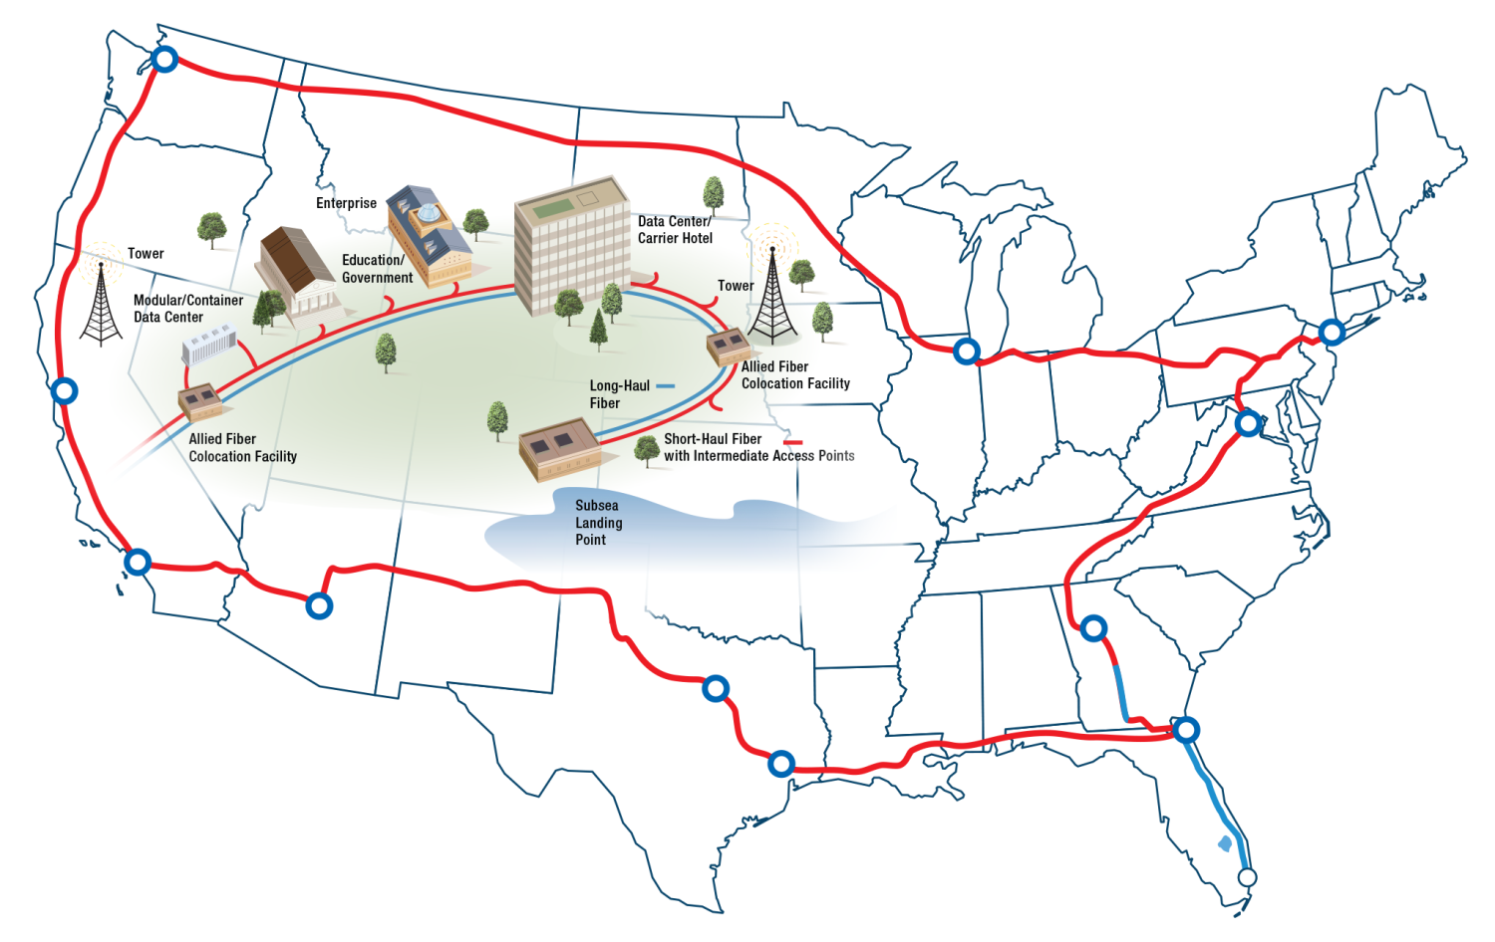
Company Overview
Internet Society, LIBTECH NYC
May 21, 2014

Slide 2
Safe Harbor
Confidential Information
The attached materials constitute Confidential Information as defined in the confidentiality provisions agreed to by your respective institutions when it accepted the invitation to this meeting. These materials are being provided to the recipients subject to the restrictions set forth in that agreement. [Phi Beta Iota: This applies to selected working verbally delivered and other documents. This set of slides is posted for the public with the explicit permission of Hunter Newby CEO of Allied Fiber.]
Forward Looking-Statements
The attached materials contain certain forward-looking statements regarding our Company, its financial condition and its results of operations, as customarily prepared by management for its internal use. All of these statements are based on estimates and assumptions prepared by its Company’s management that, although we believe to be reasonable, are inherently uncertain. These statements involve risks and uncertainties, including, but not limited to, economic, competitive, governmental and technological factors outside of our control that may cause our business, industry, strategy or actual results to differ materially. We undertake no obligation to update or revise any of the forward-looking statements contained herein, whether as a result of new information, future events or otherwise. The financial information presented herein has been provided for indicative purposes only, is preliminary and remains subject to change, including potential adjustments in connection with the audit procedures to be performed by our independent public accountants.
Non-GAAP Financial Measures
This presentation (i) contains non-GAAP measures, (ii) uses terms which are not presentations made in accordance with GAAP, (iii) uses terms which are not measures of financial condition or profitability, (iv) should not be considered as an alternative to GAAP financial measures, and (v) contains terms which are unlikely to be comparable to similar measures used by other companies.
2

Slide 3
Table of Contents
Description Pages
Industry Basics 4
Who is Allied Fiber? 6 - 10
What is the Big Picture for Connectivity? 12 - 15
What is Allied Fiber Building Now? 17 - 21
What is Next for Allied Fiber? 23 – 24
3

Slide 4
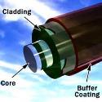

Industry Basics
Definitions
What is Optical Fiber?
An Optical Fiber strand is optically pure glass, slightly thicker than a human hair, typically encased in 4 other layers, including optic core, optic cladding, buffer coating, and an outer jacket
Fiber strands are used to transmit information by carrying pulses of light, typically digitally, where a pulse of light is a “1” and a no pulse is a “0”
What are Fiber-Optic Networks?
First developed in the 1970s and commercially applied in 1977, Fiber-Optic Networks transport the information we see and use every day
They are among the most technologically advanced innovations in the field of networking
Fiber-optic networks form the nuts and bolts of a communications network
What is Colocation and Network-Neutrality?
Colocation is the housing of transport equipment, other communications equipment, servers and storage devices in the same location
Some colocation providers, such as Allied Fiber, are network-neutral meaning that they enable the customers who colocate in their facilities to purchase bandwidth infrastructure and other telecommunications services from third parties
Network-neutral colocation providers sell interconnection services that enable their customers to cross connect to other customers located within the same facility
What is a Meet-Me-Room?
A Meet-Me-Room is physical location in a building where all types of network operators, including carriers, service providers, enterprise, government, education networks, and others physically interconnect so that traffic can be passed through their respective networks. Network operators can also connect outside the Meet-Me-Room
4

Slide 5
Who is Allied Fiber?
5

Slide 6
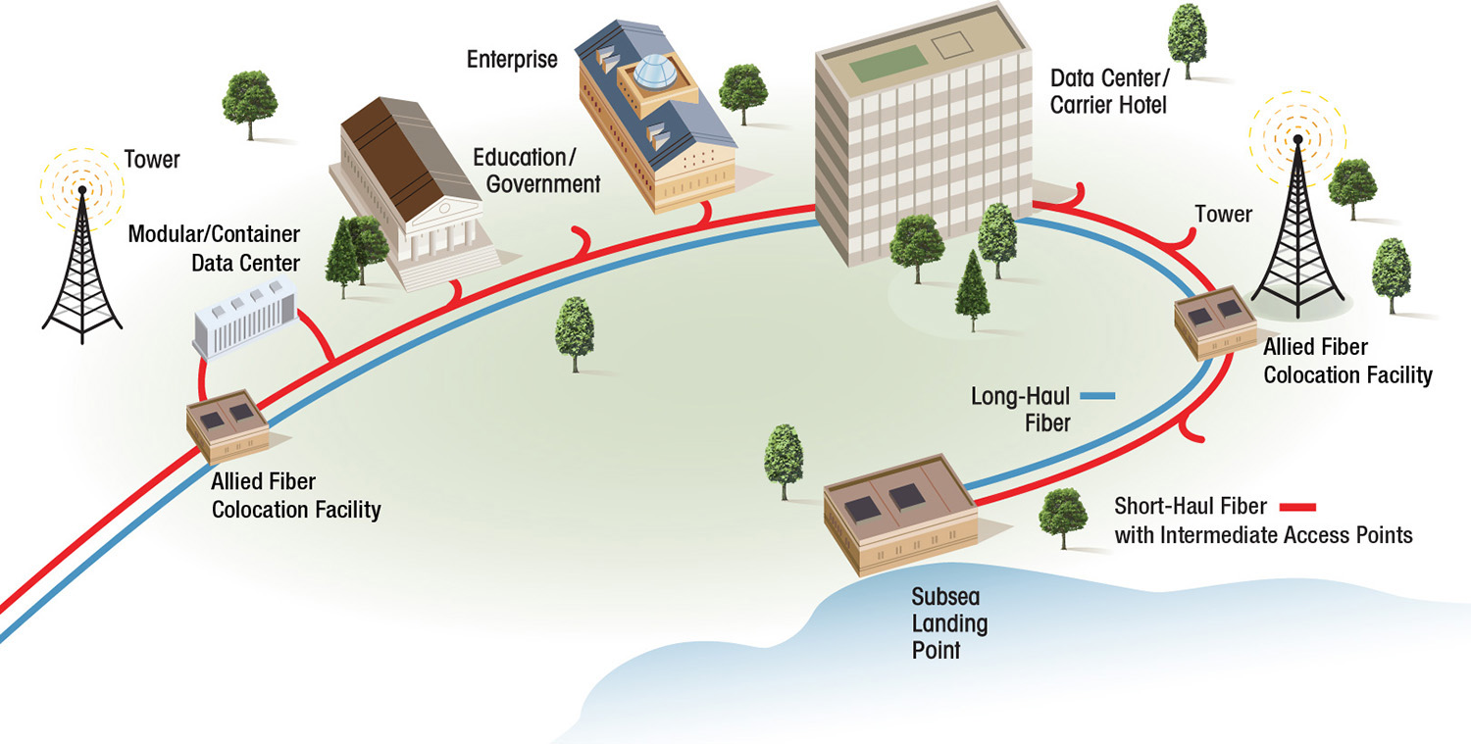

Setting the Standard for...
The Next Generation of Fiber Optic Systems
Allied Fiber is building the first integrated network-neutral colocation and dark fiber company
  Fiber optic system offers combined long-haul and short-haul capabilities coupled with network-neutral colocation facilities
  Direct access for wireless towers, rural broadband networks, service providers, enterprises, governments, education, etc.
  Enables distributed cloud computing
  Improves latency, quality of service, throughput and control
  Dark fiber infrastructure is the basis for economic development and GDP growth

Slide 7
Complementary Product Portfolio Provides Predictable and Steady Cash Flow
Fiber Leasing
Colocation Leasing
Overview
Customers lease individual strands of fiber along multi-access point route
Network-neutral dark fiber can be customized to customer specifications
Customers lease space within the network-neutral colocation facilities to house their network equipment
Facilitates interconnection with other network providers and colocation customers
Products / Service Type
Long-haul (major city fiber pairs)
  20 year IRU with full payment upfront
  Annual lease with an option to convert to an IRU
  Recurring monthly revenue for operations and maintenance expenses (“O&M”)
Short-haul (intermediate access fiber pairs)
  20 year IRU with full payment upfront
  Annual lease with an option to convert to an IRU
  Recurring monthly revenue for O&M
Lease space in network-neutral colocation facilities
  Recurring monthly revenue for space
  One-time setup and electrical connection fee
  Recurring monthly power usage fees
  Technical support fees
Financial Profile
Fiber IRU Cash Revenue Profile
Monthly Colocation & Other Cash Revenue Profile
Significant Upfront Cash Revenue Funds Network Expansion
Scalable and Reliable Monthly Cash Revenue Funds Operations and Growth
$
$

Slide 8

Diverse Network Operator Universe has a Unique
Set of Motivations for Purchasing Dark Fiber
Wireless
Backhaul is increasingly becoming a network operations concern, especially with expansion of 4G / LTE
Explosive growth anticipated, driven by increasingly data intensive applications
Carriers
Operating a lit network over dark fiber is what defines a carrier as a carrier
  Carriers need control of the underlying economics of the transport system
  Avoid purchasing lit service from one another
  Control of provisioning timeframes to realize revenue as soon as possible
  Control of quality of service to keep customers happy and buying more lit service
MSOs & CLECs
Possess operational resources necessary to be in control of their own network
Prefer the cost benefits and control offered through leasing dark fiber as opposed to lit services
ISPs
Need connectivity to regional and long-haul fiber networks and connectivity for backhaul
Distance from these networks is the key cost driver for ISPs
Proximity to many rural areas will enable ISPs to offer competitive pricing for connectivity
Enterprises
Prefer operational and financial control of their network
Dark fiber is a lower cost and more customizable solution than lit services
Networks now seen as a strategic asset and potential competitive advantage
Diversity, security and privacy are important factors
8

Slide 9
Evolution of Allied Fiber
6/08:
Allied Fiber, LLC formed
9/09: Norfolk Southern Railway (“NS”) agreements executed
7/10: Completed construction of ducts from Manville, NJ – Phillipsburg, NJ
10/10: Completed construction of ducts from Chicago, IL – Indiana Harbor, IN
9/11: Major MSO agreement executed
2/12: Completed co-construction of 216 count fiber cable in NS duct from Valdosta, GA – Macon, GA
June
2008
Jan
2009
Sept
2009
Jan
2010
July
2010
Sept
2010
Oct
2010
Nov
2010
Jan.
2007
Sept
2011
Dec
2011
Feb
2012
April
2014
1/09: Initial investments from friends and family
1/10: Additional investment from Media & Entertainment family office
9/10: Completed construction of ducts from Phillipsburg, NJ – Bethlehem, PA
11/10: Customers contacted and negotiation of agreements commenced
12/11: Completed construction of ducts in Chicago metropolitan area;
12/11: RBOC agreement executed
2/13 – 4/14: Completed and funded deals with Flagler and NS; MIA - JAX construction completed; MIA – JAX network live
9

Slide 10
What is the Big Picture for Connectivity?
10

Slide 11
Unprecedented Growth in Data Consumption Fueling
Demand for Broadband Capacity
An Increasingly Mobile Society
Proliferation of Cloud Computing
(1)
(2)
Exabytes /
Month
Global Mobile Data Traffic
Worldwide IT Cloud Services Revenue by Segment
$Bn
’12 – ’17 CAGR: 66%
Proliferation of smart phones and tablets and continued shift towards digital content driving mobile data usage
  Nearly 20% of total forecasted 2017 global mobile data traffic attributable to North America
  Vast geographic profile of the U.S. creating challenges for fiber penetration of wireless towers
Majority of U.S. wireless towers currently not connected to fiber backbone
Enterprise IT outsourcing trend to accelerate as companies seek options to reduce costs, while enhancing technical capabilities
By 2015, one of every seven dollars spent on packaged software, server and storage offerings will be through the public cloud model
Source: Cisco Systems Visual Networking Index (February 2013).
Source: IDC.
11

Slide 12
Demand for Broadband Capacity Cannot Be Met Due to Substantial “Fiber Gap”
Optical Fiber Gap
U.S. Business Fiber Trend
(1)
The U.S. lags behind most developed countries as far as Internet speed is concerned. Optical fiber facilities currently reach only 36.1% of U.S. commercial buildings, leaving the remaining 63.9% in the “Fiber Gap”
The demand on current fiber-optic cables has put a severe strain on suppliers and delayed projects put forth by service providers
The Fiber Gap has closed a mere 25.2% since 2004, when the penetration rate was 10.9%, representing a compound annual growth rate of only 16.1%. At that rate, it will take another 18 years for the U.S. to reach 95%+ fiber penetration
“Direct fiber is clearly the preferred access technology for Carrier Ethernet services, as well as for higher speed connectivity to IP VPNs, Cloud-based applications and the Internet. Enterprise customers prefer direct fiber due to the benefits of scalability to multi-gigabit speeds plus lower bandwidth costs as compared to other access options”, Rosemary Cochran, Vertical Systems Group
% of Commercial Building with 20+ Employees
Source: Vertical Systems Group, Inc.
12

Slide 13
Fiber Gap Creates Compelling Opportunity for Allied Fiber
Industry Challenges
Allied Fiber Solution
Geographical Reach / Access
Vast geographic profile of U.S. limits reach of existing fiber infrastructure
Existing long-haul dark fiber only allows for access in major metropolitan markets
Provides wireless network operators and growing rural markets with economically viable access to dark fiber
Unique multi-access point design enhances accessibility of fiber and carrier-neutral colocation services
Growing Capacity Constraints
Exponential growth in data placing pressure on existing fiber infrastructure
Rights-of-Way requirements are barrier for construction of new cohesive fiber network
63% Fiber Gap in the U.S. limits connectivity
Allied Fiber has Rights-of Way access to parallel ducts providing incremental capacity to support future growth from ever increasing demand for broadband
Allied Fiber is installing some of the largest capacity optical fiber cables in the U.S. ever deployed
Carrier-Controlled Conflicts
Carrier-controlled fiber capacity creates conflicts when selling services to other carriers / competitors
Sector consolidation is exacerbating this issue as remaining capacity is controlled by shrinking number of carriers
Allied Fiber’s network-neutral design removes competitive limitations, enhances control of the network, and avoids premiums associated with carrier-controlled fiber or lit service
Provides low cost startup opportunities for new service providers
Technological / Design Inefficiency
Existing fiber capacity uses older cable and systems with inconsistent fiber types that cannot support the new state-of-the-art transmission equipment at maximum utilization
Allied Fiber employs the latest generation optical fiber technology, enabling higher throughput levels through the same number of fiber strands than currently available fiber
13

Slide 14
Key Dark Fiber Statistics
Dark Fiber Services by Segment
Options for Obtaining Bandwidth
(1)
(2)
Dark Fiber End Users
(1)
For carriers, large enterprises, government agencies and major content providers, lit fiber services can be restrictive
Leasing dark fiber through Indefeasible Rights of Use (IRUs) allows virtually unlimited bandwidth, security, control and flexibility as the lessee installs its own optical equipment
Allied Fiber’s business model serves the requirements of each of the above market segments
Source: IBIS World, Nortel Networks and Wells Fargo Securities, LLC.
Metro Dense Wavelength Division Multiplexing or “Metro DWDM” systems are designed for access, metro and regional optical networking applications.
14

Slide 15
What is Allied Fiber Building Now?
15

Slide 16
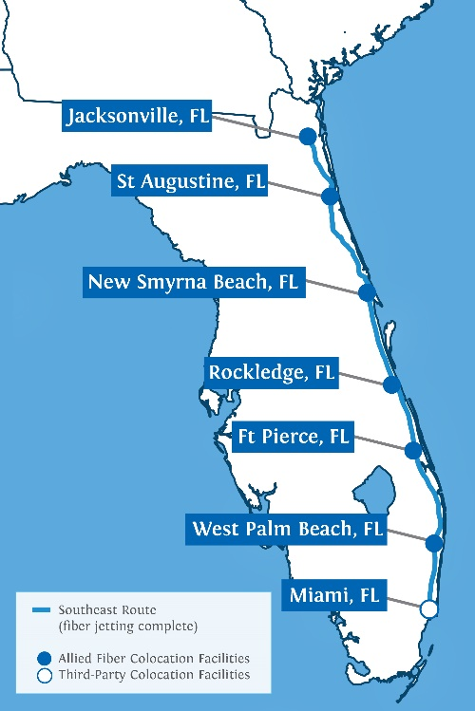
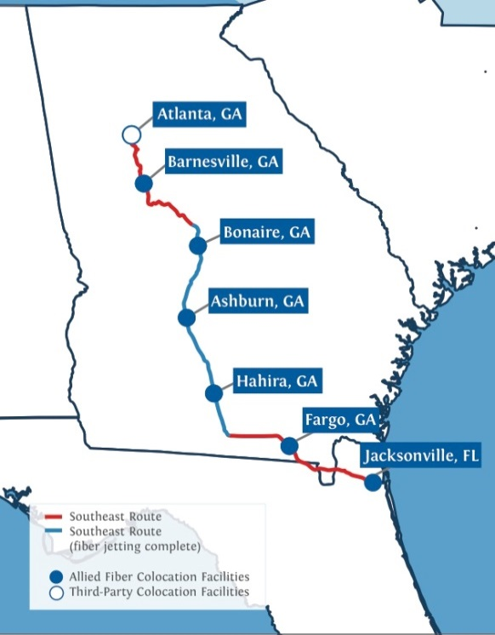
Florida and Georgia Routes
Route Access
Fiber Access
Colocation Access
727 total route miles
  364 +/- route miles from Miami, FL to Jacksonville, FL
  363 +/- route miles from Jacksonville, FL to Atlanta, GA
  150 route miles already built in GA
Enhances existing route diversity and reduces redundancy
Florida East Coast Railway (“FECR”) Right-of-Way (“RoW”) agreement completed and first two year’s rent funded; Norfolk Southern Railway (“NS”) Right-of-Way agreement completed and executed
Last “fully-built” underground conduits available along corridor
3 new undersea cables terminating in Jacksonville and Boca Raton, FL provide fiber access to South America, Europe and the Caribbean
Intermediate access points at least every 3,000 / 5,000 (feet depending on the route)
  Allows wireless operators and enterprises to efficiently connect to a network-neutral fiber backbone
Much needed rural broadband solution
More than 250 towers already connected to Company’s fiber
Network-neutral facilities located every 60 miles
  Accommodates long-haul signal regeneration equipment, short-haul customer and local colocation customer interconnection
Improves network control, performance and reduces latency
Allied Fiber’s Southeast Routes

Slide 17
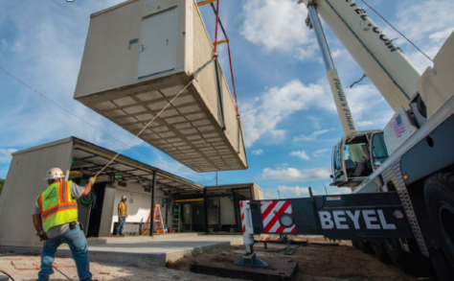
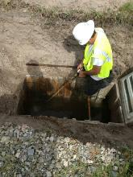
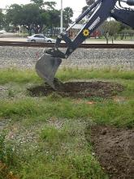
Allied Fiber Completes Fiber Jetting from Miami to Jacksonville
Fibers Spliced and Tested End-to-End as of Feb 8th, 2014
Loss Per 100km Span Only. 24db
Allied Fiber System Specifications:
  Fiber Count / Type:
    528 Fibers – SMF28e + LEAF
  Florida Colocation Facilities:
    Network-Neutral
    No Monthly Recurring Cross Connect Fees
    Cabinet Specifications Per Colo: 64 Cabinets, 23” x 84”
    Power / Cooling / Monitoring: 150kW Protected AC 120v & DC -48v Power, Backup Generator, HVAC, 24x7 NOC Monitoring
    Locations: West Palm Beach, Ft Pierce, Rockledge, New Smyrna Beach, St. Augustine and Jacksonville – installed
    Spaced Approximately Every 60 miles / 100 kilometers
  Handhole Splice Points:
    Every 5000 Feet Along the 360+ Mile Florida Route for Lateral Access
Construction of the Miami, FL to Jacksonville, FL Route
17

Slide 18
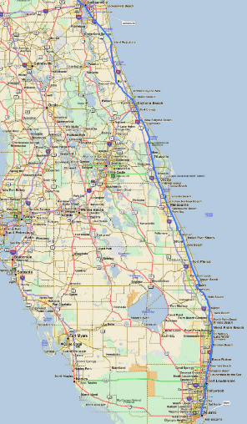
Florida Construction Complete
Construction of the Miami, FL to Jacksonville, FL Route
Allied Fiber has mobilized crews of > 75 Florida-based personnel along the 380 mile route of its MIA-JAX segment
  Fiber jetting completed from MIA-JAX
  6 of 6 colocation facilities already installed
Hundreds will be employed by the entities using this fiber
  Multiple Florida towns, counties and schools already planning to utilize the Allied Fiber system
Allied Fiber’s ≈ $18 million next-generation fiber build in Florida
  Facilitates the extension of fiber to hundreds of wireless towers
  Will provide 6 new network-neutral colocation facilities along eastern Florida which will facilitate the open interconnection between ALL Florida networks within those facilities
Construction has been completed between Jacksonville and Miami
18

Slide 19
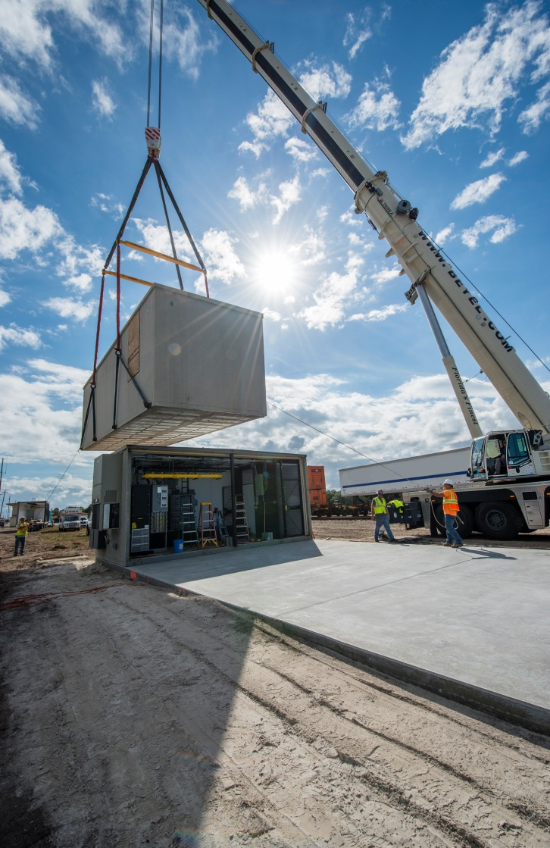
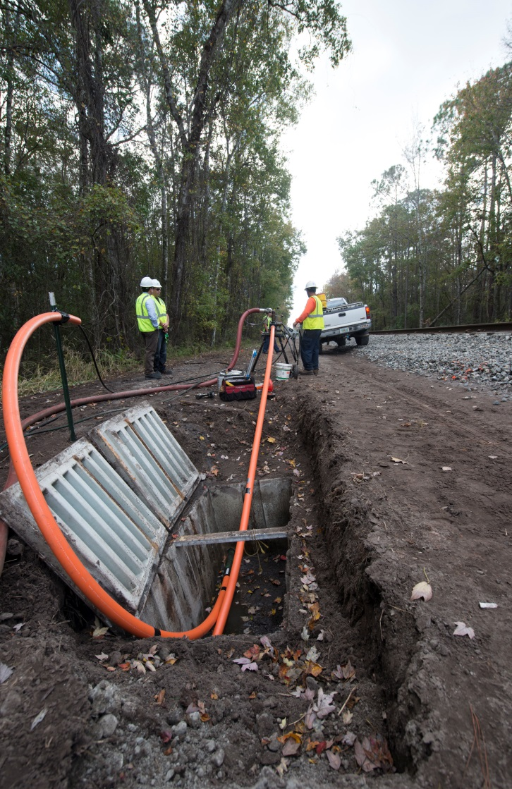
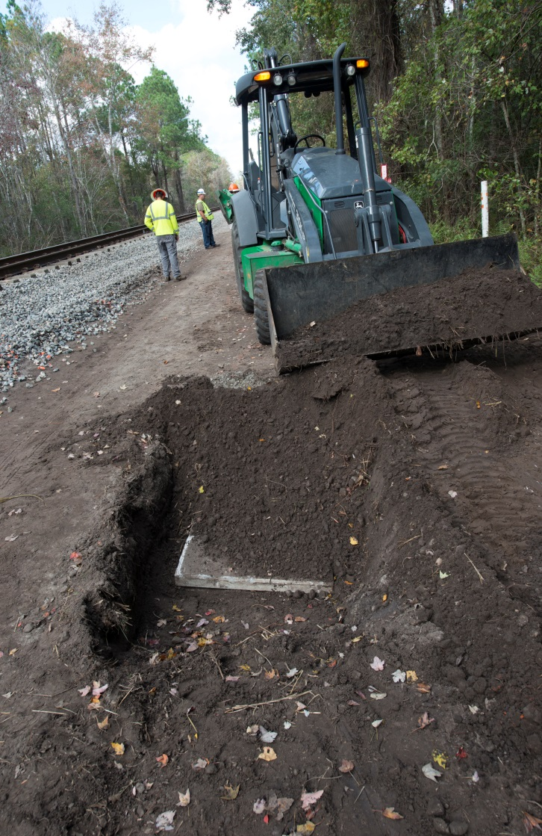
Construction of the Miami, FL to Jacksonville, FL Route
19

Slide 20
Florida Construction Timeline
2/13:
Flagler/FECR agreement executed and funded
5/13: Corning 528 count cable production started
6/13: Site survey work, drawings, civil/structural/MEP and other engineering work started
7/8/13: Fiber jetting & testing started;
7/11/13: State permitting started;
7/22/13: Local permitting started
2/3/14: New Smyrna Beach colo facility delivered and installed
4/14: Full MIA – JAX route completed and live
Feb
2013
April
2013
May
2013
June
2013
July
2013
Nov
2013
Dec
2013
Jan.
2007
Feb
2014
March
2014
April
2014
4/13: Cable mfg. contract awarded to Corning Fiber Works
5/13: Site work, vendor & equipment procurement; first reels of fiber ordered
6/13: First reels of fiber delivered; Geotechnical sampling completed
11/13/13: Launch date for West Palm Beach colo facility
12/5/13: Ft. Pierce colo facility delivered and installed
3/14: Rockledge, ST. Augustine and Jacksonville colo facilities delivered and installed
20

Slide 21
What is Next for Allied Fiber?
21

Slide 22
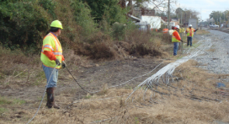
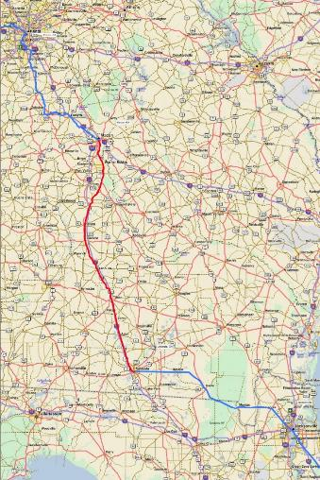
More than 40% of the Georgia Segment is Already Built and Carrying Traffic
Construction of the Jacksonville, FL to Atlanta, GA Route
Leveraged existing relationship with Norfolk Southern Railway to build along railroad rights of way
Starting in Jacksonville, FL, Allied Fiber will continue construction north to Valdosta, GA where it will pick up a 150 mile co-constructed segment that has already been completed. Construction will then continue from Macon, GA to Atlanta, GA
150 mile segment is operational and carrying live traffic
  Multiple Georgia, national and international entities already planning to utilize the Allied Fiber system
  Allied Fiber’s Macon, GA – Valdosta, GA route is already facilitating the connection of 250+ wireless towers
  Allied Fiber’s next-generation fiber build in Georgia will…
  Facilitate the extension of fiber to hundreds of additional wireless towers and rural municipalities
  Provide 5 new network-neutral colocation facilities along central Georgia which will allow the open interconnection between ALL Georgia networks within those facilities
  Provide undersea cable operators and their customers with direct access to critical interconnection points in Atlanta, GA
22

Slide 23
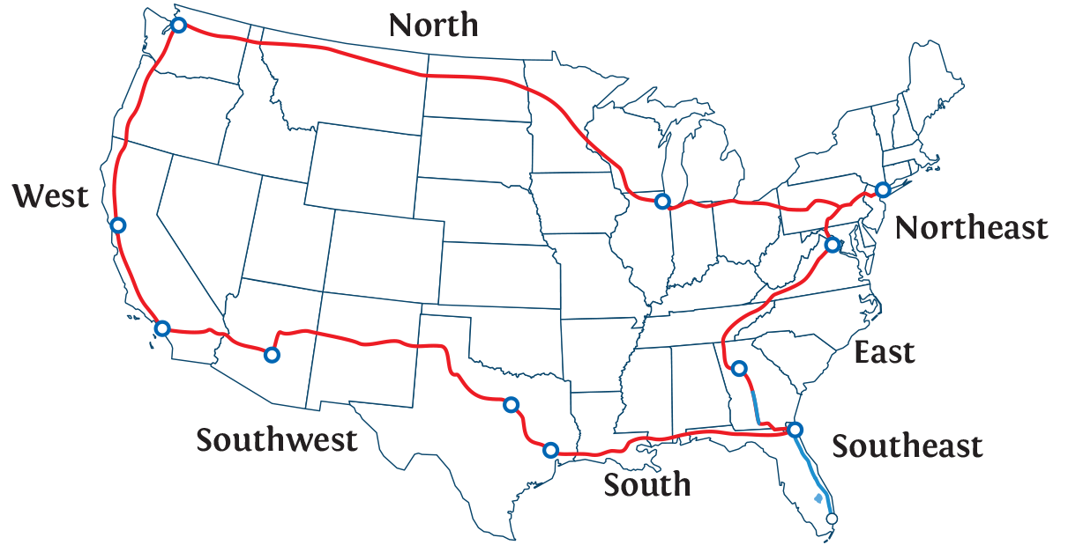
Long-term Plan to Broaden our Footprint Across the U.S.
2015
2016
2018
Northeast Route:
New York, NY →
Ashburn, VA →
Chicago, IL
East Route:
Atlanta, GA →
Chattanooga, TN
East Route:
Chattanooga, TN →
Ashburn, VA
North Route:
Chicago, IL →
Seattle, WA
West Route:
Seattle, WA →
Los Angeles, CA
Southwest Route:
Los Angeles, CA →
Dallas, TX
South Route:
Dallas, TX →
Jacksonville, FL
Note: Allied Fiber may build certain routes before or concurrent with others based on customer and/or market demand.
23

Slide 24
Allied Fiber
Thank You!
Questions?
24

