Slide 1
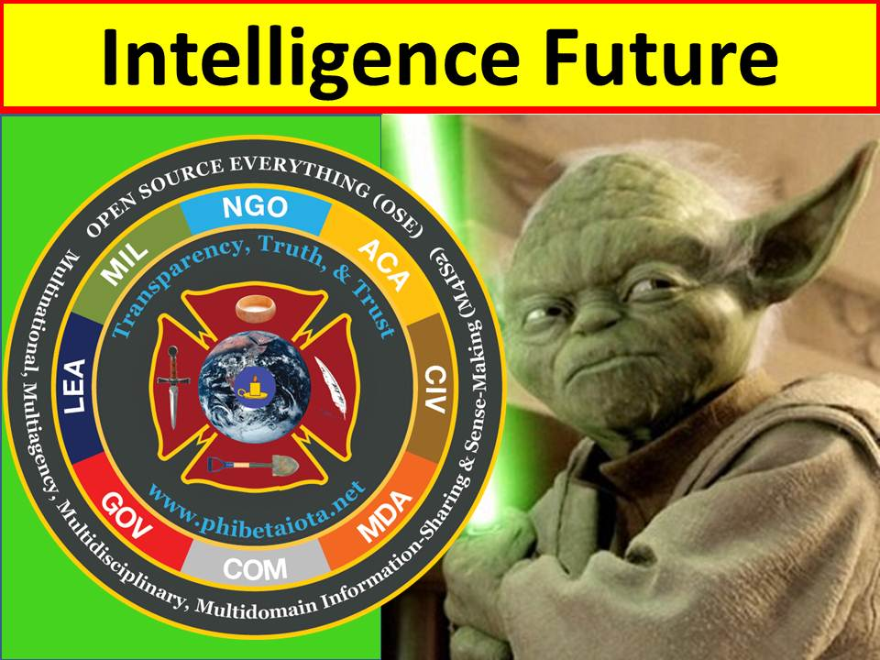
Open Source Intellignce (OSINT)
http://tinyurl.com/2016-OSINT
Notes:
I have prepared 40 slides to deliver in 40 minutes, leaving 20 minutes for questions now, and then we can discuss details in the working groups and if desired later via email or skype. You will not have time to read every word – I am delivering impressions from 25 years of work as the primary pioneer in this field, you can study the briefing in detail later, my planned words are in Notes format at the tiny url shown here – 2016-OSINT.

Slide 2
Plan for the Brief
WHY
  Secrets cover 4% “at best” of what we need
  Most threats are not military in nature
  All policies demand open discussion for effect
HOW
  OSINT is HUMINT not TECHINT
  Craft of Intelligence – process – is IMPORTANT
  80% of OSINT demands out-sourcing to individual humans and money with which to pay them
Notes:
This is the plan for the brief. I will be showing some complex graphics you can return to later on your own. For today the key points are these.
PAUSE

Slide 3
POLICY INTELLIGENCE
Includes Financial, Religious, Ideological Treason
Law Enforcement Intelligence
Military Intelligence
Spies & Lies
Commercial Information & Intelligence, Espionage
Mass Media (Corporate), Political Media, Bloggers
Civil Society – Clubs, Labor, Non-Government, Religion
Education – Citizen Intelligence Minutemen
Notes:
Alvin Toffler helped me create this slide. We were returning from a lunch with US defense intelligence leaders when he turned to me and said “they don’t want to leave their little green box.” I instantly visualized this.
Two points: OSINT is about harvesting ALL of this information outside the green box. And second, at the policy level, it is vital that we understand competing interests.

Slide 4
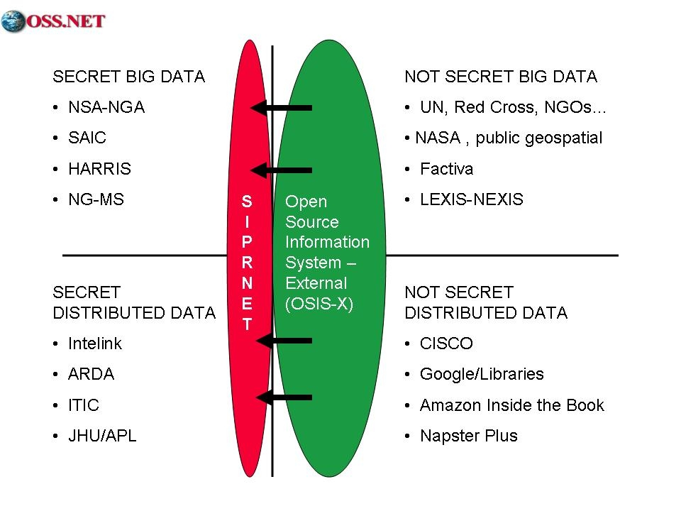
Notes:
My first book was entitled ON INTELLIGENCE: Spies and Secrecy in an Open World. My core concern today is that the US has corrupted NATO intelligence by over-emphasizing secret technical collection that is not processed, and neglecting everything else. There are major centralized and distributed repositories of OSINT that we should not ignore.

Slide 5
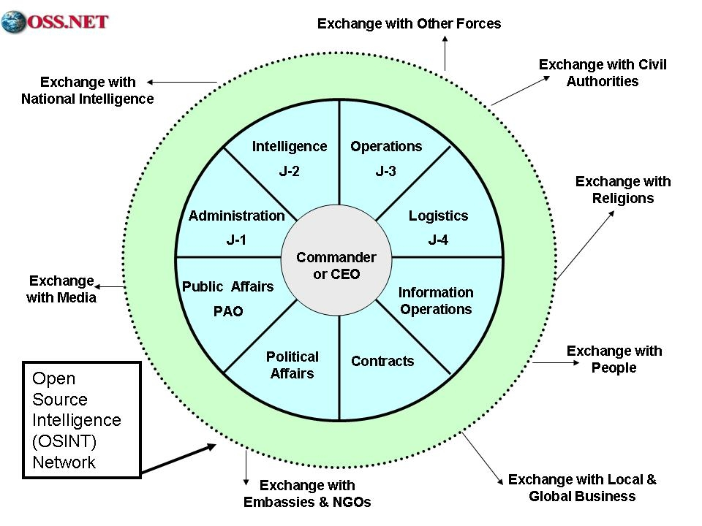
Notes:
LtCol Gary Beaver, USA gave me this concept, this is how he used OSINT in Bosnia, as a buffer zone to enable information sharing operations with external elements.
PAUSE

Slide 6
Intelligence Challenge What Do We Need to Know?
1st Generation (Attrition) EASY: Where’s the Army?
2nd Generation (Maneuver) EASY: Where are the trenches?
3rd Generation (Soft Power) MODERATE: How many with what?
4th Generation (Non-State) HARD: Watch every non-state actor
5th Generation (Cyber) HARD: Watch everything on the fly
6th Generation (Bio/IO) HARD: Make sense of billions of bits
7th Generation (Total War) VERY HARD: 24/7 33+ languages and get your own house in order. As quickly as possible, 183 languages going back 200 years.
Notes:
As war has grown more complex, intelligence has failed to adapt.
I’ll give you a moment to look at this graphic.
The harsh reality is that OSINT is the only source able to answer 80% or more of our commanders needs as well as acquisition, policy, and strategy needs.

Slide 7
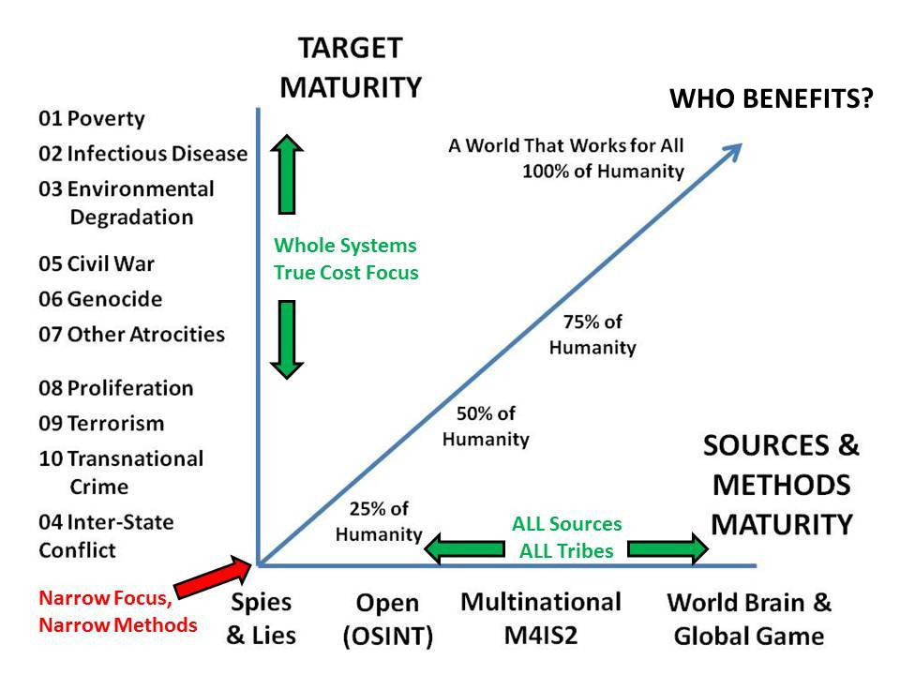
Notes:
This is my latest depiction of where we are in relation to where we need to be.
We are not serious about understanding and defeating all ten high level threats to humanity, and we are not serious about creating deep OSINT, multinational multilingual information sharing and sense-making, or my ultimate desire, the world brain and global game – that connects all minds to all information all the time.

Slide 8
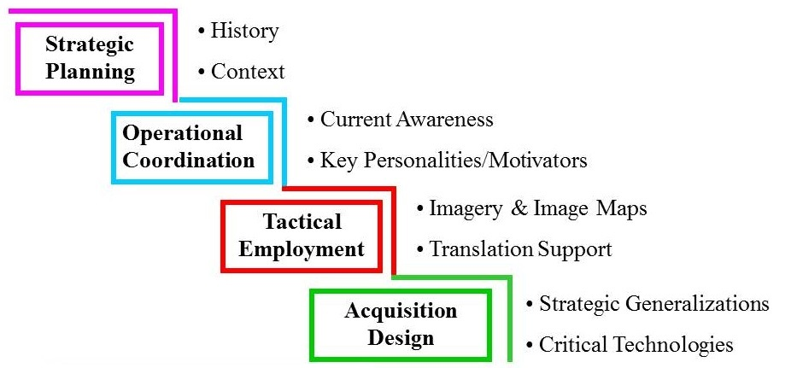
Notes:
In 1997 I was honored by General Peter Schoomaker, then Commander in Chief of the US Special Operations Command, and later Army Chief of Staff. This is the slide that led him to order the creation of the J-23 unit. At its height with 22 employees and $5 million a year in discretionary funding, it was answering 40% of all Special Operations intelligence requirements for the entire world, against 60% at a cost of billions from the secret world. PAUSE

Slide 9
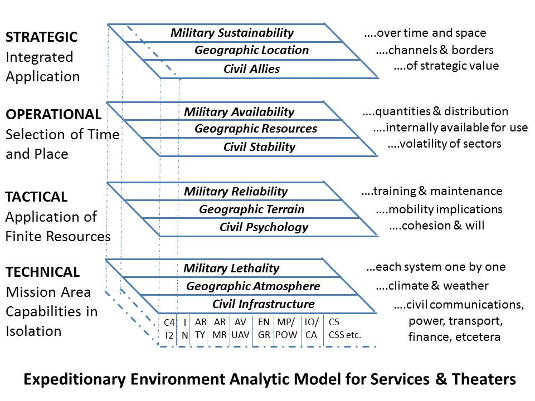
Notes:
In 1988 the Marine Corps pulled me out of the CIA and made me the senior civilian responsible for creating the Marine Corps Intelligence Center – our primary duty was acquisition intelligence. This is the model I created for studying the real world. The real world is hot and humid with bridge loading limits of 30 tons or less, limited line of sight distances, and poor cross-country mobility. I provide a link to the study on the last graphic.

Slide 10
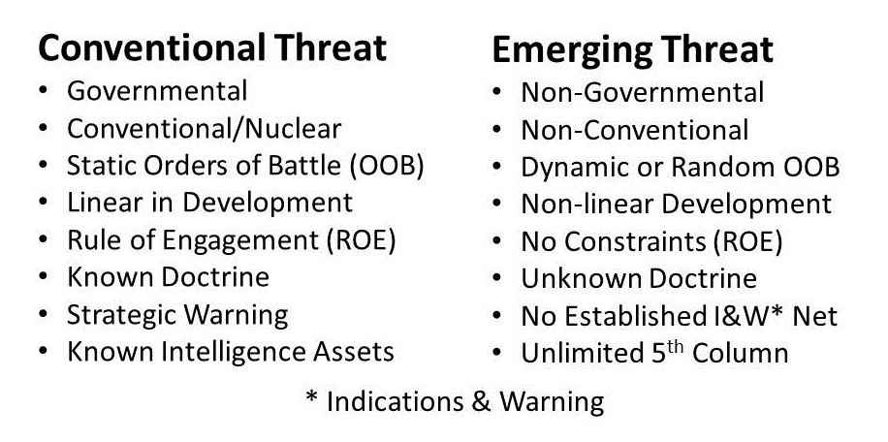
OOB: Order of Battle --- ROE: Rules of Engagement
1989 General Al Gray on Global Intelligence Challenges (American Intelligence Journal)
2014 On Defense Intelligence: Seven Strikes (CounterPunch)
Notes:
In 1989, based on my experience with the new model, I ghost wrote for the Commandant an article sounding the alarm on emerging threats and calling for third world appraisals needed to justify peaceful preventive measures such as would have prevented ISIS and the illegal immigrants. We were ignored. The American “way of war” is expensive, technical, and counter-productive. It has corrupted NATO.

Slide 11
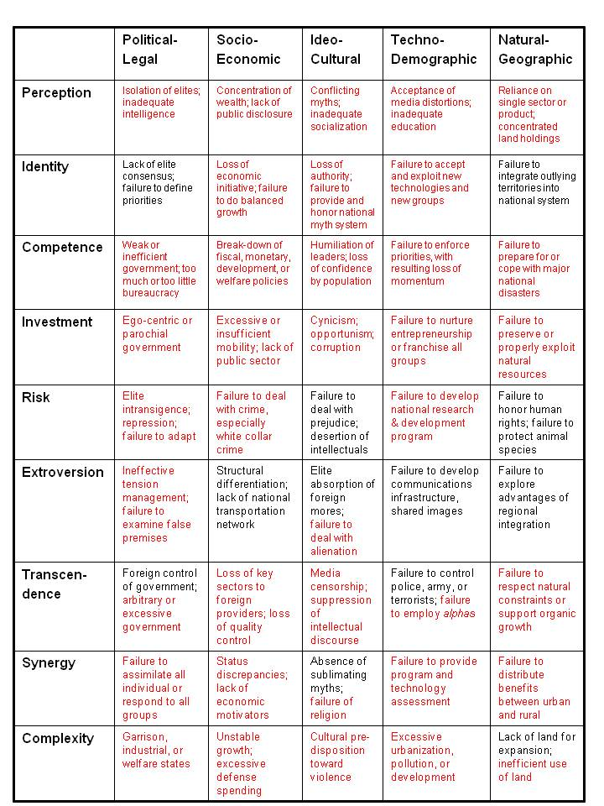
http://tinyurl.com/Steele-Revolution
Notes:
This is the heart of my 1976 graduate thesis that created a model for studying the preconditions of revolution. The conditions shown here in red exist in the USA today. I will not discuss this in detail, you can read the paper and study the graphic in at the tiny URL shown here.
The core point is that secret intelligence is useless and OSINT is priceless, in this context.

Slide 12
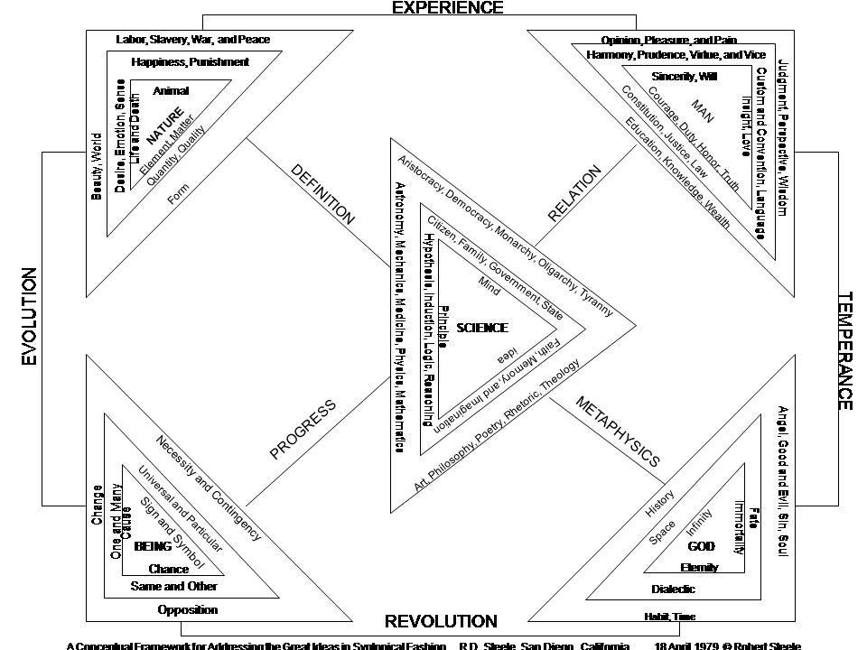
Notes:
The Great Books of the Western World as published by the University of Chicago and Encyclopedia Britannica have a stunning two-volume Syntopicon with reference sections for each of 144 key cultural concepts. As a young lieutenant bored with garrison duty I created this chart one day, to show all 144 concepts in relation to one another. We cannot understand other cultures without understanding how they see each of these concepts.

Slide 13
STATE IS PRIMARY ACTOR
Defense Against Weapons Systems “Over There”
Offense Against Fixed Ground
OLD
State as Threat and Target
Individual as Threat and Target
NEW
Offense Against Distributed Groups
Defense of Infrastructure Here at Home
PRIVATE SECTOR IS PRIMARY ACTOR
Notes:
Another area where OSINT is fundamental is in relation to the new reality that war is less about state on state military power and more and more about distributed individuals each capable of shutting down entire power and communications and water networks.
Ultimately OSINT is about turning every citizen into an intelligence minuteman, and being on guard, openly, all the time.

Slide 14

Four Major Belligerent Groups in Earth Context
Banks & “The Complex”
Old Gold Families
Central Families
IMF, WTO, WB
Military-Industrial Complex
Corrupt Global Elites
Nation-States
900 lb gorilla (USA)
Nordics & BENELUX
European Union
BRICS + Indonesia
Failed States
Hybrid Networks
Halawa System
System D
Local Currencies
Cyber-Currencies
Open Money
Tribes & Gangs
Old Lands, Old Ways
Ethnic, Blood, Marriage Ties
Religious Orders & Rules
Hidden Powers
Information Crime Alliances
Notes:
This depiction of the four major belligerent groups further emphasizes the vital nature of OSINT for state security.
We have failed to be serious about creating orders of battle for non-state actors. We have failed to be serious about counterintelligence against non-state threats to the state and the society.

Slide 15
Public
Health
DATA
Corruption
ECONOMIC
Truth – Corruption, Unemployment
MILITARY ACHILLES’ HEELS
Off-Base Power, Water, Antennas, Down-Links
ELECTRONIC INFRASTRUCTURE
Power, Financial, Communications, Transportation
PHYSICAL INFRASTRUCTURE
Tunnels, Pipelines, Bridges, Dams, Towers
Notes:
Homeland defense is vastly more important today. I was the author of the letter to the White House in 1994 sounding the alarm on cyber-vulnerability, with three co-signers including the top NSA security engineer and Winn Schwartau. We were ignored. For the past 25 years we should have been fortifying all cyber-systems – instead we allowed NSA and US IT CEOs to handicap and sabotage cyber-security for their convenience.

Slide 16
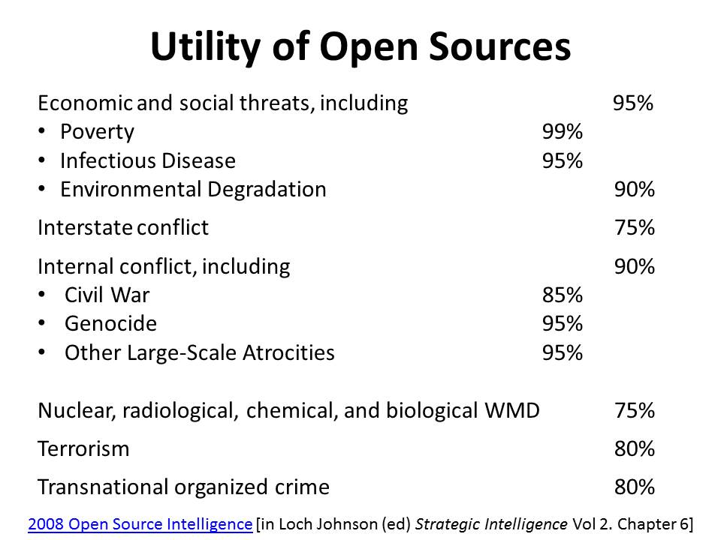
Notes:
Here I offer my estimate of the utility of OSINT against each of the ten high level threats to humanity as identified by LtGen Brent Scowcroft, USAF (Ret) and other members of the UN High-Level Panel on Threats, Challenges, and Change, as it reported out in 2004 in a book entitled A More Secure World: Our Shared Responsibility. It is not possible to be a Smart Nation or a Safe Nation without a major investment in OSINT.

Slide 17
Definitions
OSD - Open Source Data
OSIF - Open Source Information
OSINT - Open Source Intelligence
V-OSINT Validated Open Source Intelligence
Notes:
Most OSINT is not OSINT. To qualify as intelligence or decision support it must answer a question from a specific person.
I learned that to make peace with the CIA we had to distinguish between OSINT that any commercial provider can create, and Validated OSINT that only an all-source government analyst can bless, saying we concur, or at least, we do not have a basis for disagreeing.

Slide 18
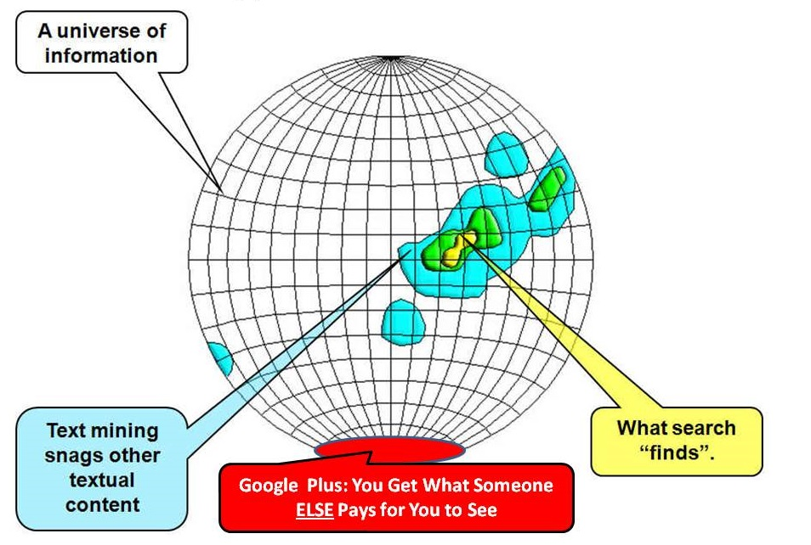
NATO-American Approach to OSINT
Notes:
I modified this graphic from Stephen E. Arnold. The fact is that the NATO-US approach to OSINT merely skims the surface, like the drunk looking for his keys under the light. Google indexes less than 4% of the web and nobody is indexing the analog information or the unpublished information.
Worse, Google manipulates search results depending on who pays to be seen.

Slide 19
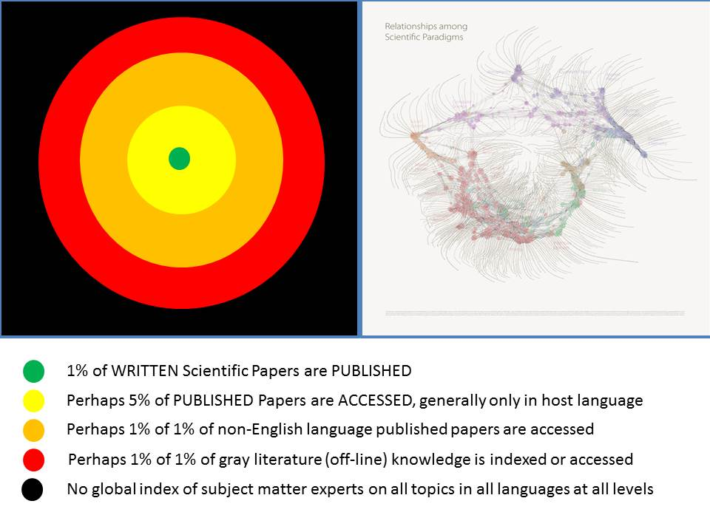
Notional NATO/Nordic Access
Notes:
Here is a deeper look at this challenge. Only 1% of WRITTEN scientific papers are PUBLISHED. It only gets worse when you consider foreign languages and whether researchers will perform due diligence.
On the left is the fragmentation of the scientific community, an archipelago of isolated fiefdoms where a PhD can be earned knowing everything about nothing and nothing about everything.

Slide 20
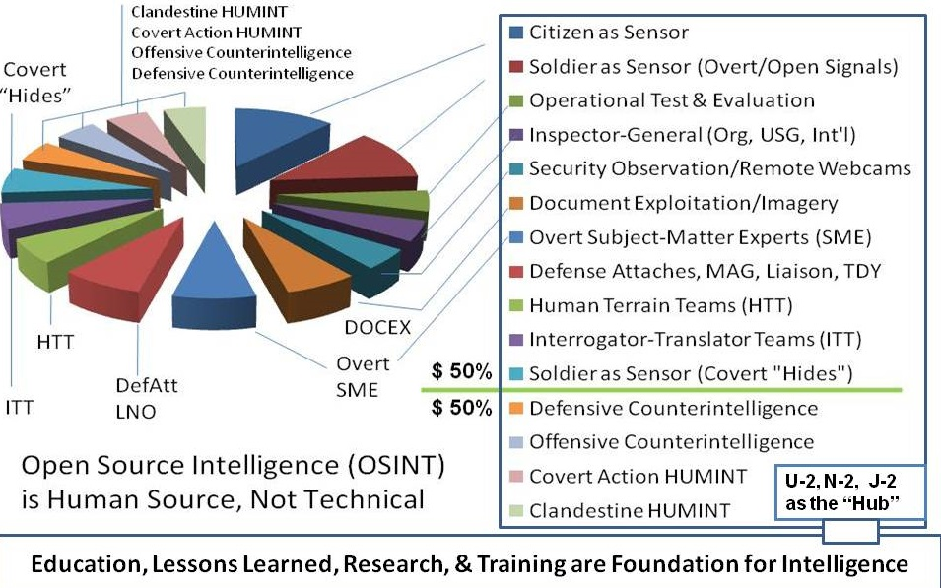
NOT
SECRET
SECRET
Notes:
I was interviewed to be the senior defense leader for HUMINT, and this was my vision. I was not selected – they wanted someone who would focus only on stealing secrets. The fact is that HUMINT consists of at least fifteen slices, only four of which are secret. It is irresponsible to not manage all HUMINT together, and I would emphasize that OSINT is HUMINT, not TECHINT. My monograph is free online at http://tinyurl.com/Steele-HUMINT.

Slide 21
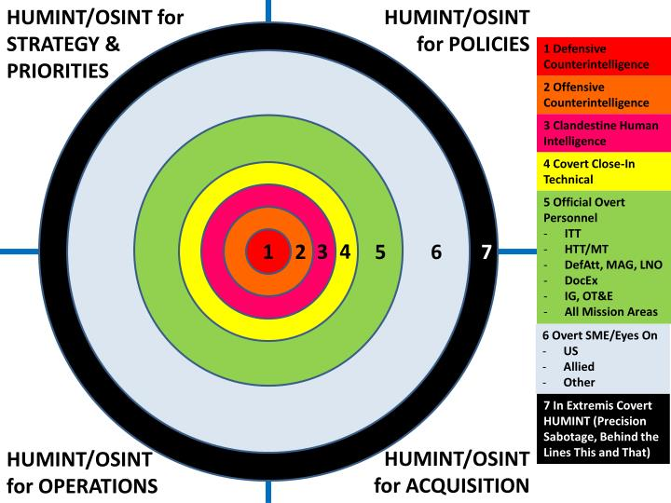
Open Source
Notes:
Here is another way of looking at the centrality of OSINT in relation to both secret intelligence and counterintelligence, and the ultimate combat mission of sabotage behind enemy lines. PAUSE Please note that OSINT (and all-source intelligence) should be organized to support strategy, policy, acquisition, and operations. I don’t know of anyone doing this correctly.

Slide 22
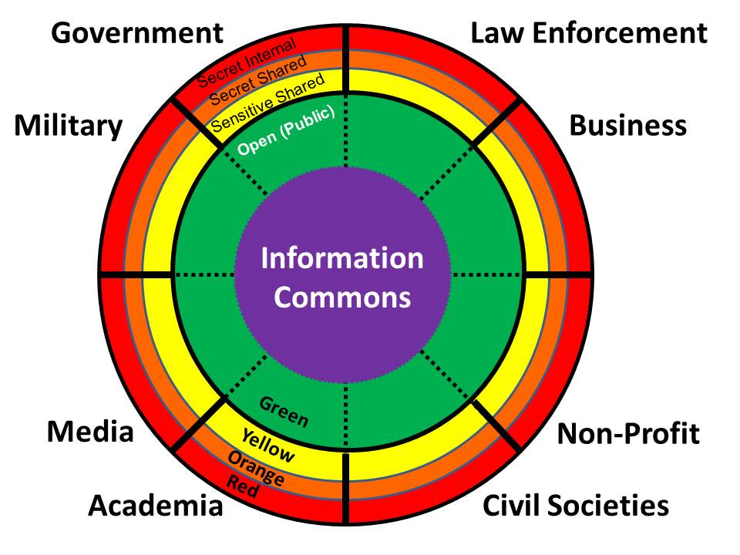
Notes:
You will recall the isolated boxes from the beginning of my remarks. Here I show the eight tribes of information, emphasizing that government is the smallest and least informed tribe. We cannot do OSINT without harnessing what these other tribes can access – and most of them do not like us, do not trust us, and do not want to share.
BRIEFLY DESCRIBE EACH TRIBE

Slide 23
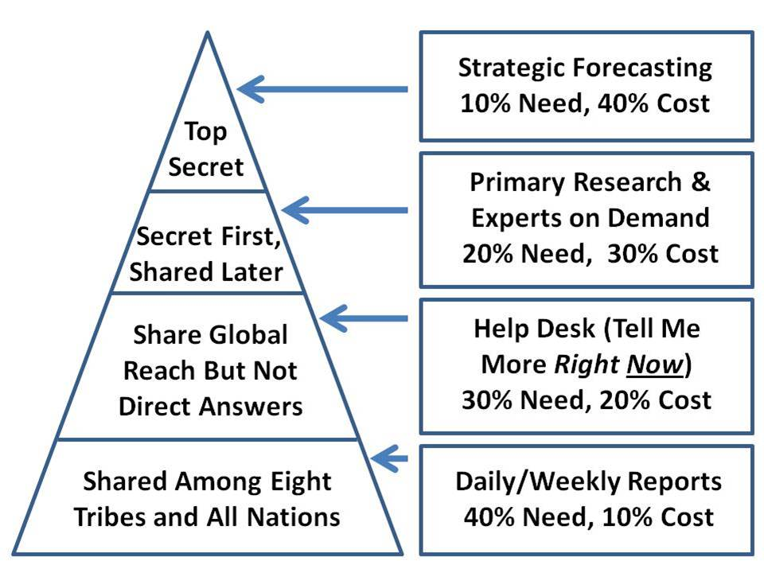
Notes:
This graphic was created by Jan Herring, the first National Intelligence Officer for Science & Technology in the US, in the 1970’s. We still do not do this.
Note that OSINT can become secret.
Note the ratios of need versus cost.
We can discuss this further in our follow-on discussion.

Slide 24
Standard OSINT Cell
Centralized discovery, decentralized exploitation
Senior All-Source
Collection Manager
Internet
Out-Sourcing Specialist
Commercial Online
Out-Sourcing Specialist
Primary Research / Cover Support Plan Specialist
Financial Officer
External Contracting
All-Source Analyst &
Presentation Manager
Outside the Wire – No Internal Constraints – Serious Money (in the Millions)
Notes:
Six people can harvest the external world of knowledge if they know what they are doing and have the money with which to leverage intermediaries as well as reward individual human elements as needed.
The collection manager needs to have the confidence of the secret world and to hear their requirements in classified terms.
DISCUSS EACH OF THE OTHERS

Slide 25
Decision-Maker
Integration, Reflection, & Decision
Information Management Staff
Collection Management, Fusion, Analysis & Presentation
EXISTING INPUT
Normal Staff Process, Counterparts, Family & Friends
OPEN SOURCE INPUTS
Internet & Private Sector Fee-For-Service
RANDOM
SECRET
INFORMATION UNIVERSE
Relevant and Irrelevant – Open and Secret
Notes:
This is a quick look at where OSINT fits in relation to secret and existing staff feeds, we cannot under-estimate the impact on the decision-maker of random external influences, it is very important to have a solid grasp of what happens to your information after it is delivered, and to be constantly studying the decision-maker to see if they have been mis-guided by other sources of information including lies from allied services and leaders.

Slide 26
ALL-SOURCE ANALYSIS
ALL-SOURCE PROCESSING
HUMINT
SIGINT
IMINT
MASINT
95% of cost
20% of value
5% of cost
80% of value
OPEN SOURCE INTELLIGENCE
OPEN SOURCE INFORMATION
Notes:
This is the original graphic from the 1980’s where I tried to explain that OSIF and OSINT are the foundation for the all-source temple.
It makes no sense at all to send a spy where a school-boy can go. We must harness and harvest all of our human resources, and make the most of the least expensive, most open sources and methods.

Slide 27
Open Source Marketplace
SOURCES SOFTWARE SERVICES
Current Awareness Internet Tools Online Search & Retrieval (e.g. Individual Inc.) (e.g. NetOwl, Copernicus) (e.g. NERAC, Burwell Enterprises)
Current Contents Data Entry Tools Media Monitoring (e.g. ISI CC Online) (e.g. Vista, BBN, SRA) (e.g. FBIS via NTIS, BBC)
Directories of Experts Data Retrieval Tools Document Retrieval (e.g. Gale Research, TELTECH) (e.g. RetrievalWare, Calspan) (e.g. ISI Genuine Document)
Conference Proceedings Automated Abstracting Human Abstracting (e.g. British Library, CISTI) (e.g. NetOwl, DR-LINK) (e.g. NFAIS Members)
Commercial Online Sources Automated Translation Telephone Surveys (e.g. LN, DIALOG, STN, ORBIT) (e.g. SYSTRAN, SRA NTIS-JV) (e.g. Risa Sacks Associates)
Risk Assessment Reports Data Mining & Visualization Private Investigations (e.g. Forecast, Political Risk) (e.g. i2, MEMEX, Visible Decisions) (e.g. Cognos, Pinkertons, Parvus)
Maps & Charts Desktop Publishing & Market Research (e.g. East View Publications) Communications Tools (e.g. SIS, Fuld, Kirk Tyson)
Commercial Imagery Electronic Security Tools Strategic Forecasting (e.g. SPOT, Radarsat, Autometric) (e.g. SSI, PGP, IBM Cryptolopes) (e.g. Oxford Analytica)
Notes:
I wrote the NATO Open Source Intelligence Handbook in 2000. While good in its time the links are mostly broken and it should be re-done. In my final slide I provide links to the best resources from a few top OSINT practitioners.
What is critical about this graphic is not the detail but the organization. OSINT includes sources, softwares, and services. I give all of them a failing grade for one reason or another, we can discuss this later.

Slide 28
Languages | Machine | Dictionary | Human 1 | Human 2 | Human 3 | Countries
 | Translation | Online | Foreign | US-Based | Cleared
English, French, German, and Russian reporting is – as a general rule – incomplete or wrong.
Arabic, Aramaic, Berber, Catelan, Chinese, Danish, Dari, Dutch, English, Farsi, Finnish, French, German, Indonesian, Irish, Italian, Japanese, Korean, Kurdish, Kurmanji, Norwegian, Pashto, Polish, Portuguese, Russian, Serbian, Spanish, Swedish, Tamil, Turkish, Urdu
Afrikaans, Aimaq, Albanian (Greek), Amharic, Arabic (Andalusi), Arabic (Egyptian), Arabic (Gulf), Arabic (Hassaniiya), Arabic (Hijazi), Arabic (Iraqi), Arabic (Levantine), Arabic (Maghreb), Arabic (Maltese), Arabic (Najdi), Arabic (Standard), Arabic (Sudanese), Arabic (Yemeni), Armenian, Assamese, Atuence, Azerbaijani, Bai, Basque, Bassa, Bengali, Berber, Bulgarian, Burmese, Catalan, Cebuano, Central Khmer, Chechen, Chinese (Mandarin), Croatian, Czech, Danish, Dari, Dutch, Dzongkha, Edo, Efik, English, Estonian, Éwé, Farsi, Finnish, French, Fulfulde, Gaelic, Georgian, German, Greek, Gujarati, Gurung, Hausa, Hebrew, Hindi, Hungarian, Ikanuri, Ilongo, Indonesian, Italian, Japanese, Japanese, Kabiye, Kabuverdianu, Kannada, Kanuri, Kashmiri, Kazakh, Kirghiz, Khemer, Korean, Kurdi, Kurmangi, Lingala, Latin, Latvian, Lithuanian, Luba-Kasai, Malagasy, Malay, Malayalam, Maldivian, Mandinka, Maninka, Maori, Marathi, Munukutuba, Nepali, Norwegian, Nyanja, Oriya, Panjabi, Pashto, Polish, Portuguese, Pulaar, Romanian, Rundi, Russian, Rwanda, Sango, Sanscrit, Sardinian, Serbian, Sindhi, Sinhala, Slovak, Somali, Sotho, Spanish, Swahili, Swati, Swedish, Tagalog, Tajik, Tamil, Tatar, Telugu, Thai, Tibetian, Tigrigna, Tswana, Tumbuka, Turkish, Turkmen, Ukrainian, Urdu, Uzbek, Vietnamese, Xhosa, Yiddish, Yoruba, Zarma, Zulu (136)
Notes:
The major powers either don’t get it or lie a lot. You cannot achieve ground truth without a deep use of the local language.
There are at least 31 core languages and over 136 others than need attention.
Machine translation is not good enough for most languages. You need a mix of indigenous speakers who also speak a Western language, and a handful of trusted officers who have spent a lifetime learning the target language.

Slide 29
CUSTOMER
CONTINUOUS FEEDBACK LOOP
OSINT CENTER
Face to Face Top Expert
ONLINE
Internet Stream
Expert Forum
Q
Commercial
Online Feeds
A
Report
DIRECT ACCESS:
OPEN TOOLKIT WITH TAILORED SOURCE ACCESS
Commercial
Maps & Images
Links
Questions for Spies
Offline Stream
(“Gray Literature”)
OFFLINE
PRODUCTION TOOLKIT
PLUS EXPERT ANALYSTS
MEDIATED ACCESS:
EXPERTS WITH PROPRIETARY SOURCE METADATABASE
Human Experts
“On Demand”
PROCESSING TOOLKIT PLUS EXPERT ANALYSTS
HUMAN BEINGS IN THE FIELD
Circuit Riders
“Eyes & Hands On”
HUMAN BEINGS FACE TO FACE
INTEGRATED ONE-STOP SHOPPING PROCESS
Call Center -- Multi-Level Security -- Umbrella for Unified Billing
Notes:
This is the heart of an OSINT cell’s advanced operations if you have more than six people. Note that it includes ingestion and sense-making processes, and that there are at least three outputs: human; written, and classified requirements.
The Dutch service in theory is not allowed to use secret sources and methods unless the OSINT people certify they cannot find out using open sources and methods.

Slide 30
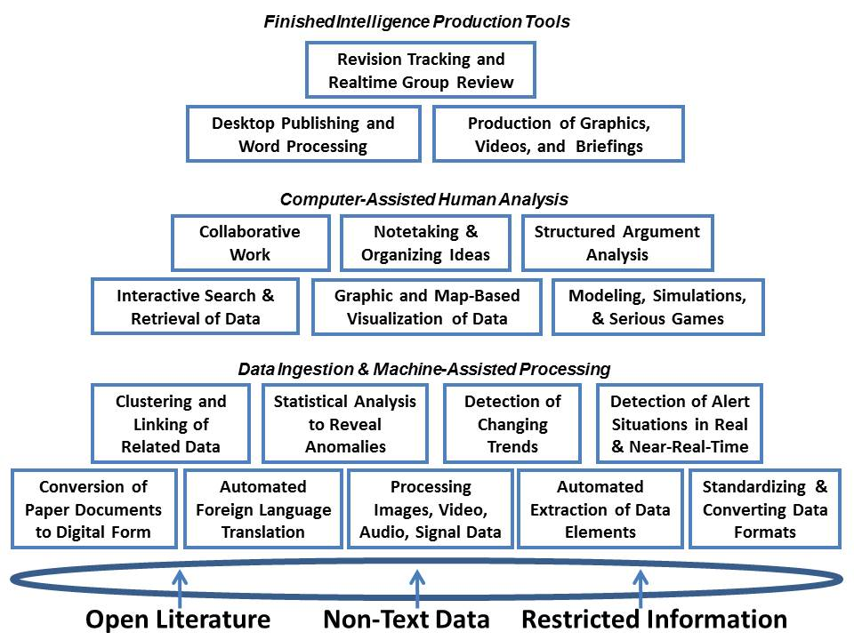
Notes:
I was a founding member of the Advanced Information Processing and Analysis Steering Group in the 1980’s and into the 1990’s and I am sorry to say that despite our knowing then that we need all of this in an integrated tool-kit able to ingest and make sense of massive amounts of unstructured multi-lingual multi-media data, it still does not exist today.

Slide 31
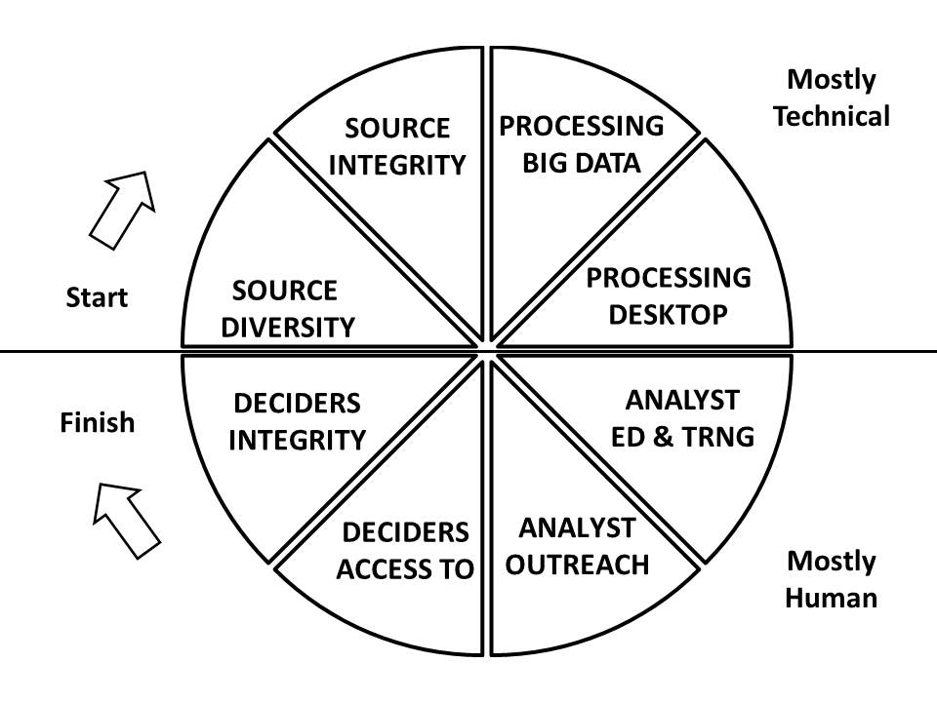
Notes:
These are the eight areas where I would like to help just one country – all eight tribes of information – get it right. All of these eight quadrants are no better than yellow and most are red in my view.

Slide 32
Generic OSINT Budget
My Personal View: 5% of the Total Intelligence Budget
HUMAN Training & conferences everywhere
HUMAN Internet monitoring services
HUMAN Information broker services
HUMAN Private investigative services
HUMAN Academic research services
HUMAN Commercial imagery procurement
HUMAN Russian & other tactical military map procurement (both digital and hard copy)
HUMAN Circuit Rider fund (travel & expenses)
Notes:
I cannot stress this enough. OSINT is HUMINT, not TECHINT, and OSINT requires adequate funding – on the order of 5% of the total intelligence budget – if it is to be fully effective.
PAUSE

Slide 33
Case Study: The Burundi Exercise
1 Man 6 Calls Beat Entire US Intelligence Community
Top Ten Academics (ISI)
Top Ten Journalists (Lexix-Nexis)
Tribal Orders of Battle (Jane’s)
Pol-Mil Overviews (Oxford Analytica)
Soviet 1:50,000 Combat Charts (Eastview)
100% Commercial Imagery (SPOT)
Knowing who knows is the acme of skill
Stefan Dedijer, Croatia-Sweden, 1992
Notes:
This was an overnight exercise for the Aspin-Brown Commission seeking to reform the intelligence community. The CIA had a map and an old economic study. This is what I produced with six phone calls. DESCRIBE EACH As a result, the Commission recommended that OSINT be a top priority for DCI attention and a top priority for funding. Later the 911 Commission recommended a separate Open Source Agency. Nothing happened.

Slide 34
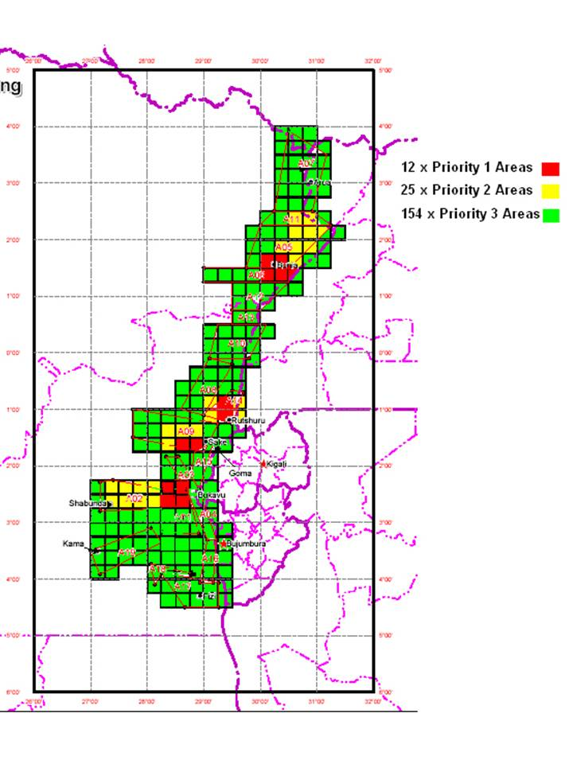
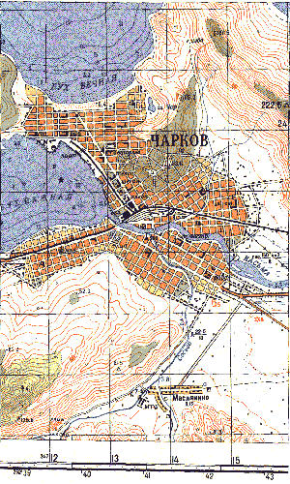
Case Studies: Maps
Burundi Emergency
Denied Area Border Crossing
Congo for United Nations new maps $3M
Somalia combining Russia 1:100K & Google Earth
Notes:
When I started the OSINT fight within the US Intelligence Community in 1988-1992, I noticed immediately that the civilians have no idea about the vital important of maps – and especially military charts with contour lines. Over the years this has been one of the most important accomplishments in OSINT, greatly aided by the release of all the Soviet maps of Africa and South America – but not China, that warehouse mysteriously burned down – and by commercial imagery.

Slide 35
Case Studies: Other
Citation Analytics – top experts on anything (published, names in news, then unpublished field experts & rising students identified by published experts)
Islamic finance – 20 families from Indonesia to India to Arabia, evaluated for donations to Bin Laden and others – mix of online, social engineering, and local tax and other records
True Cost of Goods – virtual water, fuel, toxins, child labor, regulatory violations and tax avoidance
Web sites – 396 terrorist, insurgent, & opposition websites in 29 languages – done in 60 days using European students
UK Convictions – global discovery of land, buildings, yachts, other assets – local real estate and tax records examined manually
Notes:
With citation analytics for about $1,500 I can identify to most cited published experts, and from there get to unpublished field experts. I can also hire their best graduate students for 20 cents on the dollar.
Finance and true costs require field work by humans, including examinations of hard copy tax and real estate and boat records.
The best web monitoring is done in the original languages – students fluent in the target languages are inexpensive.

Slide 36
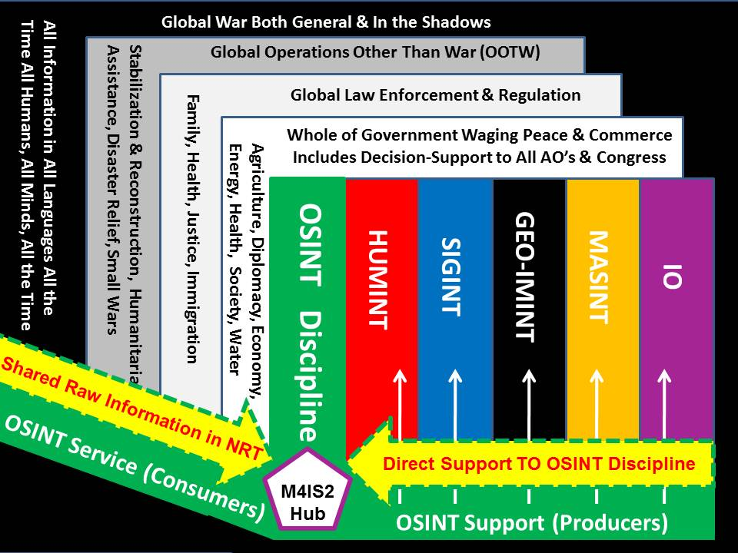
Notes:
This is what it looks like when it is working. No one has this. My own government refuses to be serious about OSINT or more recently, Open Source Everything Engineering, see http://tinyurl.com/Steele-Future for my full vision.
In my view the Nordics should offer to host a joint EU-NATO Multinational Decision Support Centre and network whose primary mission will be to produce the truth and confront lies being told by others.

Slide 37
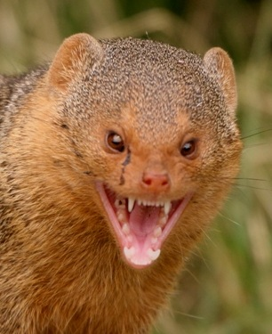
Counterintelligence & OSINT
Corruption
Democracy
Diplomacy
Education
Energy
Environment
Health
Ideology
Religion
Research
Water
Notes:
I cannot over-state the importance of counter-intelligence. In the past 25 years what I have come to appreciate apart from the urgency of getting OSINT right, is counterintelligence.
In the USA we have financial ideologicial, and religious traitors in key leadership positions, and the FBI is not allowed to do its job.
Rooting out traitors is fundamental.

Slide 38
Closing Thoughts
Ethics is an operating system.
Intelligence without integrity is not intelligence.
OSINT is a foundation for enhancing integrity in all-source intelligence – and command.
Notes:
My closing thoughts.
Ethics is an operating system. Will and Ariel Durant in Lessons of History speak to the role of morality in the game of nations. The US and Europe have failed to live up to their ideals – they actively support all but two of the dictators on the planet, and turn a blind eye to financial, religious, and ideological crimes against humanity.
We in the intelligence profession have the power to educate, inform, and elevate.

Slide 39
Further Reading
2016 Arno Reuser (NL) Open Source Intelligence Resource Discovery Toolkit
2016 The Future: Recent “Core” Work by Robert Steele
2015 Ben Benavides OSINT 2ool Kit On The Go Bag (Bag O’Tradecraft)
2014 Handbook Online for Internet Tools and Resources for Creating Open Source Intelligence (OSINT) by Dr. Ran Hock, Chief Training Officer, Online Strategies, Inc.
2013 OSINT Literature Review, Name Association, Lessons Learned
2010 Intelligence for Earth: Clarity, Diversity, Integrity, & Sustainability
2008 Open Source Intelligence (Operational)
2007 Open Source Intelligence (Strategic) 2.0
2004 Special Operations Forces OSINT Handbook (Strawman)
2000-2002 NATO OSINT Handbooks
2000 ONE WORLD, READY OR NOT: From National Capabilities to Global Coverage Through a Virtual Intelligence Community Coordinated by NATO/PfP
1998 OSINT Executive Overview (Australia, October 1998)
1990 Expeditionary Environment Analytic Model
Various other handbooks including United Nations handbooks are online at Phi Beta Iota. Handbooks (70) Analysis (14) C4/JOE/Software (4) HUMINT (12) Law Enforcement (14) Military (19) OSINT Generic (19) Stabilization (22) Threats/Topical (14) UN/NGO (22)
See Also: NATO OSINT to OSE/M4IS2 Round-Up 2.0
Notes:
Here are a few links, the larger website holds over 20,000 posts by over 800 contributors I have nurtured over the past 25 years and I am always available to support your learning as well as your work.

Slide 40
Open Source Intellignce (OSINT)
http://tinyurl.com/2016-OSINT
Notes:
If you did not note the tiny url before, here it is again.
It is an honor to be in your company.
Thank you.

